Slide 1
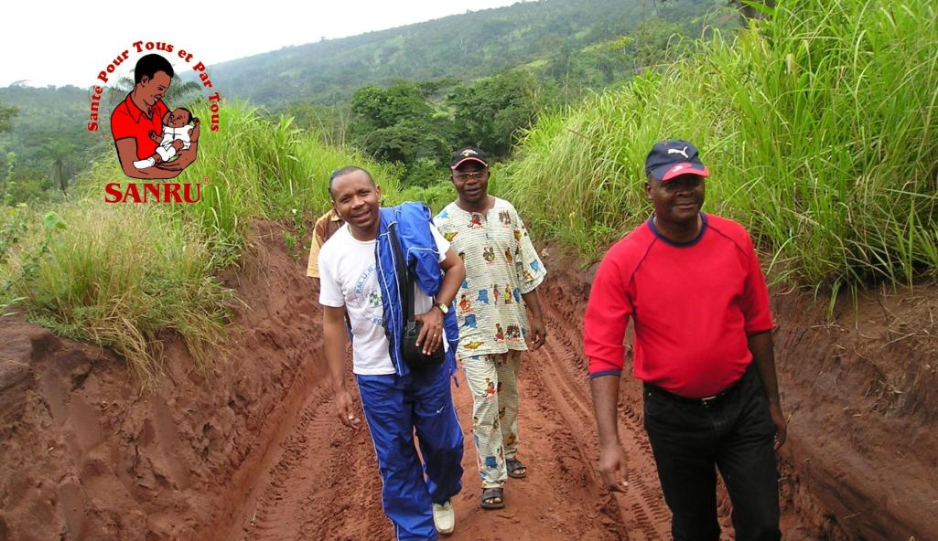
SANRU:
The Long Road to Health for All
and by All

Slide 2

The Five Decades of SANRU
Before 1981: Pre-SANRU
Frank Baer, Miatudila Malonga
1981-1991: SANRU I & II
Kalambay Kalula, Ray Martin
1991-2000: SANRU Interlude
Larry Sthreshley
2000-2010: SANRU’s Return
Paul Derstine, Leon Kintaudi
2011 + : SANRU NGO
Diakumbi Zabusu, Rick Santos

Slide 3
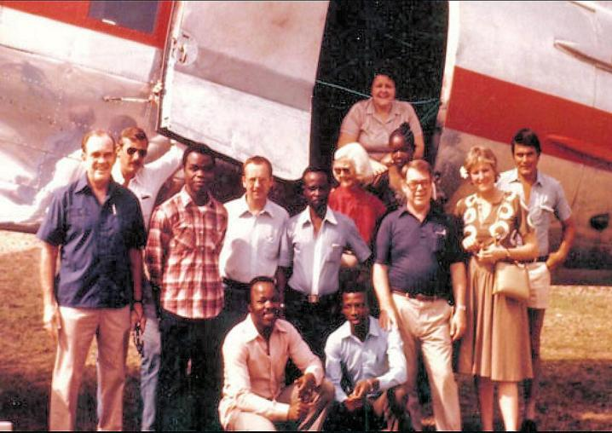
Before 1981: Pre-SANRU

Slide 4
Before there was SANRU…
By Franklin Baer
SANRU Vice-President
Independent Consultant, Baertracks

Slide 5
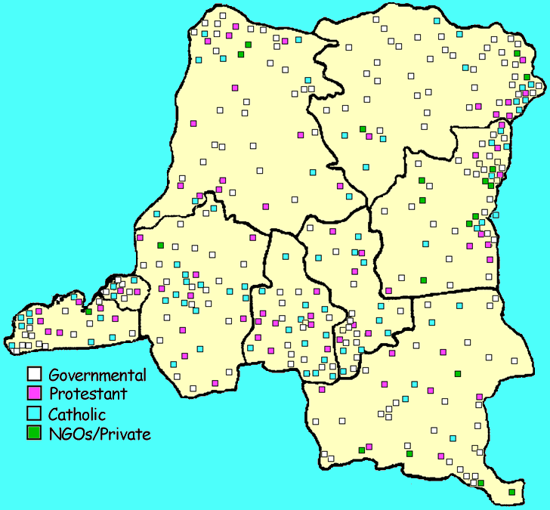
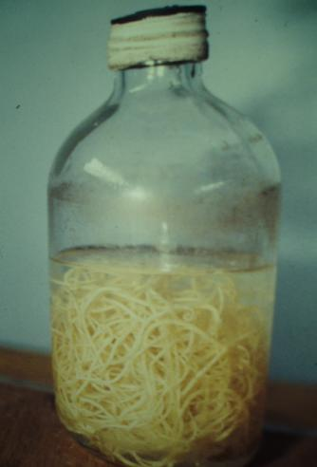
The Situation in the 1960s-1970s
By 1960 there was a complex network of more than 400 hospitals managed by the Gov’t, churches and NGOs
Some visionaries began looking and working beyond the walls of the hospital.

Slide 6
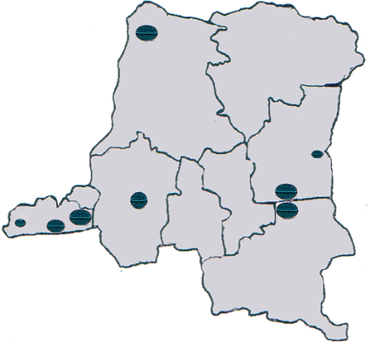
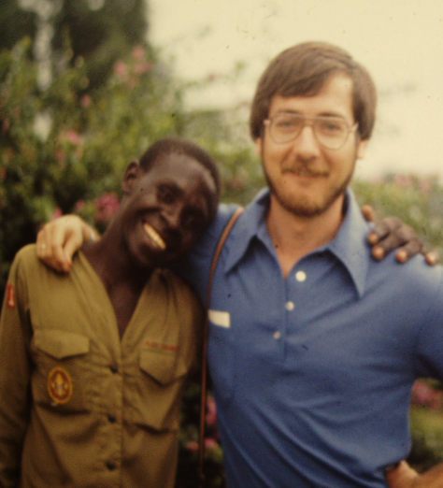
Kimwenza Conference (1975)
Primary Health Care
Decentralized Health Zones
Collaboration with churches in providing PHC & HZ mgmt
Kabamba (CEPLANUT)
Malengro (Katana)
Abell (Kimpese)
Ruppol (CTB)
Fountain (Vanga)
Mercenier (Kasongo, Anvers)
Close (Formetro)
1976
Ngwete (Prof, Minister of Health)

Slide 7
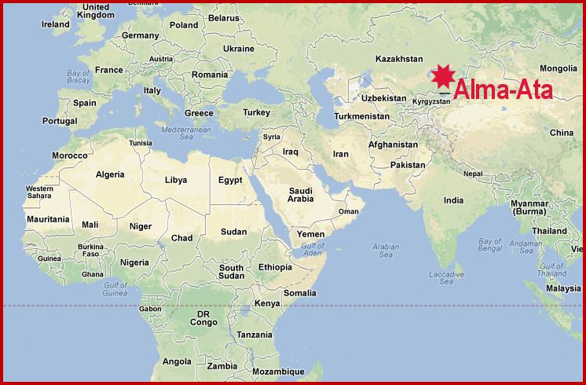
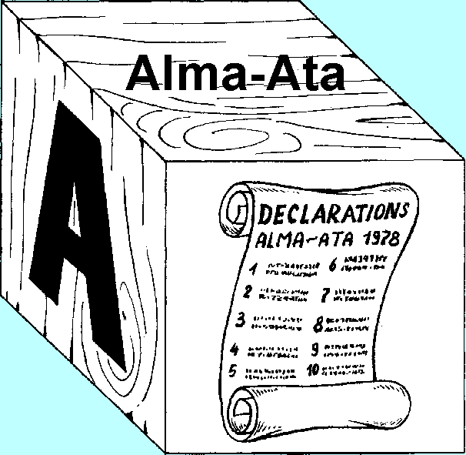
Alma Ata – 1978
Adoption of Ten Declarations to support PHC
Conference (1975)
Primary Health Care
Health Zones
Collab. with churches
Conference (1975)
Primary Health Care
Health Zones
Collab. with churches
Projects to implement the above??

Slide 8
The Origins of SANRU:
The Basic Rural Health Project
By Miatudila Malonga
President SANRU NGO
MOH Representative to SANRU I

Slide 9
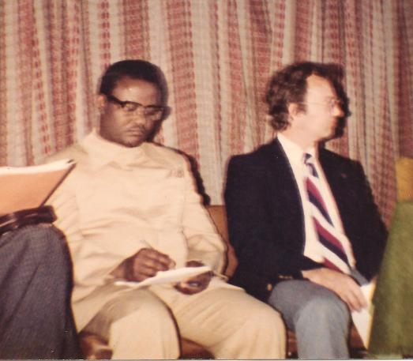
In 1980, Richard Thornton, a Health and Population at the Kinshasa Office of USAID, conceived the Basic Rural Health Project following:
  Requests for assistance from various American missionaries
  Review of the strategies adopted at the Zaire’s 1975 National Conference
  Recommendations of the 1978 International Conference at Alma Ata
Thornton proposed his idea to the Minister of Health who agreed to the proposal for the total conformity of the proposal with:
  the Zaire’s 1975 National Conference
  the Alma Ata Conference

Slide 10
The Minister of Health instructs Malonga Miatudila to join in the development of the Basic Rural Health proposal because:
  Malonga was among the very few Zairian Public Health Specialists trained under a USAID-financed program
  Malonga has participated in the fight against various outbreaks, including Ebola, 1976; Meningitis, 1978; and Cholera, 1978.
  Malonga was a “crazy-boy” for “Primitive Health Care” (PHC)
  Malonga was available

Slide 11
To maximize the chances of success, given formidable odds, the design of the Basic Rural Health Project carefully took into consideration various lessons learnt in the country, including:
  The comparative advantages of a Faith-Based Organizations in the provision of social services, particularly education and health,
  The lack of success of USAID’s Kongolo Pilot Health Zone Project
Kongolo

Slide 12
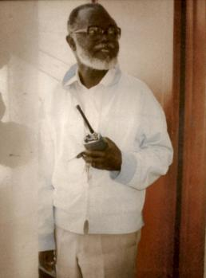
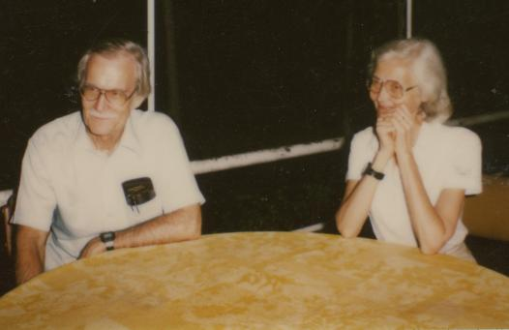
Based on the country’s history, the design of the Basic Rural Health Projects choose to use a Faith-Based Organization as the project implementing agency
For a long period, the Catholic Church resisted the idea of participating in the project
Eventually, the Federation of the country’s protestant churches – presently known as ECC or Eglise du Christ au Congo – was asked and agreed to act the implementing agency of the Basic Health Project
Bok
Mgr. Bokeleale
Nlaba Nsona
Ralph & Florence Galloway

Slide 13



1981-1991: SANRU I & II
The Basic Rural Health Projects

Slide 14
USAID Support for
SANRU I & II
(1981-1991)
By Ray Martin
Former USAID Health Officer/Kinshasa
Executive Director Emeritus of CCIH

Slide 15
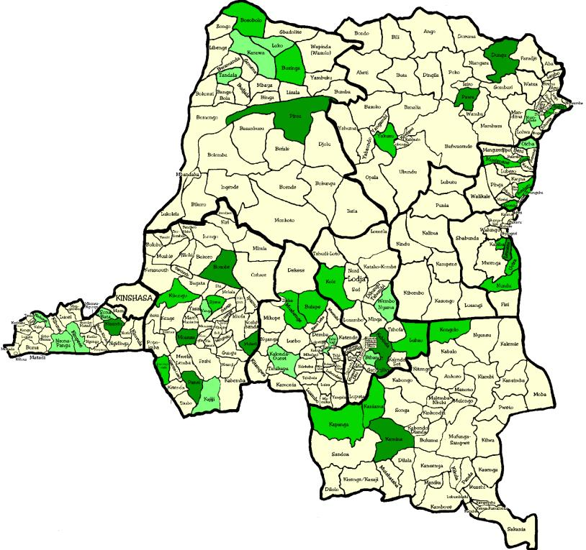
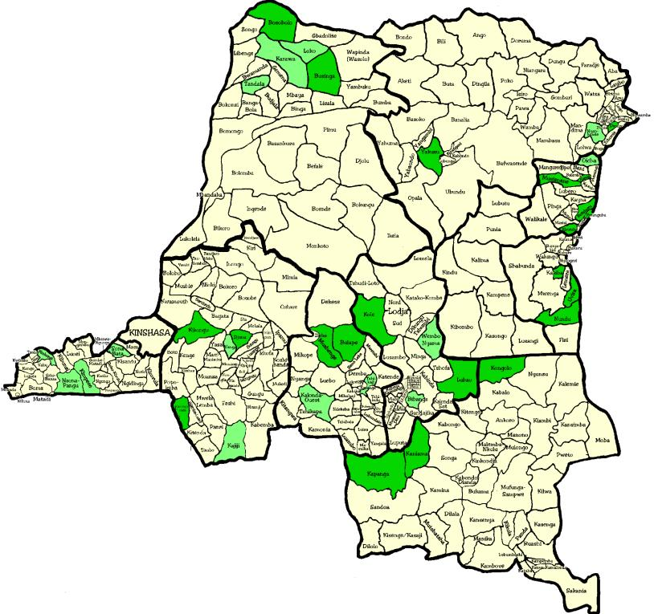
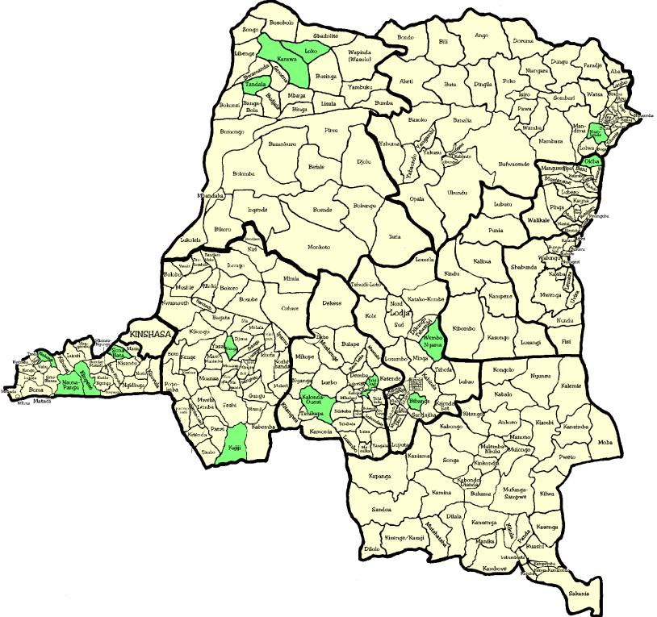
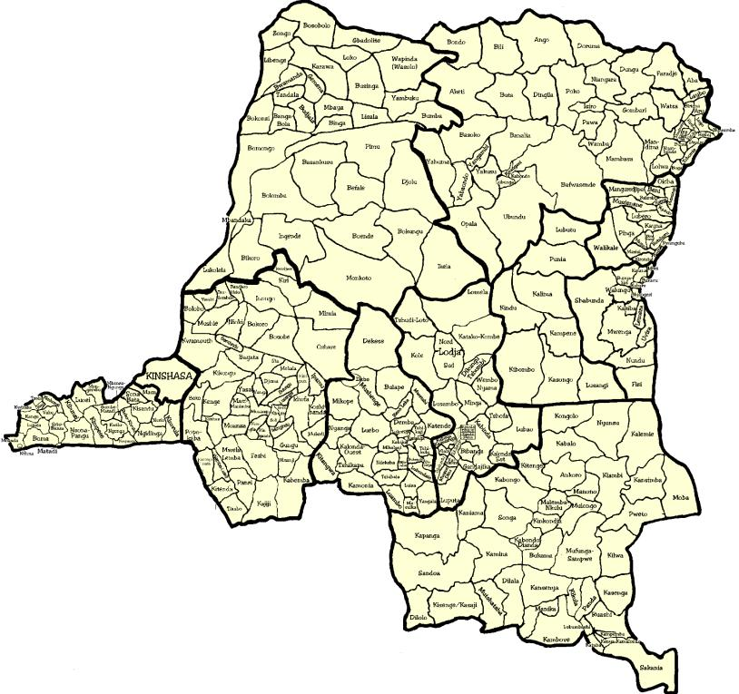

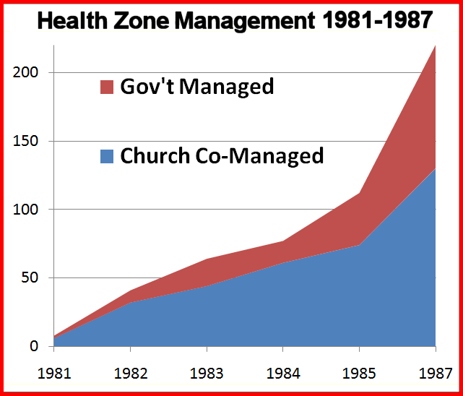

Year | Functional HZ | FBO/NGO Managed HZ
 | Nbr | Nbr | %
1981 | 8 | 6 | 75%
1982 | 41 | 32 | 78%
1983 | 64 | 44 | 69%
1984 | 87 | 61 | 70%
1985 | 112 | 74 | 66%
1987 | ~220 | ~130 | 39%
1990 | 179 | 117 | 65%
2000 | ~100 | ~60 | 60%
SANRU I
The creation of Congo’s health zones around functional hospitals was a bottom-up process that was pioneered by FBOs.

Slide 16
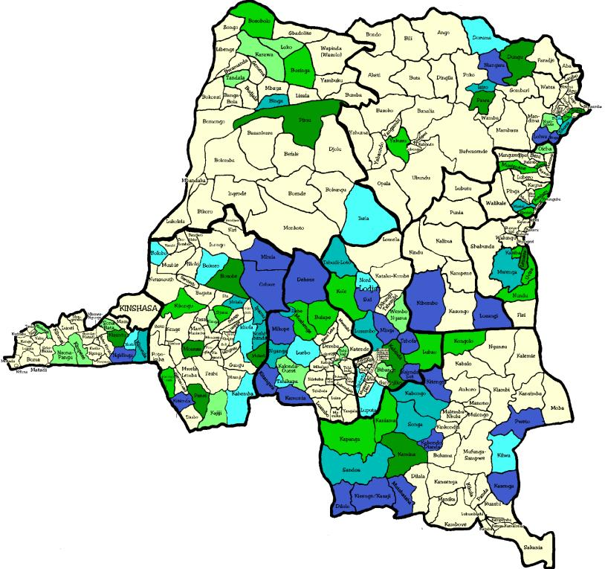
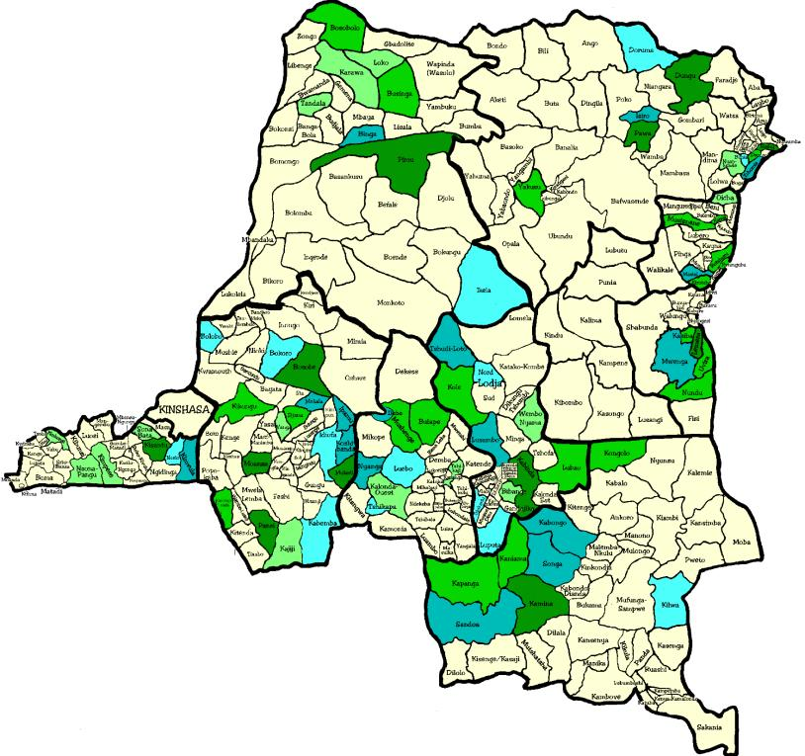
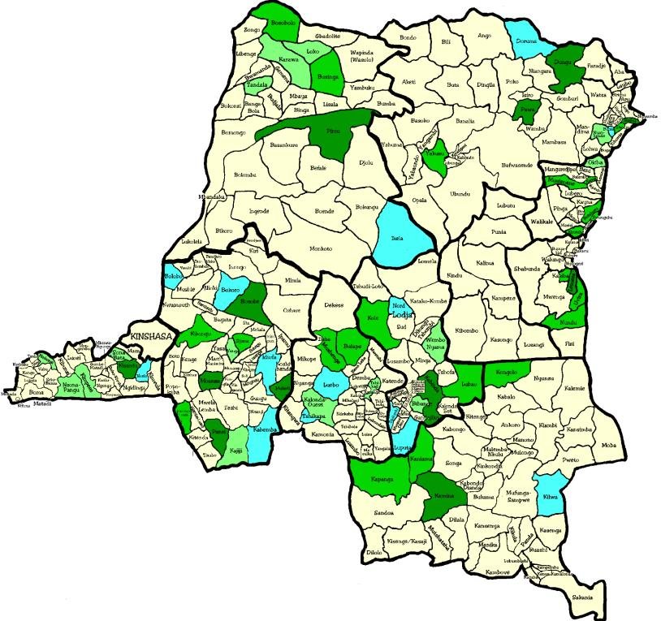
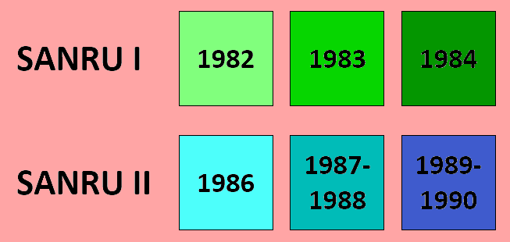
SANRU II

Slide 17
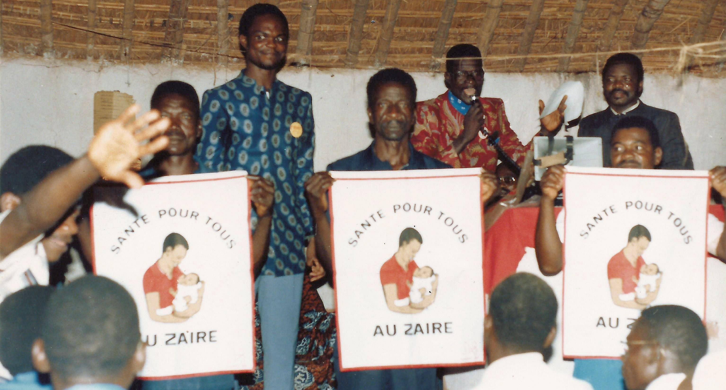
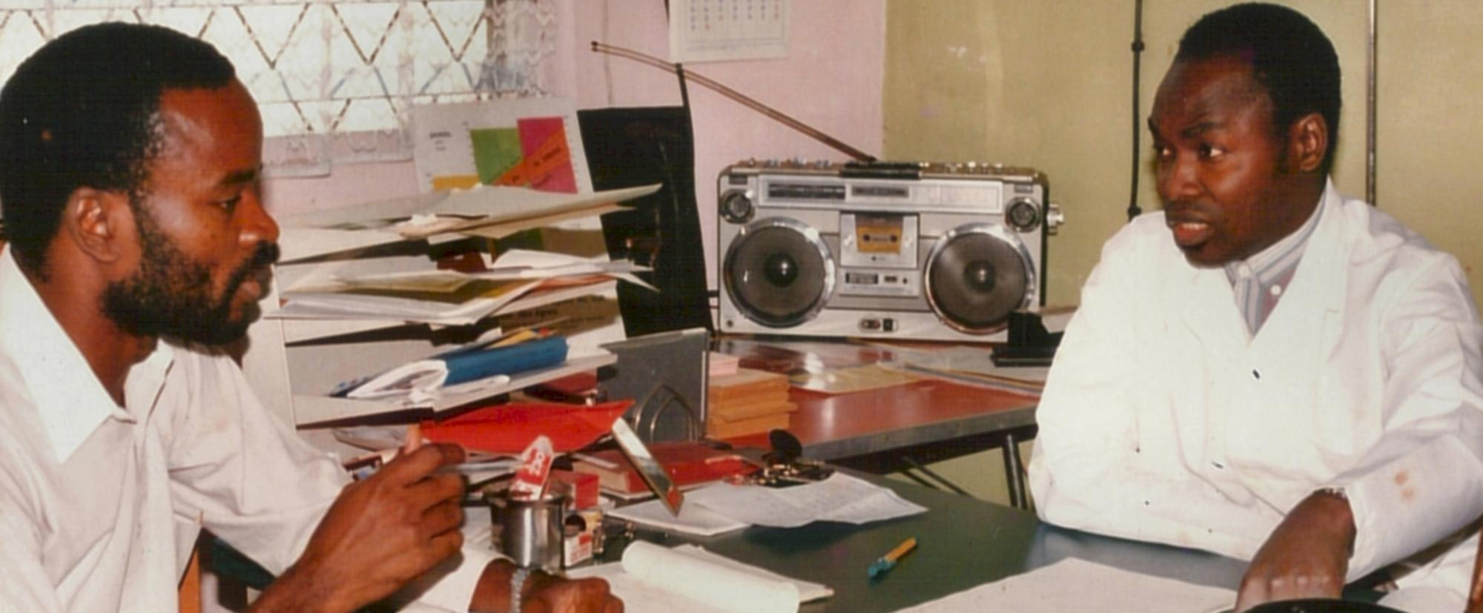
Sambe Duale (above)
SANRU in Action at the Health Zone Level
Felix Minuku (right)

Slide 18
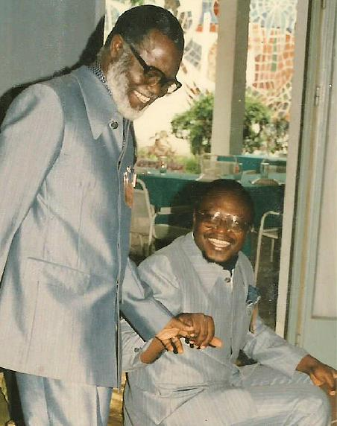
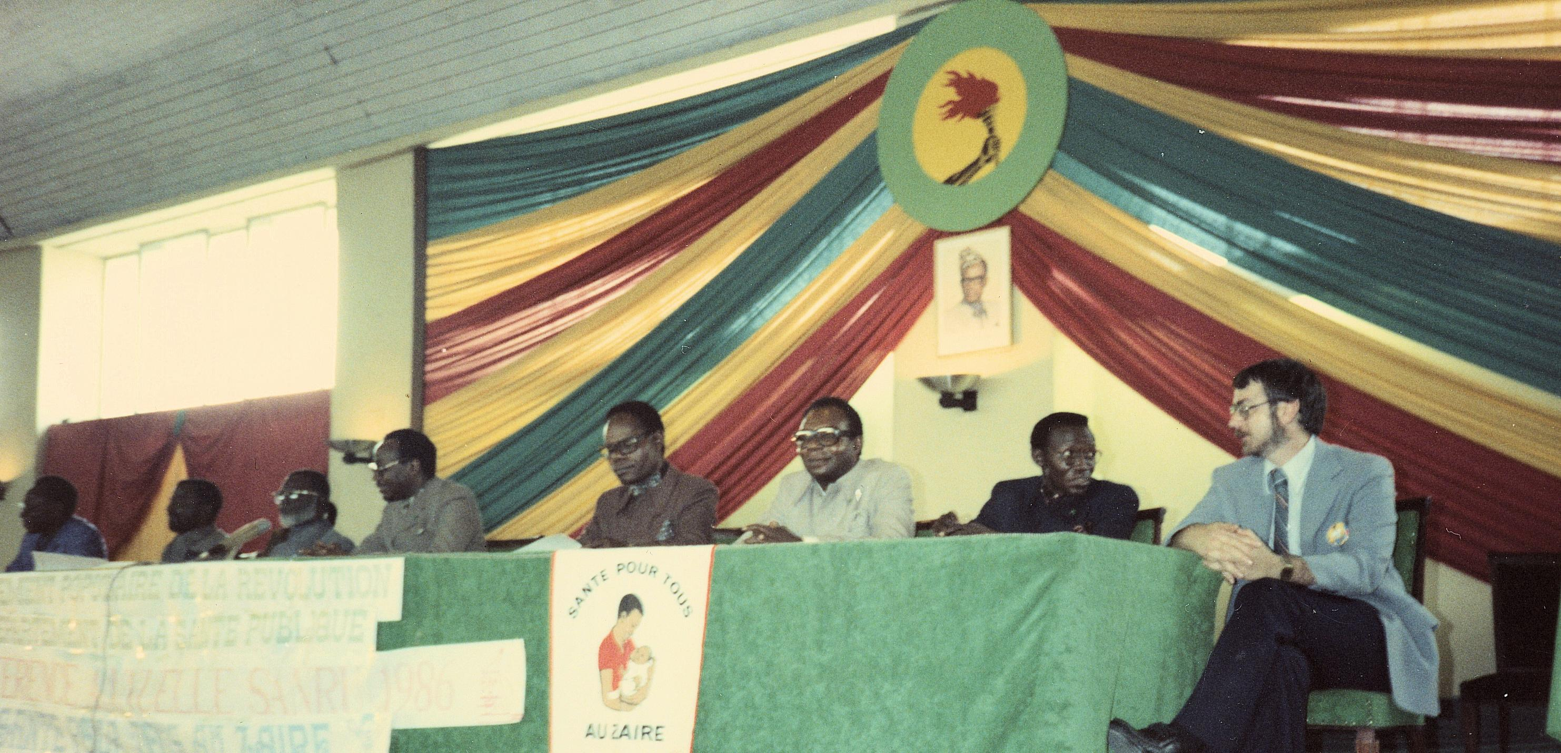
SANRU National Conferences (1983-89)

Slide 19
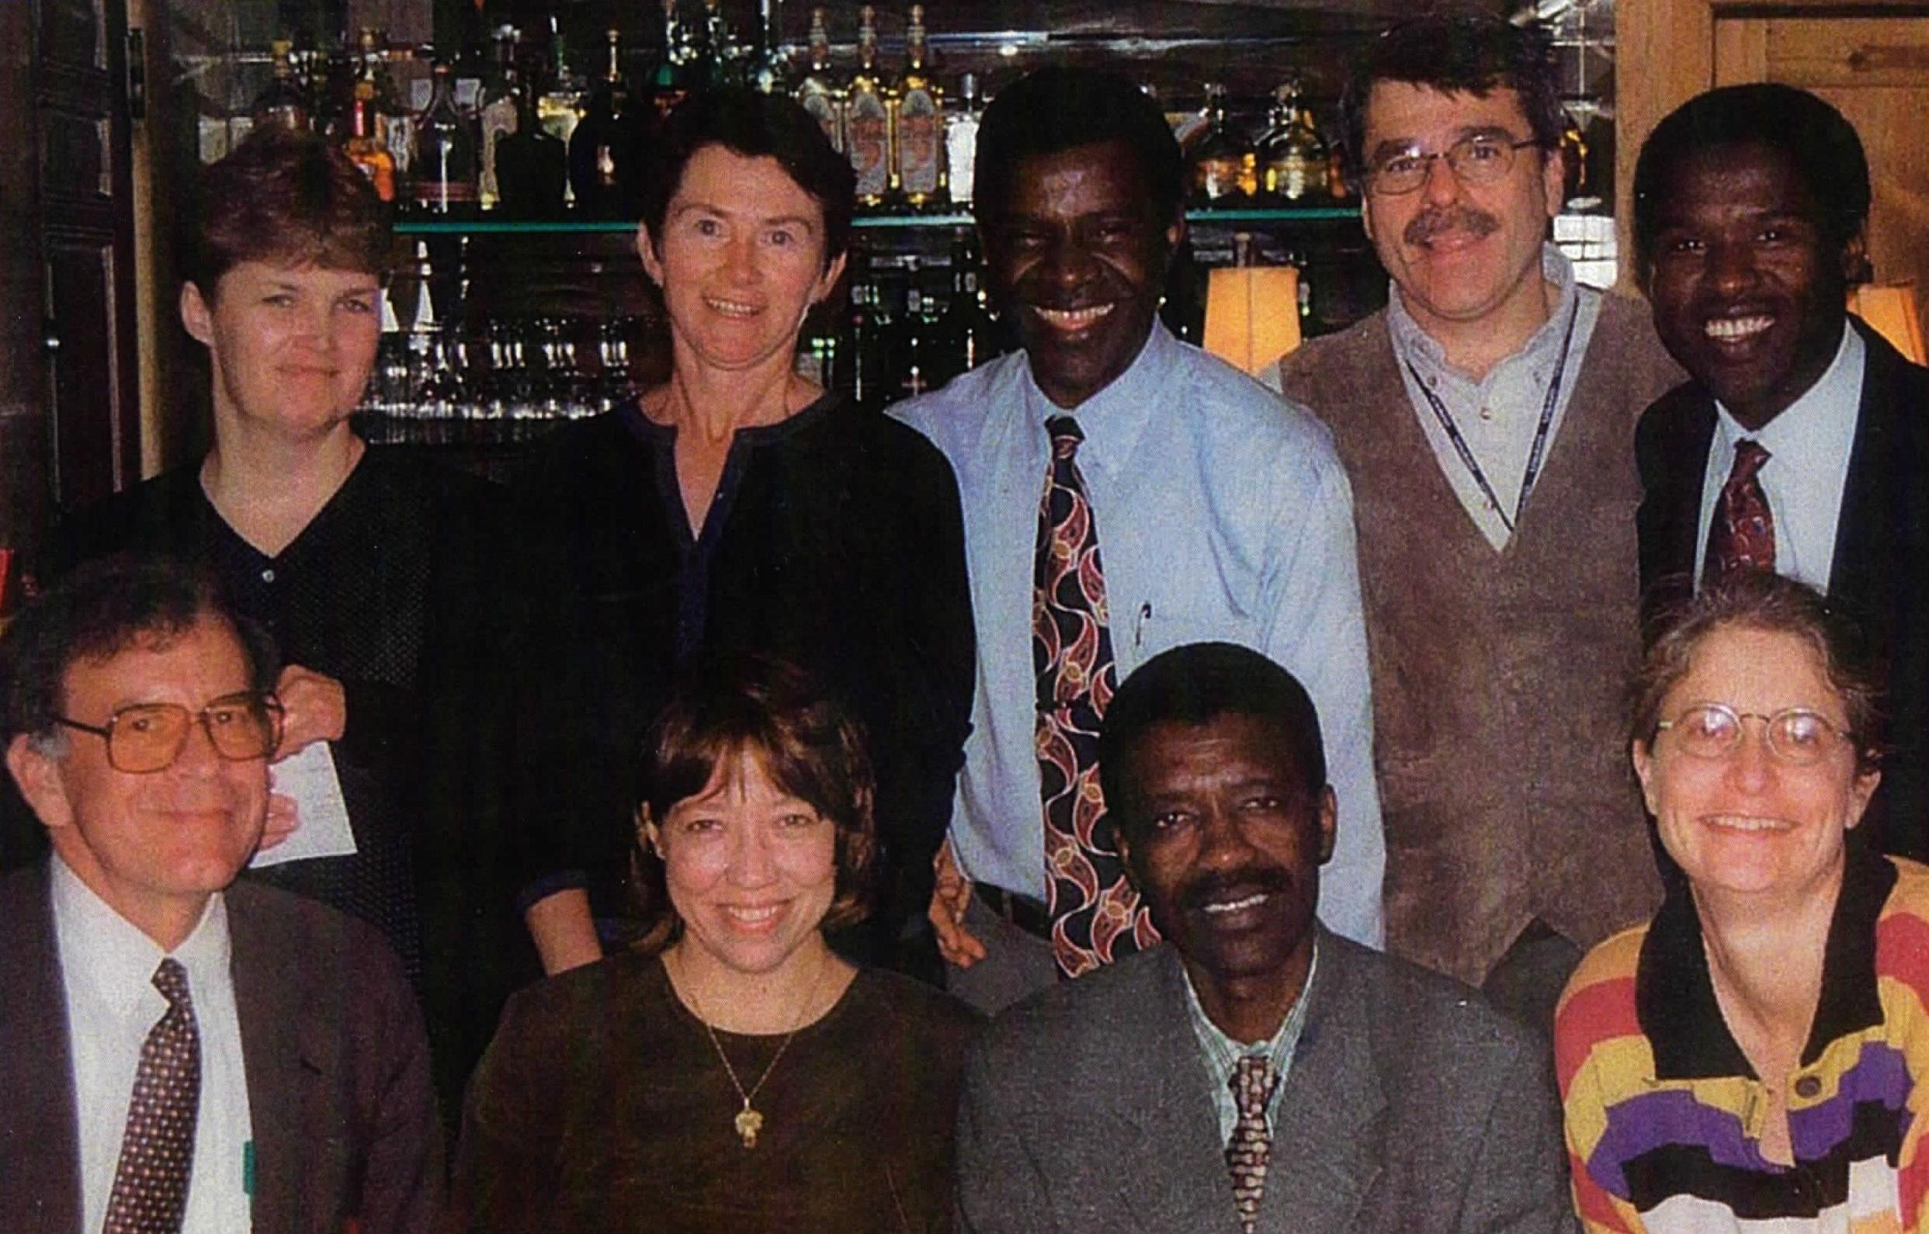
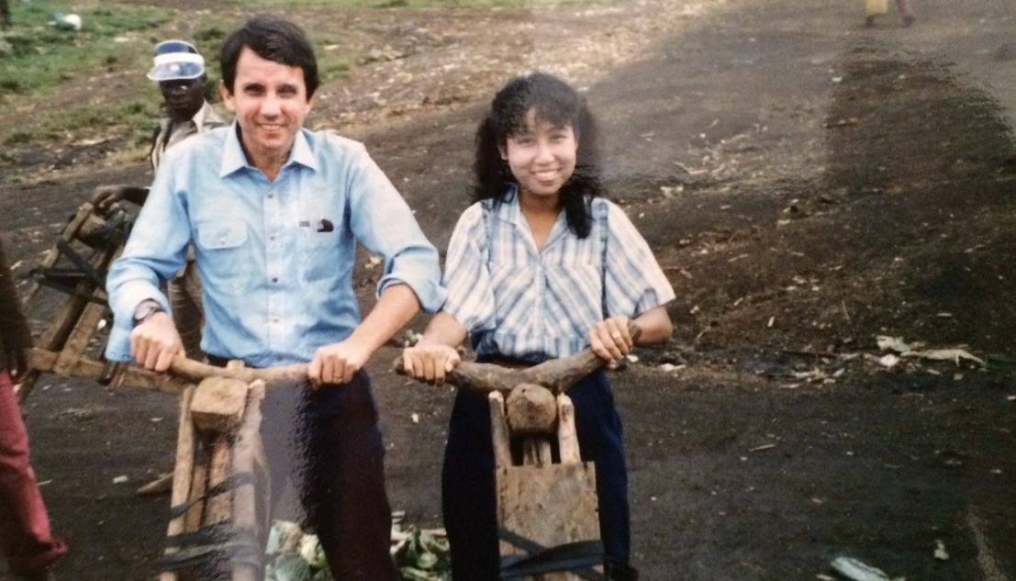
Ray Martin (above left)
USAID Staff
for SANRU I and II
Glen and May Post (right)

Slide 20
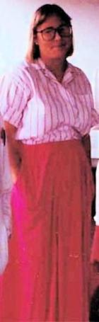
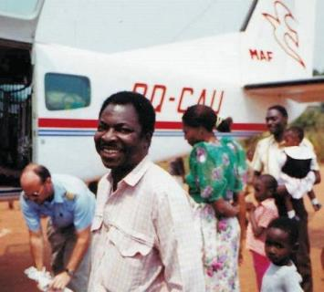
Lucy
Mize
One of my most vivid SANRU memories is driving with Dr. Emile Bongo at dusk on a terribly rutted road, the car on an angle that took my breath away, only to arrive in a clearing and see a line of women waiting patiently for services from a SANRU site.
I knew then that the work SANRU was doing was making a differ-ence in a fundamental way of lives of these women. And it convinced me that this is what I wanted to do, and thus began my career in international public health.
Emile Bongo during a SANRU supervision
I have since gone over somewhat to the “dark side,” and find myself far too remote from the field and from the women who need our services. Yet, it is still my unshakeable conviction, that those of who can, should continue to engage so that everyone gets a better chance at health and hope.
Lucy (currently on board the USNS Mercy for DoD training)

Slide 21



Slide 22
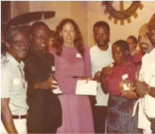
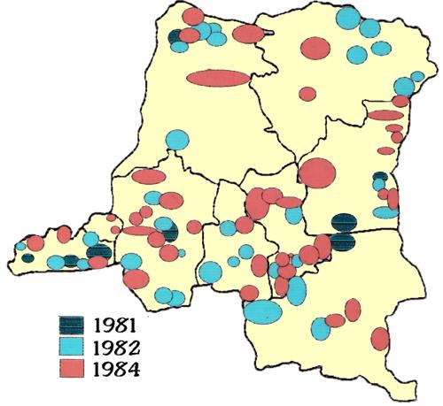
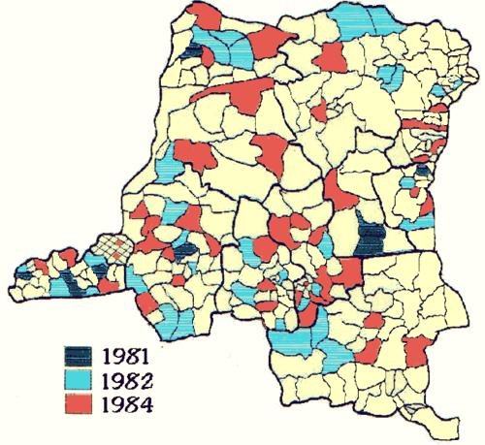
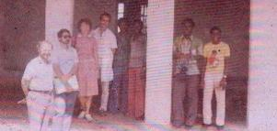
Background: Keys strategies and recommendations from SANRU I
Main recommendations:
  4 – 5 year extension of the project with assistance to an additional 50 Health Zones
  Opening the BRH project to all hospitals (not just ECC hospitals) for HZ development.
  Strengthening the Ministry of Health (MOH) in primary health care (PHC):
Main comment :
  SANRU I was designed as a strategic project that provides technical assistance to 50 Health Zones, rather than services directly to the population
FOCUS: To create a national critical mass of Public Health Professionals in order to build a strong
      health system and increase accessibility of the population in need especially in the rural area

Slide 23
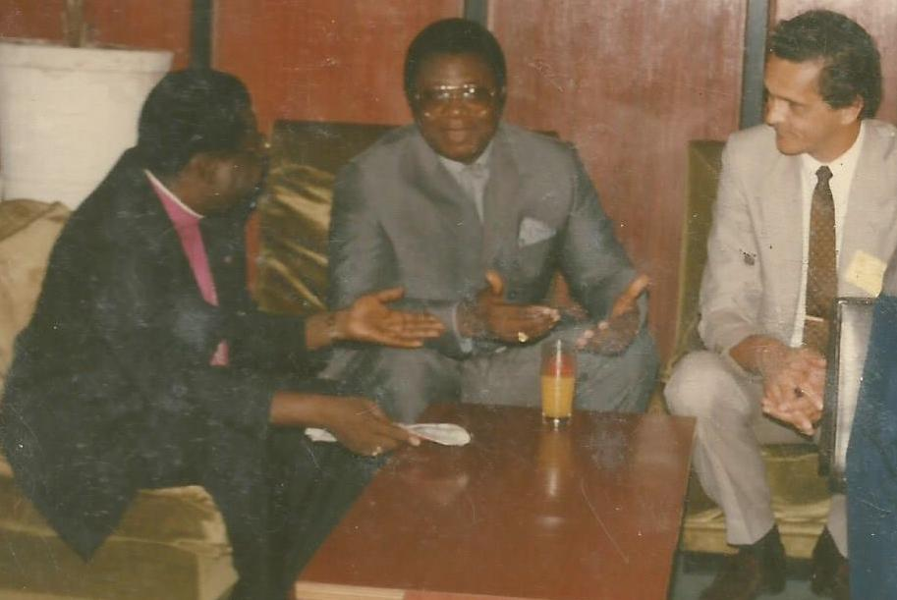
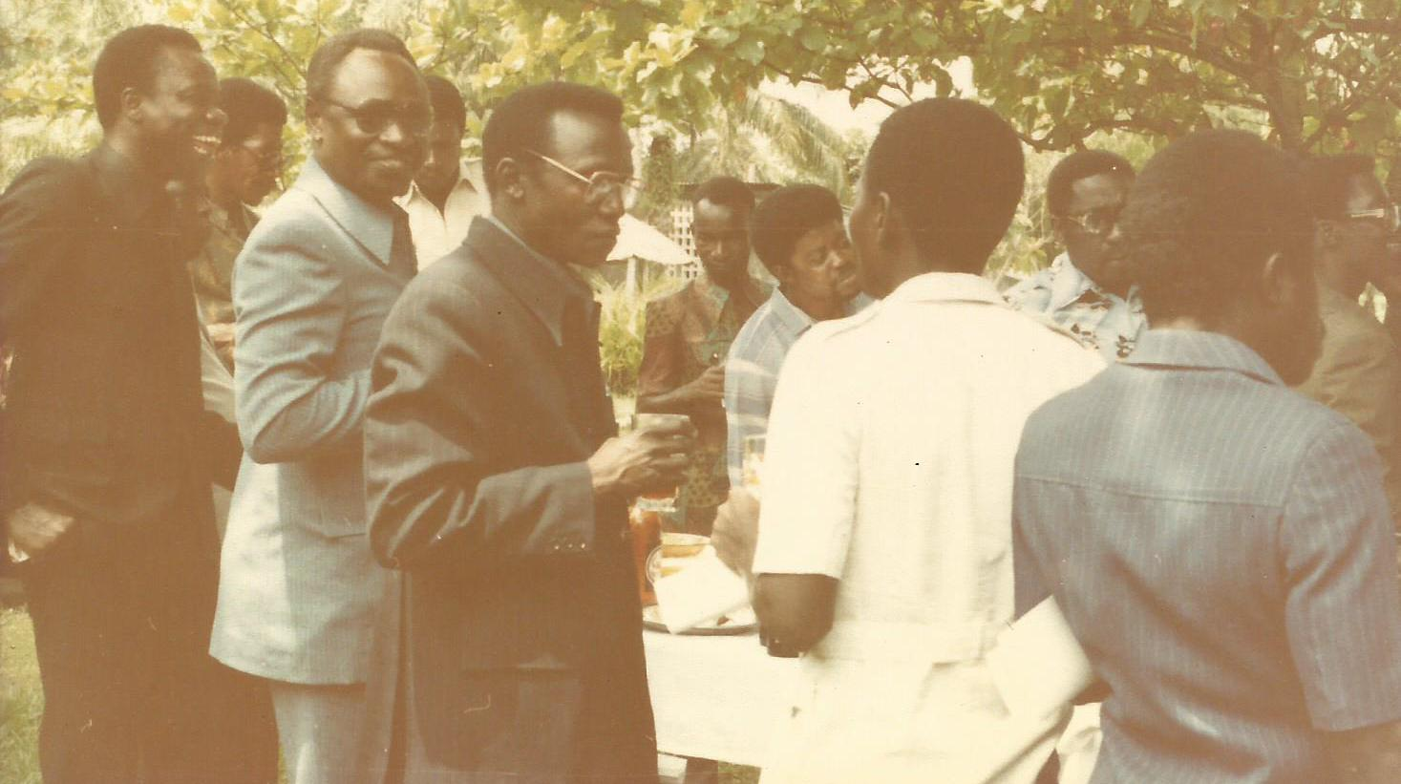
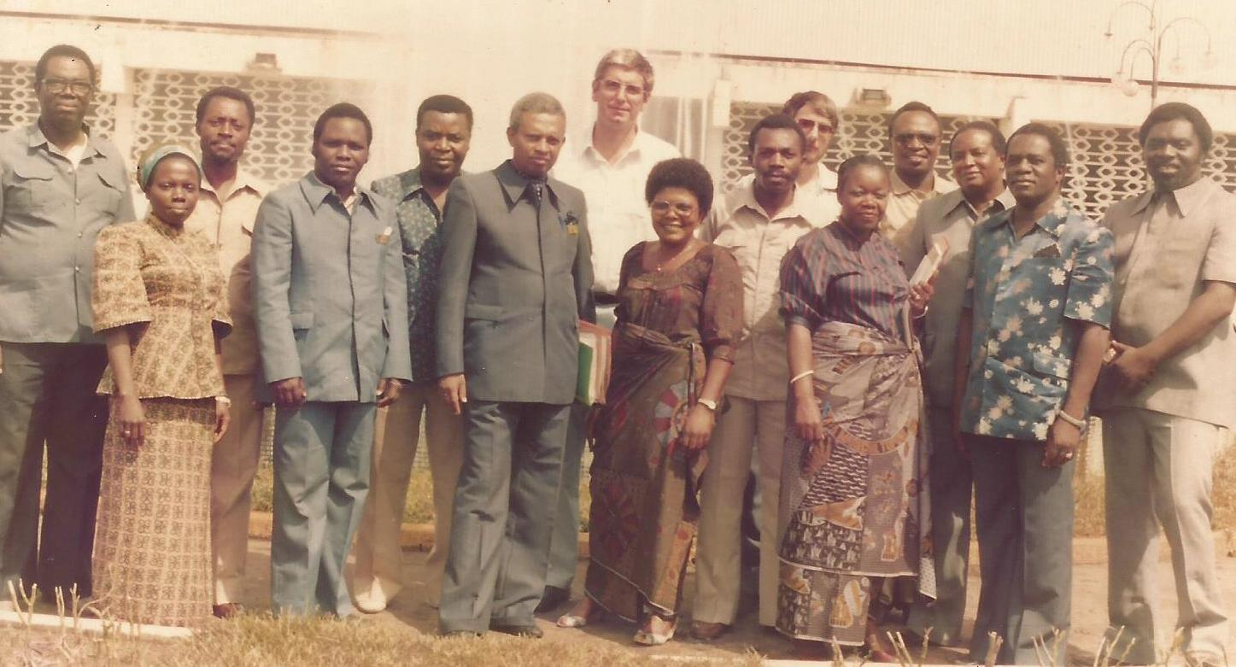
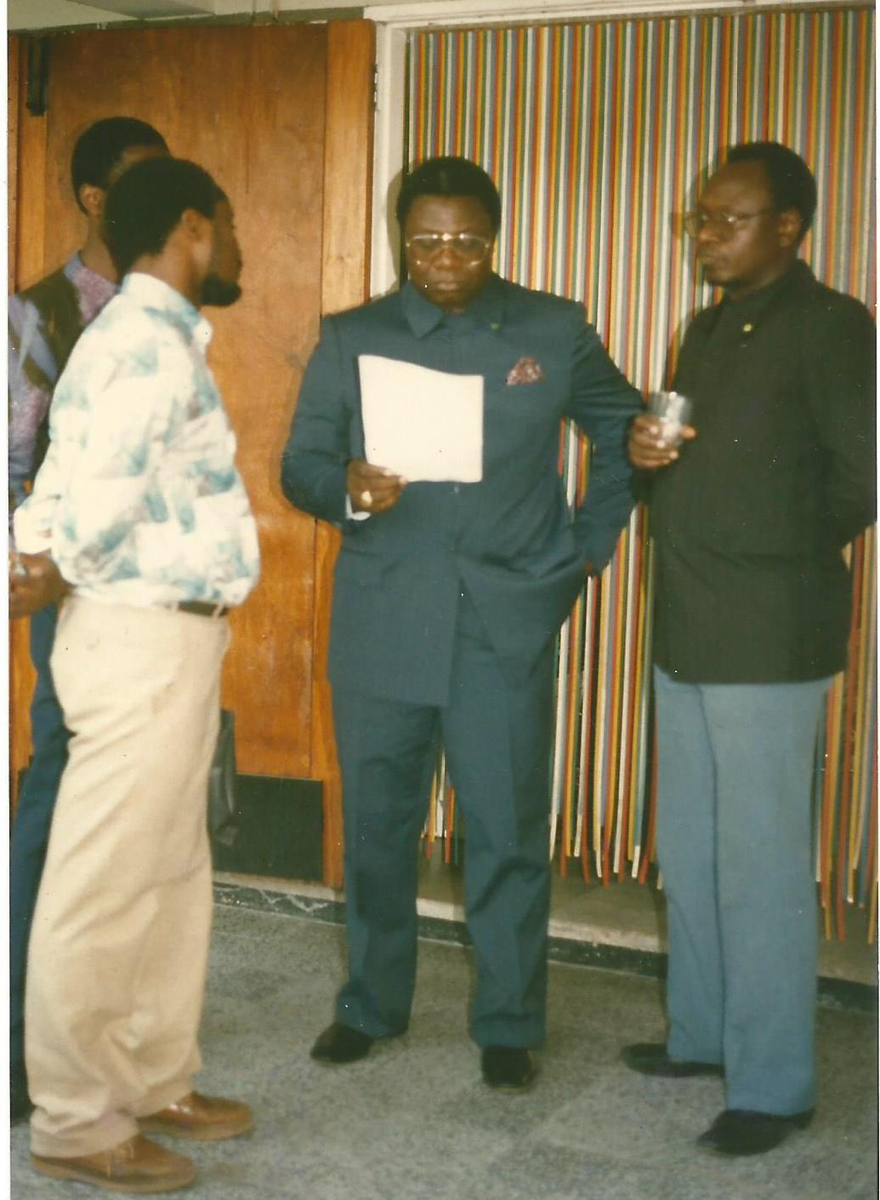
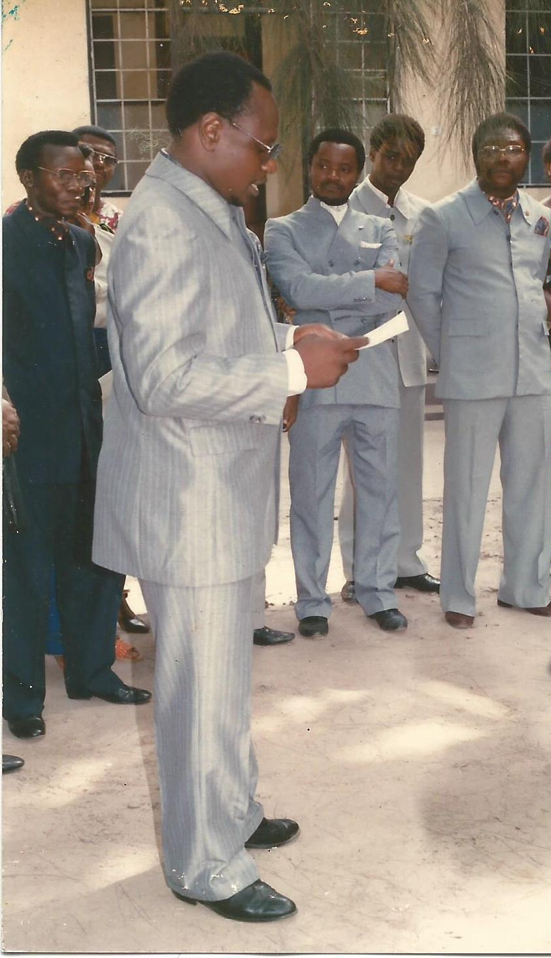
LEVELS OF SANRU IMPACT :
STRATEGICAL
1
  Building a strong partnership among the three partners : Government – USAID – ECC
2
  Contribution to the MOH five year health plan (1982-1987): Role of the direction PHC
TECHNICAL
OPERATIONAL
3
  Regular briefings with the Minister of Health
INTERNATIONAL

Slide 24
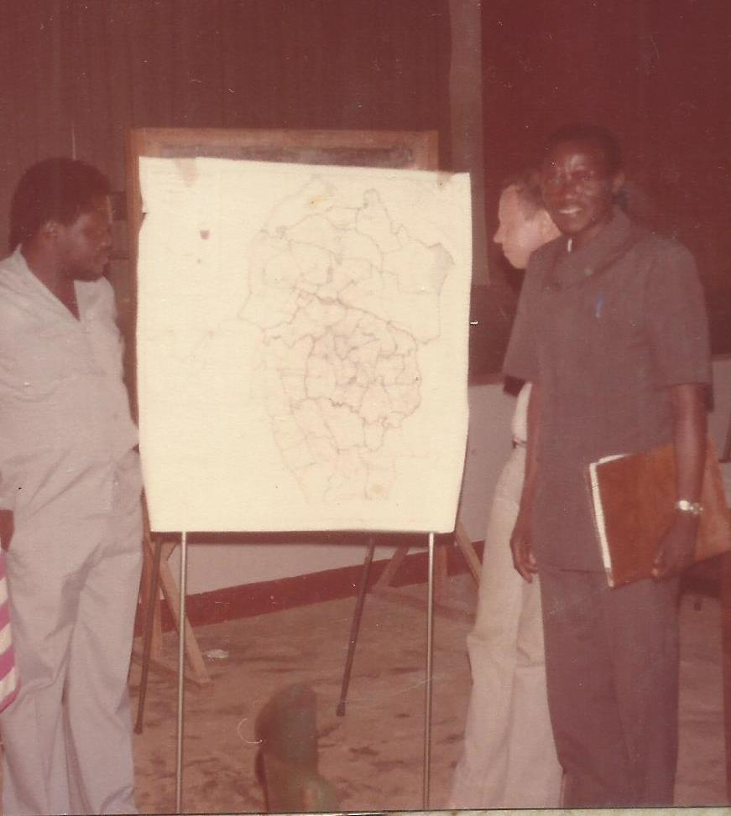
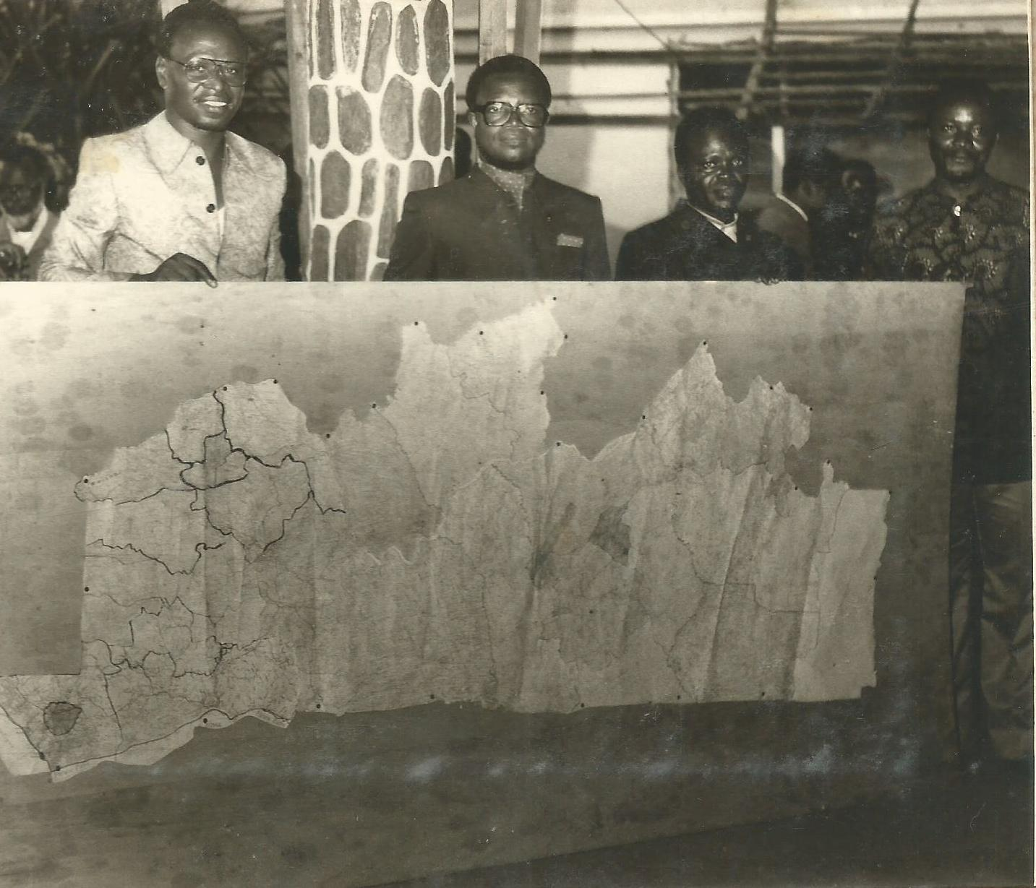
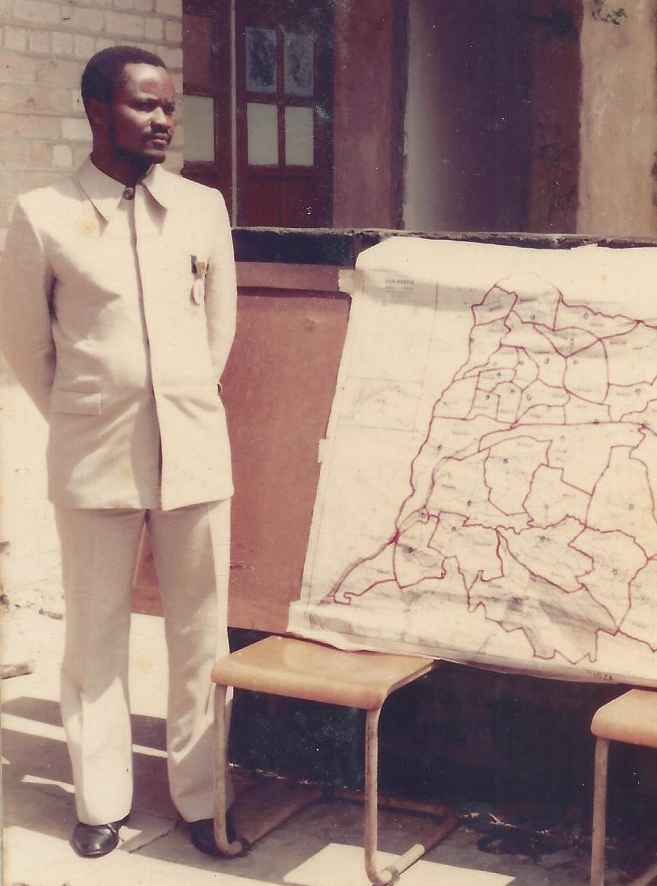
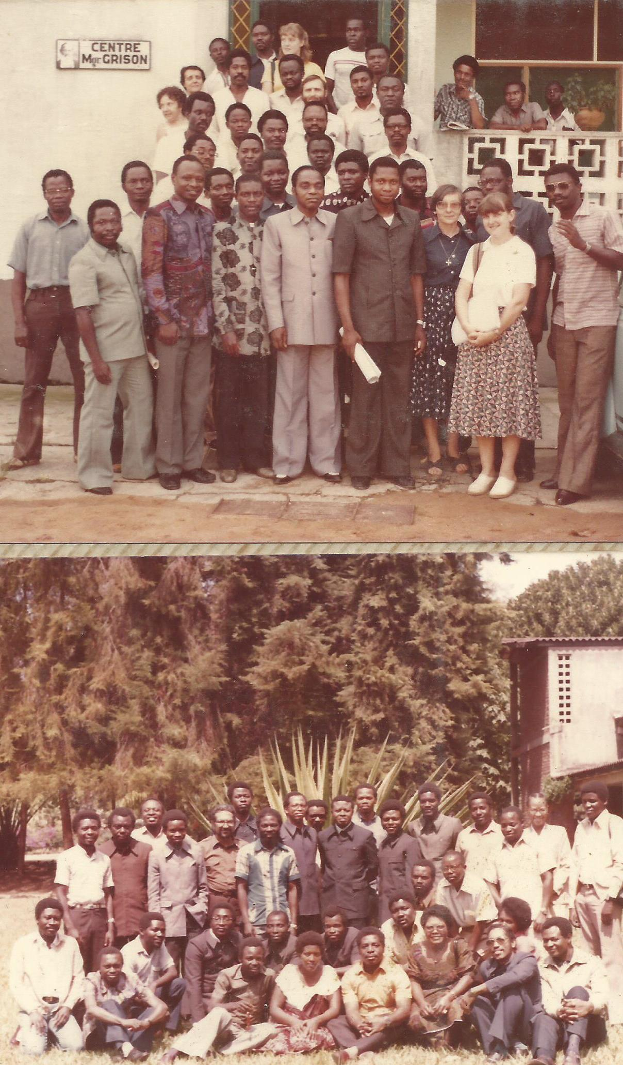
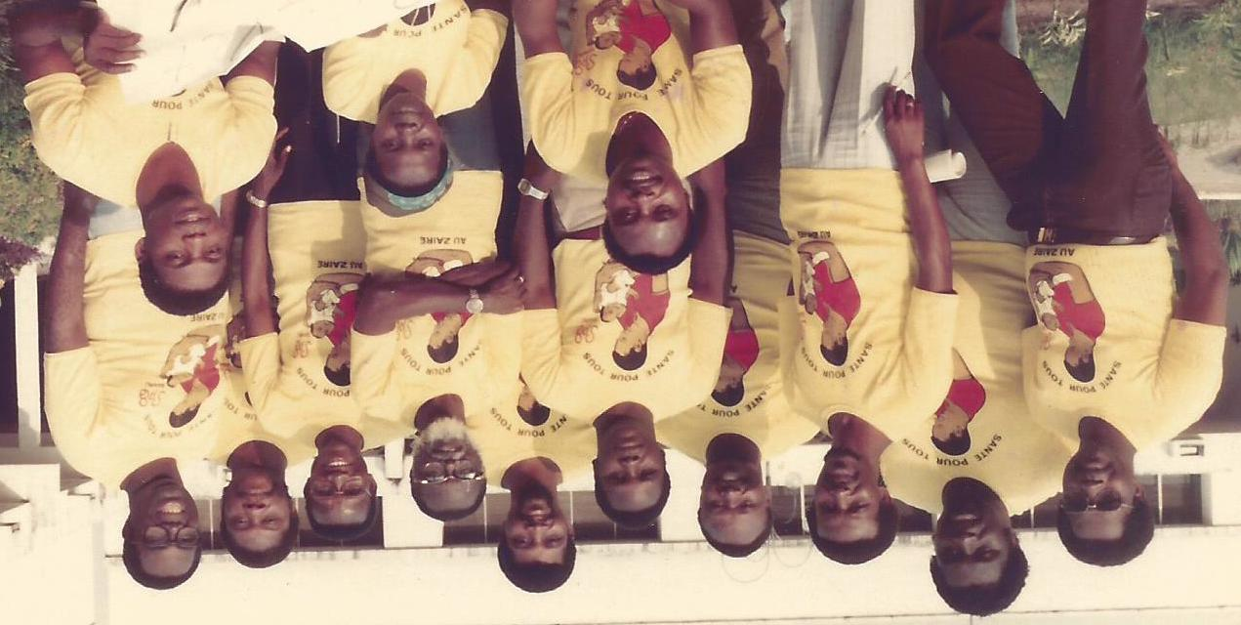
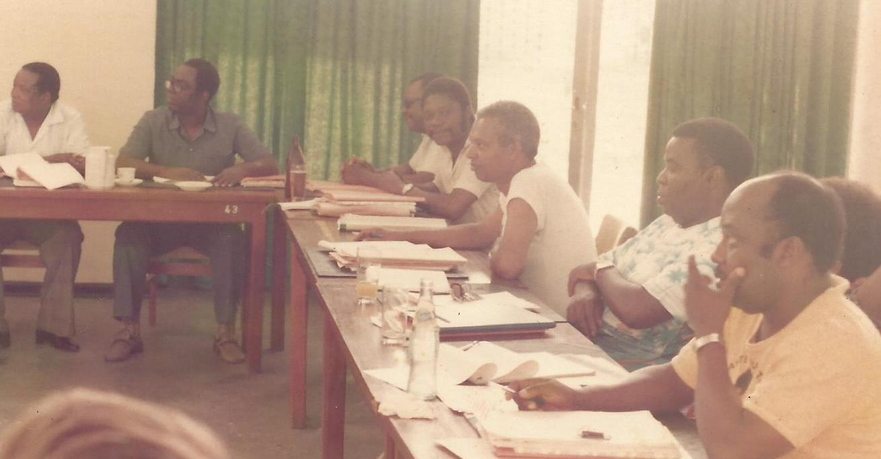
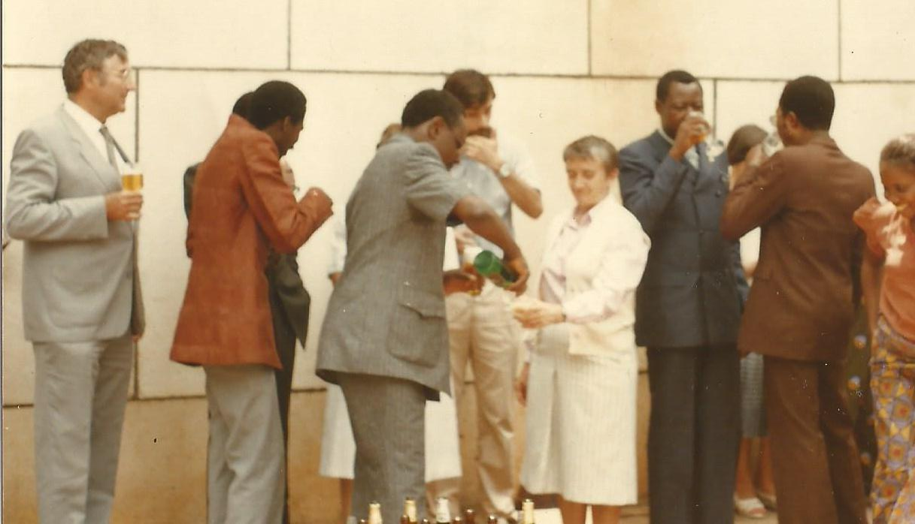
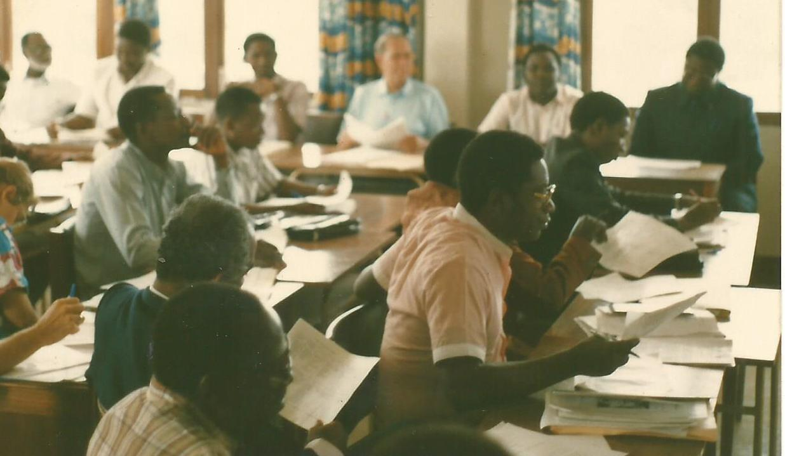
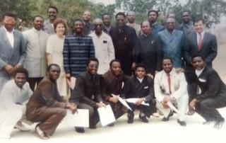
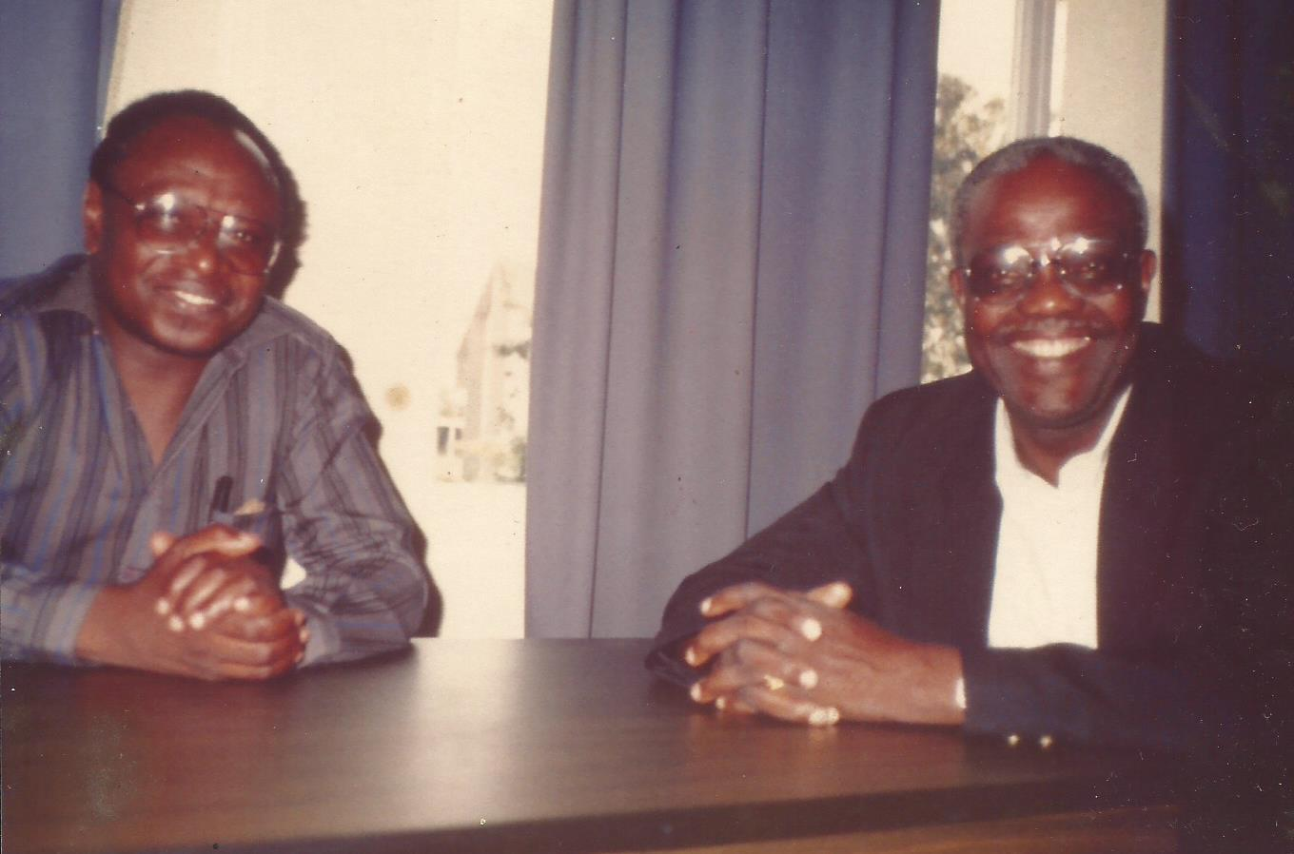
LEVELS OF SANRU IMPACT Con’t :
1
  Bottom-up delimitation of HZs fulfills MOH vision to create 300 HZs
STRATEGICAL
TECHNICAL
2
Development of health strategies and tools in close collaboration with national directors, programs & projects
3
Problem solving approach in collaboration with all parties involved
OPERATIONAL
INTERNATIONAL
4
Technical support to the Kinshasa School of public Health (Teaching activities and devlp. Of modules)

Slide 25
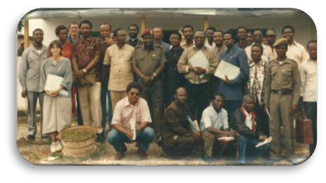
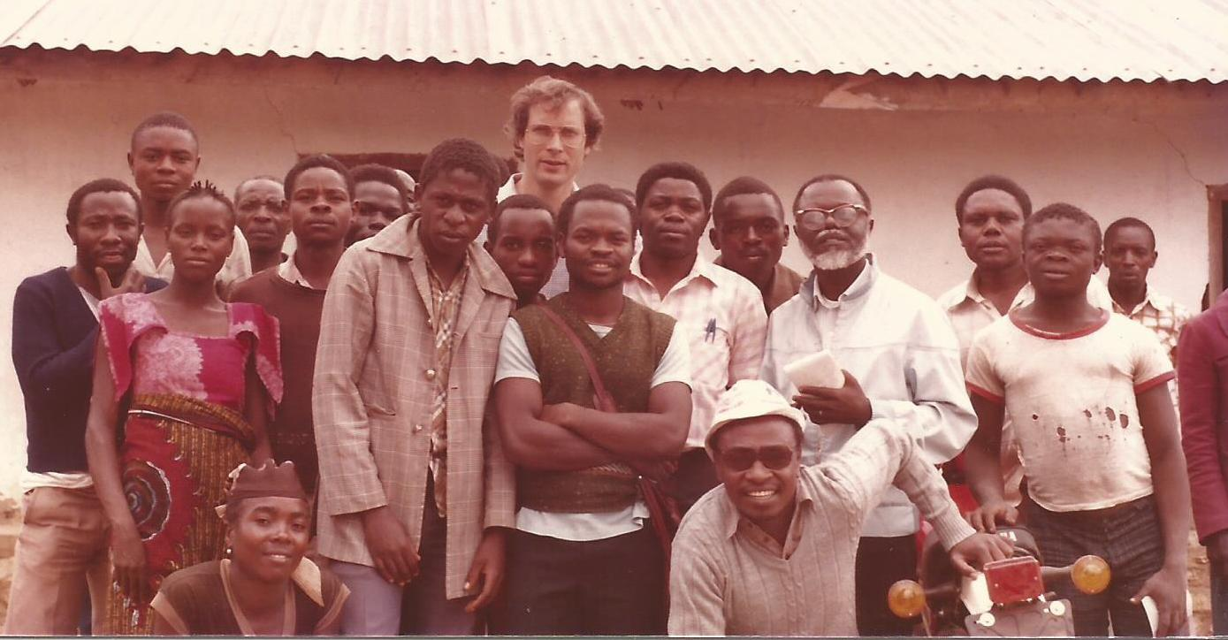
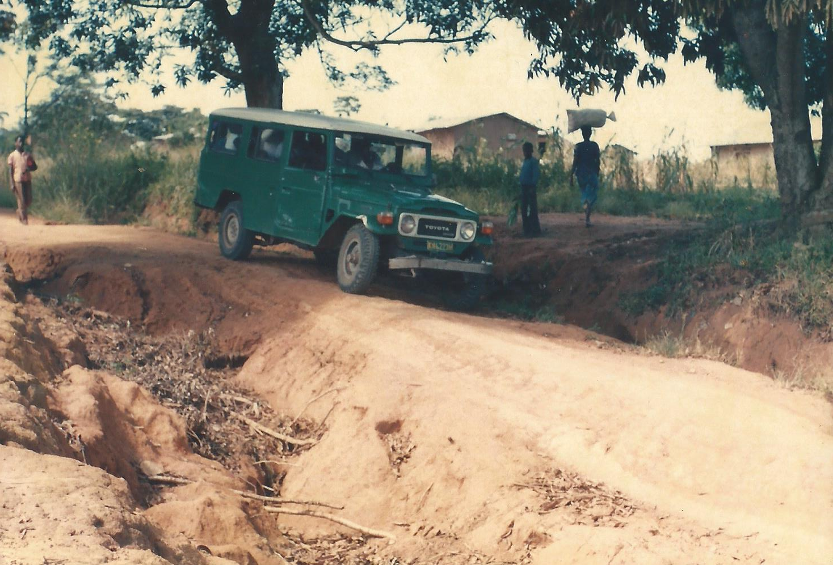




LEVELS OF SANRU IMPACT Con’t :
1
  Technical Supervision of Health Zones
  and team building
STRATEGICAL
2
  Evaluation of Health Zones and operational researches
TECHNICAL
OPERATIONAL
3
  Bureau d’Etudes within the MOH (Directory of MDs in DRC)
INTERNATIONAL
4
  Creation of the Zairian Public Health Association

Slide 26




LEVELS OF SANRU IMPACT Con’t :
STRATEGICAL
1
President of the 41st World Health Assembly in 1988 (Geneva) : Dr. Ngandu-Kabeya, Minister of Health and Social Affairs of Zaïre
2
President of the 38th Regional Committee for Africa in 1988 (Bamako) : Dr. Ngandu-Kabeya, Minister of Health and Social Affairs of Zaïre
TECHNICAL
OPERATIONAL
3
Congelese expets in differents international organisations : WHO – UNICEF – WB – UNFPA – USAID. -
INTERNATIONAL
4
Collaboration with the World Federation of Public Health Associations (CPHA – APHA..)

Slide 27
CONCLUSION:
SANRU HAS BEEN A POWERFUL TOOL FOR HEALTH DEVELOPMENT IN DRC
ITs MULTI DIMENSSIONAL CONTRIBUTIONS HAVE ALSO IMPACT ON THE HEALTH DEVELOPMENT IN AFRICA
THERE IS A NEED FOR DOCUMENTATION AND DISSEMINATION OF SANRU SUCCESS STORIES AT LARGE SCALE.

Slide 28















Matondo
Aksanti sana
Kwasakidila
Merci mingi
Merci beaucoup
Thank you

Slide 29


Armand
Utshudi
My connections to SANRU span all five decades!
I helped USAID implement a pilot health zone project before SANRU. The Kongolo HZ was not a great success, and is one reason why Rick Thornton designed Basic Rural Health to be managed by ECC.
I was the USAID SANRU I program officer. After the “evenements” of 1991 I worked with USAID in Mozambique for several years, and then moved to the U.S. I’m now a U.S. citizen, and have my own NGO (CRADI.org). I’m also proud to have been a founding member of SANRU NGO!
I’m missing the SANRU soiree because I’m in DRC for the final evaluation of USAID’s current Inte-grated Health Project in DRC. My best wishes for a healthy and prosperous future to all my old friends from USAID and SANRU.
- Armand (on assignment in DR Congo)

Slide 30

1991-2000: SANRU Interlude

Slide 31

Dr. Nkuni and ECC-DOM
Projects implemented during the SANRU Interlude
Projet | Dates | Funding | Budget | HZs
MAP International | 1981-91 | MAP | $1,200,000 | 38
PASS | 1992-94 | World Bank | $ 450,300
ZCAT Project | 1993 | WCC | $124,000 | 22
ZUAC Project | 1994 | World Bank | $230,000
MBF &CRS Essen. Meds | 1994-95 | OFDA | $2,310,000 | 46
PATS project | 1995-97 | EU | $1,320,000
Ebola Outbreak Coord. | 1996 | US Gov’t | $1,500,000
Residence Project | 1997-01 | EZE | $870,000
Family Planning Project | 1996-98 | WB & PC(USA) | $ 170,000
Solidarité Protestante | 1997-02 | Belgium Gov’t | $4,071,000 | 15
Pats II | 1998-01 | EU | $ 730,000
TOTAL |  |  | $12,975,300

Slide 32

Lunch with Paul & Frank at CCIH 1994
An early glimpse of a potential partnership with ECC
The successful partnership between ECC and IMA for SANRU began during a CCIH conference. Thanks CCIH!

Slide 33




The Congo Crisis
For most of the 1990s much of Congo was occupied by various rebel groups seeking control of resources like Coltan. Yet health zones continued to function and SANRU survived.
Rebel controlled
Rebel controlled
Rebel controlled
Government controlled

Slide 34



The Return of USAID in 2000
The re-opening of USAID by Ron Harvey provided an opportunity to for the possible revival of SANRU.
Ron Harvey & Nancy Bolan
Reggie Hawkins & Dr. Tcheke
Emile Bongo

Slide 35

2000-2010: SANRU’s Return

Slide 36






IMA World Health and SANRU’s Return
By Paul Derstine
IMA World Health President (retired)
Former CCIH President

Slide 37

IMA and DR Congo
IMA’s interest and work in DR Congo began long before SANRU. In 1960 IMA provided medicines to 30+ hospitals in DRC affiliated with IMA members:
  Presbyterian Church USA
  United Methodist
  Disciples of Christ
  American Baptists
  Mennonite
  Adventist

Slide 38

Paul Derstine, Retired President of IMA and Mgr. Marini Bodho, President of the ECC cementing the bonds of friendship and collaboration crucial for the launch of SANRU III

Slide 39

Leon Kintaudi has provided the all-important commination to ECC and the day-to-day leadership for SANRU -- first for SANRU III as a project, then for SANRU as a program, and now for SANRU NGO.
He was justly recognized for his work in 2005 as one of Time’s “Ten Global Health Heroes.”

Slide 40


IMA’s “missionaries” to DR Congo
IMA’s secondment arrangement with PCUSA and ABC were very successful in developing its partnership with ECC for SANRU
Bill Clemmer
Wayne Niles
Larry Sthreshley
Nancy Allan

Slide 41


Bill Clemmer
I arrived in Zaire in 1995 as a missionary doctor. Those were tough years. There were never enough drugs, supplies, staff, or funds to treat the hundreds who came to Vanga hospital.
So, when I received a call from Paul Derstine in 2000 saying that IMA and ECC were submitting a proposal to USAID to restart the SANRU project I said “Great, help is on the way!”
“Well, actually”, Paul replied, “IMA is looking for a Country Representative to work with ECC on this venture… and your name was put forth.”
That was 15 years ago... and blessings continue to reign upon SANRU and its faithful and dedicated staff as they continue to serve those whose voices God has heard from above. SANRU is an instrument of peace, a vessel of hope, to the millions in need in DRC!
A SANRU team prays for a barge of medical supplies for Bolobo HZ.

Slide 42
ECC/DOM and
SANRU’s Return
By Dr. Ngoma Miezi Kintaudi ,MPH, Ph.D
Executive Director of SANRU

Slide 43
Events leading to SANRU’s Return
Jan 2000: Meetings with USAID Kinshasa by Leon and Larry.
May: Meetings with USAID/ DC by Larry, Ray, Ron, Tony, Kate, etc.
June: Feasibility visit/study conducted & presented to USAID
July: Contact with IMA and Paul Derstine
Aug.: Project design and submission to USAID
Sep.: Project begins with PCUSA ($100K)
Oct.: OFDA funding funds start-up activities for $1 million
May 2001: Project signed/funded with USAID funding ($25 million)

Slide 44

Ambassador Swing insisted that SANRU III should work in as many provinces of DRC as possible in order to emphasize the reunification of the country.
SANRU III was the first health systems rebuilding project. It was soon followed by WB with PMURR, and then by funding from other donors.

Slide 45



Dr Jean YAGI SITOLO, Minister of Health
200+ participants from all corners of DR Congo
The 2003 SANRU Conference brought participants from all corners of DRC. It was a reunification event!
Tony Gambino, Director USAID Kinshasa

Slide 46




Teaming Up with IMA since 2000:
A spectrum of and evolving partnering relationship
IMA Primed Projects
ECC/SANRU Primed Projects

Slide 47


Paul Derstine’s leadership and flexibility helped to make the partnership between IMA and ECC an effort worth pursuing.

Slide 48

Tony Gambino
USAID Mission Director 2002-2004
I consider my role in SANRU to be the single most important professional accomplishment of my career. To be specific, in helping to facilitate renewed and strong USAID funding for SANRU and its unparalleled group of dedicated professionals (many of whom will be present at your event), I believe I helped improve, and in many cases, save the lives of tens of thousands of Congolese children and women.
I have so much more I could say about SANRU, and working with Larry, Leon, Bill, and so many other people I consider among the great people alive today. It was an extreme privilege for me to be able to work so closely with so many of you. Thanks for letting me send this in. It almost breaks my heart that I can't be there. Yes, that's how strongly I feel.

Slide 49

2011+: SANRU NGO

Slide 50
A Brief History of
ECC’s Health Work
(including SANRU) by Diakumbi Zabusu
ECC Representative to SANRU NGO

Slide 51

Bishop Pierre MARINI BODHO
President of ECC

Slide 52


By 1987, more than 100 decentralized health zones were functional, and access to primary health care services increases had increase from 10% to around 50%.

Slide 53
From the 1991 Evaluation of SANRU II
SANRU's raison d'être is the initiation and strengthening of the health zones' ability to render primary health care to rural populations. SANRU has been dramatically successful in initiating or extending primary health care activities...
The concept of the health zone is a strong building block for the future development of the Zairian health system. By keeping this concept viable, SANRU can offer to a future, more development-minded GOZ a model, based on the health zone concept, on which to build a sustainable, effective, and efficient national health system.

Slide 54

SANRU’s 2003 Colloquium created a re-unified effort for health systems rebuilding

Slide 55

A Spectrum of SANRU Program Partnership Projects

Slide 56

SANRU’s Current Portfolio
of Projects assisting
418 of 516 HZs

Slide 57
The SANRU story continues into our future!

Slide 58

IMA’s Partnership
with ECC for SANRU
By Rick Santos
President IMA World Health

Slide 59

IMA’s Origins
  Interchurch Medical Association (IMA) began in 1960 as a membership association of twelve faith-based relief and development agencies:
  – Adventist Development Relief Agency – Lutheran World Relief
  – American Baptist Church USA – Mennonite Central Committee
  – Christian Church (Disciples of Christ – Presbyterian Church (USA)
  – Church of the Brethren General Board – United Church of Christ
  – Episcopal Relief & Development – Church World Service
  – United Methodist Church – Vellore Christian Med College
Since its creation IMA has partnered with churches in DR Congo to provide medicines to more than 30 member-affiliated hospitals.

Slide 60
The Evolution of IMA
Procurement: since 1960
All countries where its members work
2) Neglected Tropical Diseases: since 1995
Tanzania, India, Haiti, Liberia
3)Health Systems Strengthening: since 2000
DR Congo, Tanzania, South Sudan

Slide 61



IMA in DR Congo
From 2000-2010: Management of health zone support projects with ECC:
SANRU III
PMURR
Project AXxes
Global Fund
SANRU III
& PMURR
SANRU
Global Fund
Malaria & HIV

Slide 62

IMA in DR Congo
Current Assistance:
DFID ASSP Project: Comprehensive PHC development in 54 HZs.
Ushindi Project: SGBV support in 10 Health Zones.
SANRU Global Fund: Malaria support in N. Kivu HZs.
NTDs Control: 4 HZs with Envision

Slide 63


Dr. Kambale
I was the first Medical Director of Oicha health zone (near Beni, NKivu). I remain, as far as I know, the longest-serving MCZS in the history of SANRU. In 2003, at the SANRU National Colloquium, when Frank handed out watches to those who had served at least ten years as MCZS, he had to give me two watches, …and now then?
Oicha HZ is a good example of how health zones and PHC in collaboration with good management from church hospitals have survived multiple wars and rebel-forces occupation.
We miss the “Appui Global” approach of SANRU I/II, but are thankful for the current assistance that we receive from the SANRU Global Fund malaria project.
- Dr. Kambale (Oicha health zone)
The Health Center Mbutaba, Oicha HZ, 1988

Slide 64
The SANRU Board of Directors: Looking forward to the next 15 years!

