Slide 1

SANRU and
Health Systems Building in DR Congo
Franklin Baer
Miatudila Malonga
Ngoma Miezi (Leon) Kintaudi
Felix Minuku
Albert Kalonji

Slide 2
35 years of
Health Systems Building in DR Congo
By Miatudila Malonga
President SANRU NGO
MOH Representative to SANRU I

Slide 3
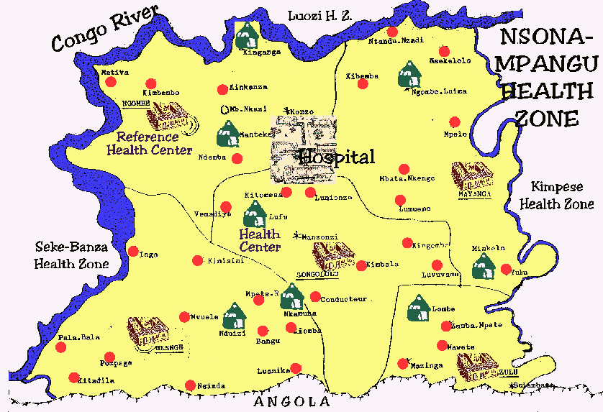
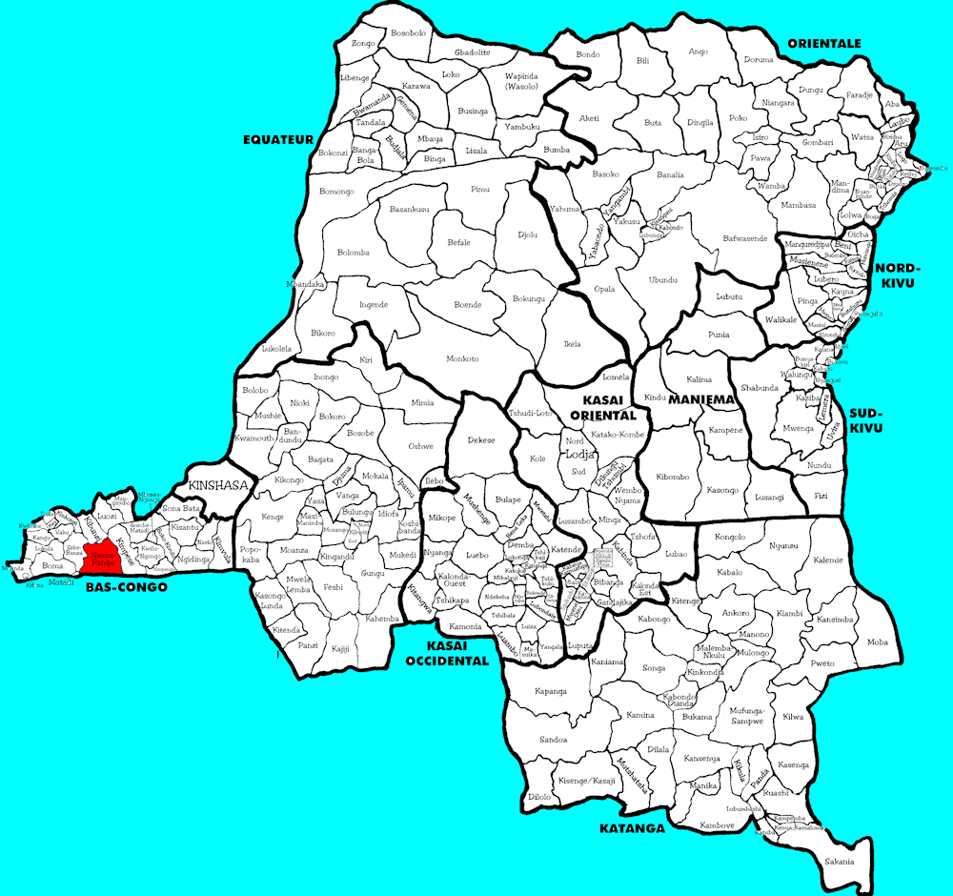
Decentralized Health Zones
In 1975, to ensure access to basic health for all became the objective of the Zaire Ministry of Health (MOH).
The strategy to achieve the objective of Basic Health for All was through the establishment of decentralized health zones.
A health zone was defined as an area comprising a general hospital and a constellation of primary health care centers.

Slide 4
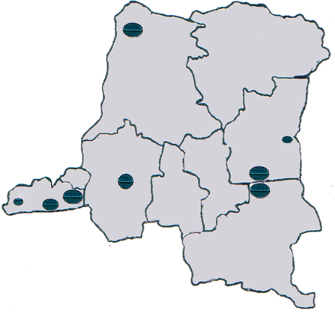
Pilot Health Zones Showed the Way
The implementation of the MOH’s vision started around a few well-functioning general hospitals which established important precedents for developing health zones:
  Kisantu Catholic Hospital,
  Vanga Protestant Hospital
  Kasongo State Hospital
  Kimpese Protestant Hospital
  Katana Formulac Hospital
  Bwamanda Catholic Hospital
  Etc.

Slide 5
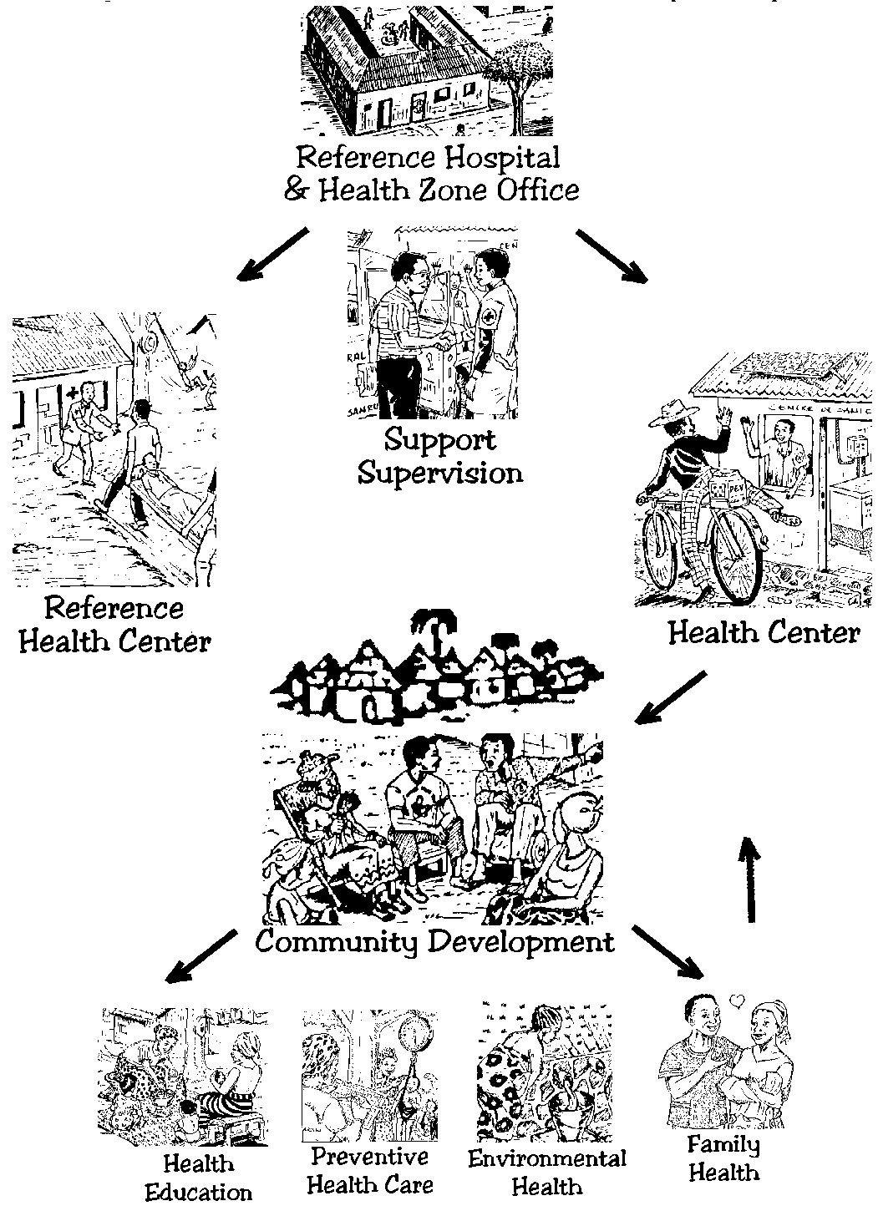
Appui Global:
Health Systems Strengthening
Support – financial, material, and technical – was provided to the health zones to strengthen their capacity in the provision of a package of services required to meet at least 90% of the medical needs of the population.
Health zones developed a very strong auto-financing capability to cover more than 50% of their functioning costs from user fees.

Slide 6
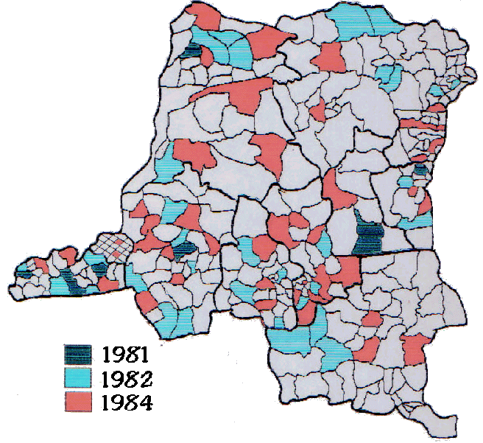
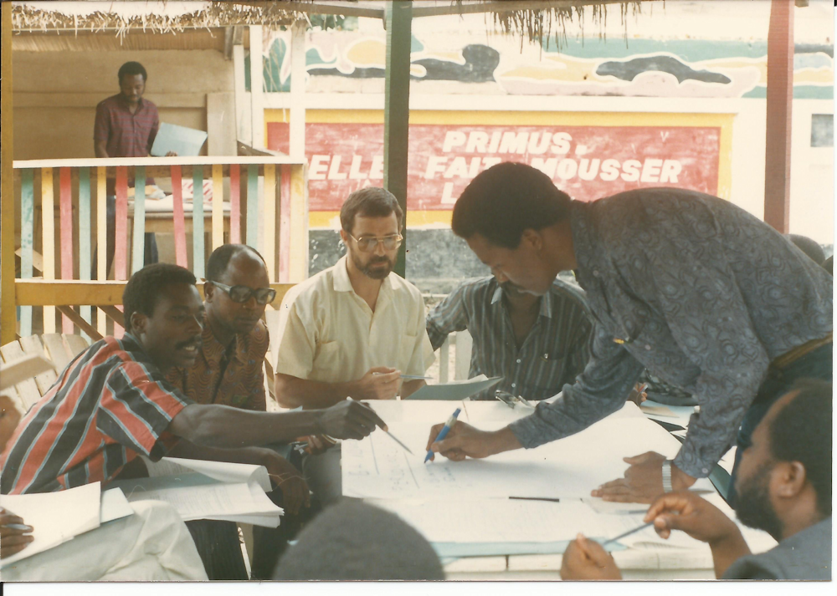
Delimitation of Health Zones
By 1984, following a long series of discussions among health providers, 306 health zones were created and empowered, each with well-defined borders (but not necessarily limited to administrative boundaries).

Slide 7
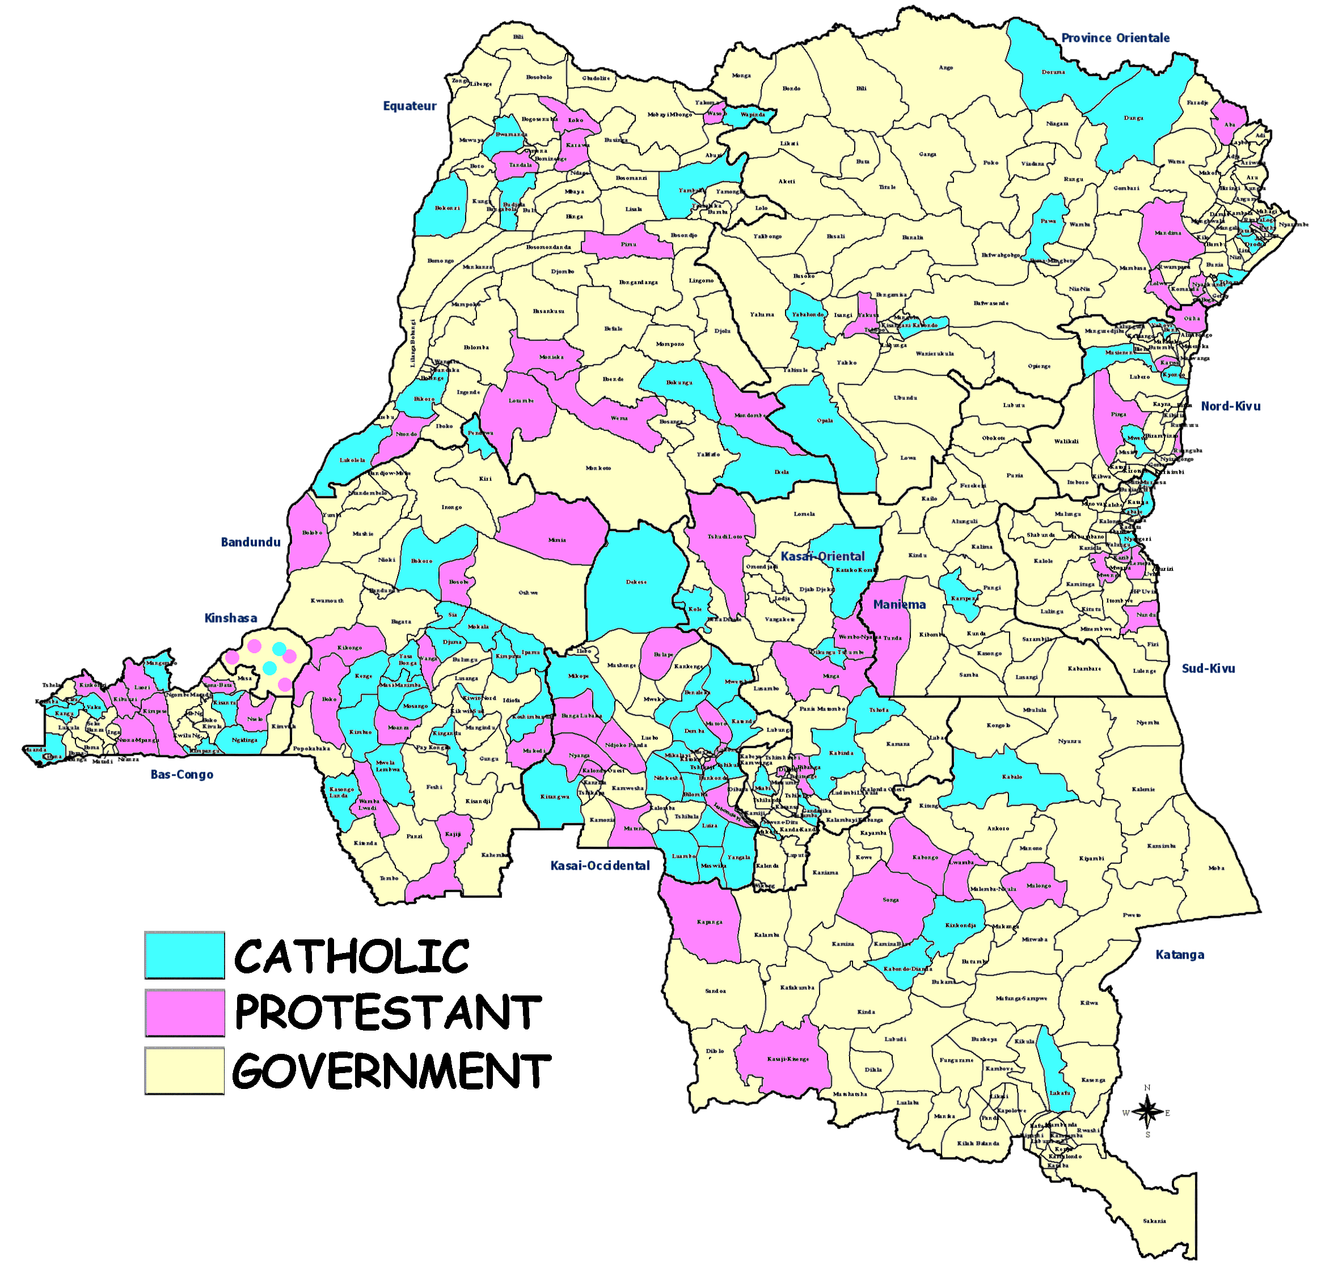
Health Zones and FBOs
Overall, the number of functional health zones increased dramatically during the last 30 years.
Today, 40% of Congo’s 516 HZs are managed by faith-based organizations and provide system sustainability during times of crisis.

Slide 8
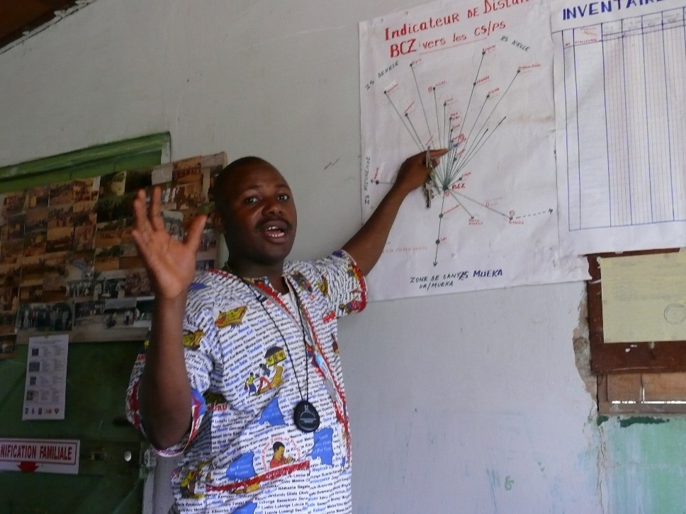
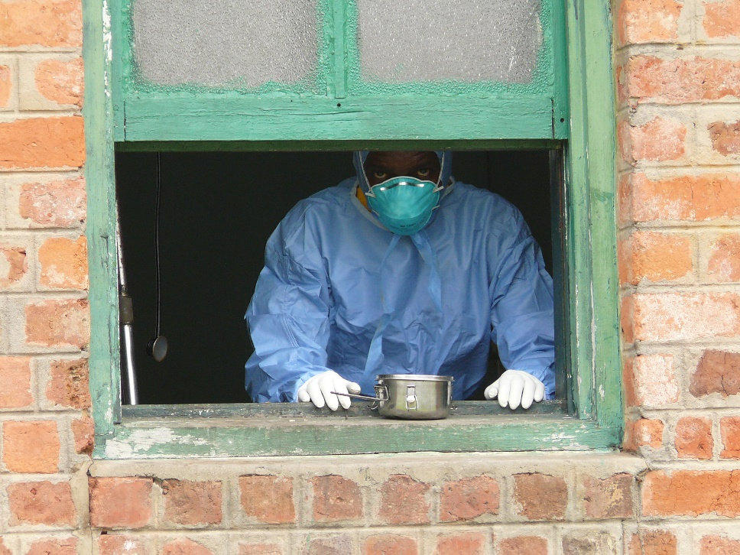
Health Zones and Resiliency
The decentralized approach of health zones has resulted in ensuring the apparently paradoxical resiliency of the country’s health system and in increasing its capacity to deal with important crises such as Ebola and HIV.

Slide 9
An Apt Conclusion from 2001
“The health zone system… is possibly the only system in the country still recognizable as a nation-wide quasi-state structure… and even with critically little or no support, it commands allegiance and support from health workers.” -A 2001WHO/UNICEF report

Slide 10
PARTERSHIPS:
TEAMING UP
TO COMBAT POVERTY
OF HEALTH CARE
By Dr. Ngoma Miezi Kintaudi ,MPH, Ph.D
Executive Director of SANRU

Slide 11
Why team up?
Problems are numerous
Actions are multiple (share among teams)
Funds need are enormous
Possibility to advocate increases
Capacity to react increases
Possibility to increase strategies

Slide 12
Who to team up with
At country level: MOH, local NGOs, local leaders of opinion, communities themselves, church networks, health zones, health centers
At international level: international organizations (ex: WHO, GF, USAID,DFID,CTB, GTZ, research organizations- universities)
All concerned who can bring assistance, even independently

Slide 13
OUR PRIMARY PARTNER IS ALWAYS
THE MINISTRY OF HEALTH
DIFFERENT PROGRAM OF MOH and SANRU TEAM:
PNLP: malaria
PNLS : HIV/Aids
PEV : vaccination
PNTS: blood safety
PNLMD: diarrhea control
SNIS DIVISION
MCNH: MATERNAL CHILD AND NEONATAL HEALTH

Slide 14
KEY ISSUES TO CONSIDER FOR TEAMING
Education
Food security
Policies
Eradication of endemic illnesses
Behavior change
Water and sanitation
Prevention activities and treatment
Real needs of the community
Shortage and Skill level of staff
Workers incentives, conditions and Career progression
Reduction of illness episodes
Local context for development

Slide 15
DIVERSIFICATION OF SANRU PARTNERS
increases our organization reach & stability
SANRU III (2001)
MOH
USAID
IMA
ECC

Slide 16
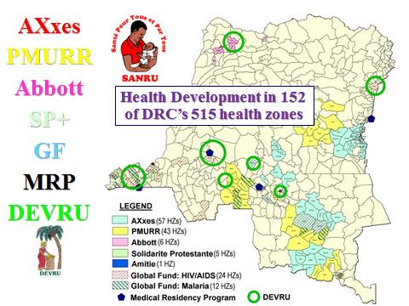
TEAMING UP WITH IMA (SINCE 2000)

Slide 17


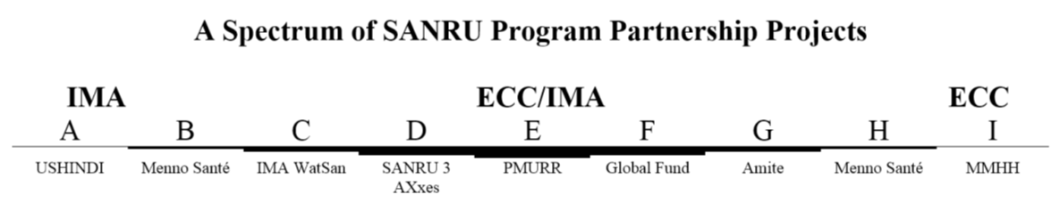
A Spectrum of Partnering with IMA
IMA Primed Projects
ECC/SANRU Primed Projects

Slide 18
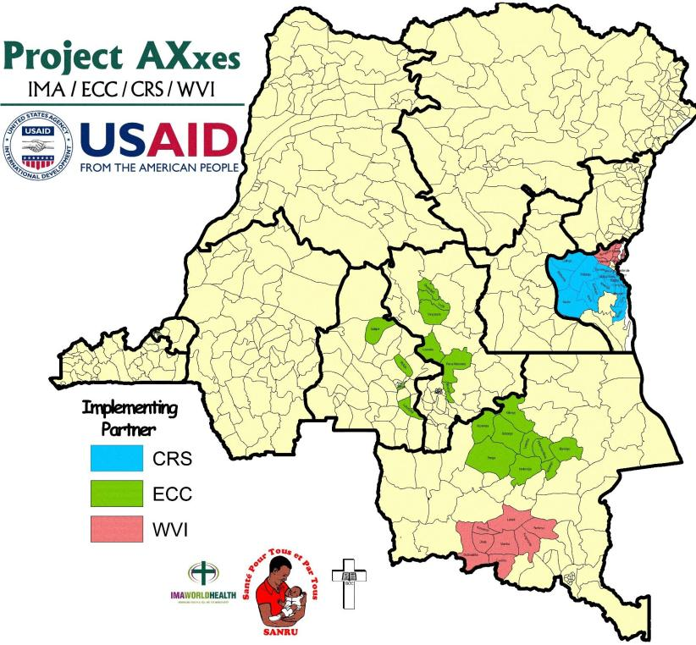
GLOBAL FUND HIV

Slide 19
DIVERSIFICATION OF SANRU PARTNERS increases our organization reach & stability
SANRU III (2001)
MOH
USAID
IMA
ECC
SANRU NGO (2011)
MOH
USAID/CDC
IMA
ECC
World Bank
Global Fund Malaria (& SRs)
Global Fund HIV (& SRs)
GAVI (& local CSOs)
HP Foundation/Tulane

Slide 20
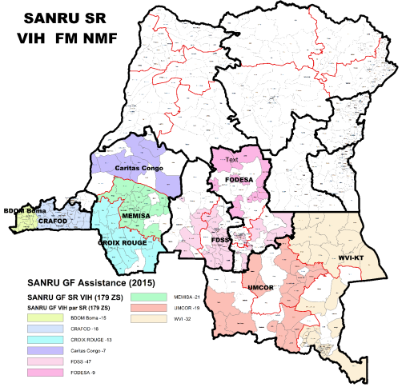
Global Fund MALARIA & HIV/AIDS teams up with 20 sub-recipient partners to implement

Slide 21
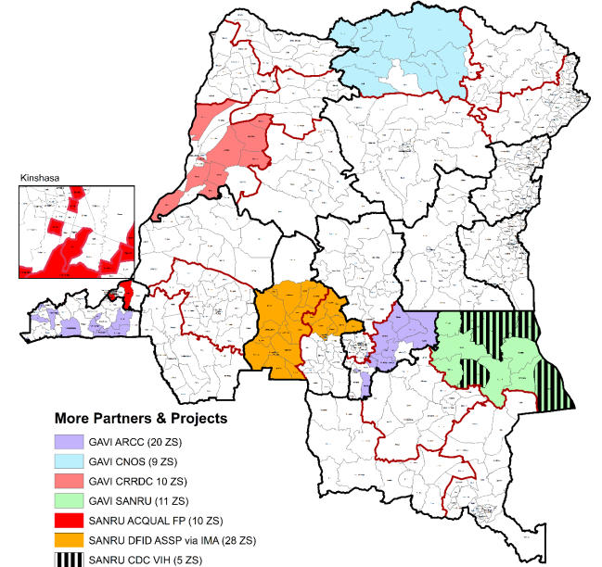
More Partners & Projects
GAVI, ACQUAL, ASSP, CDC/HIV

Slide 22
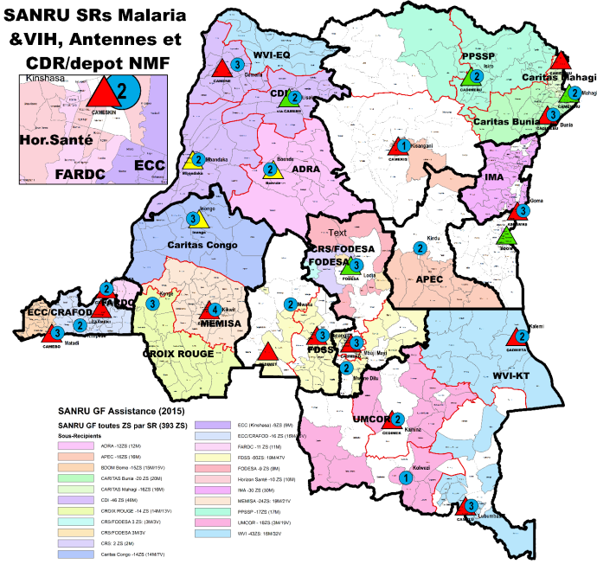
WORKING WITH REGIONAL DISTRIBUTION CENTERS (CDRs)

Slide 23
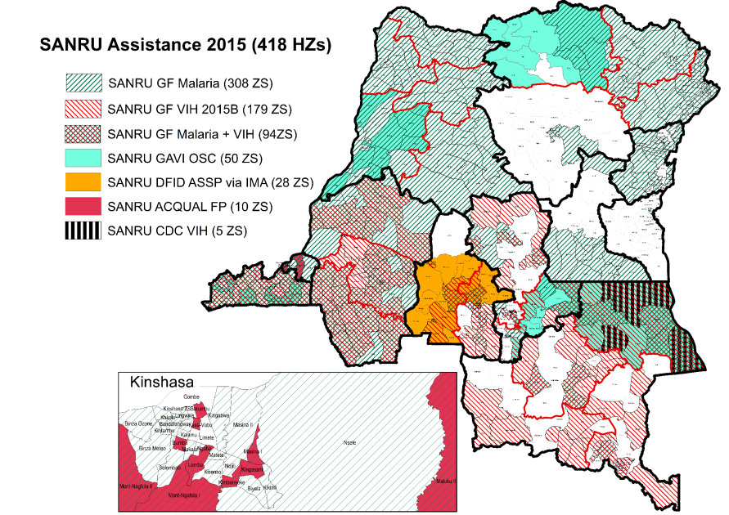
ALL SANRU PROJECTS ASSISTING 80% OF HZS

Slide 24
IN CONLUSION
SANRU’S TEAMING UP…
Increases convergence of health resources
Increases SANRU’s organizational stability
Gets more assistance to a wider population
Decreases project management costs
Improves coordination at the local level

Slide 25
TO BE SUCCESSFUL
IN COMBATTING
POVERTY IN HEALTH,
TEAMING UP IS
ONE OF THE SOLUTIONS
THANK YOU

Slide 26

Leveraging Resources: Maximizing Resources for Health Systems Strengthening and Poverty Alleviation
Dr Félix Minuku
SANRU Deputy Director

Slide 27
Introduction
A well-performing Health System is a key condition to reaching the Millennium Development Goals and reducing suffering among vulnerable populations.
With that vision, the government of DR Congo and its partners adopted in 2006 the strategy for strengthening the National Health System
National Accounts Survey for Health (2008 & 2009) found that the burden of health expenses is mostly under the community (42%)

Slide 28
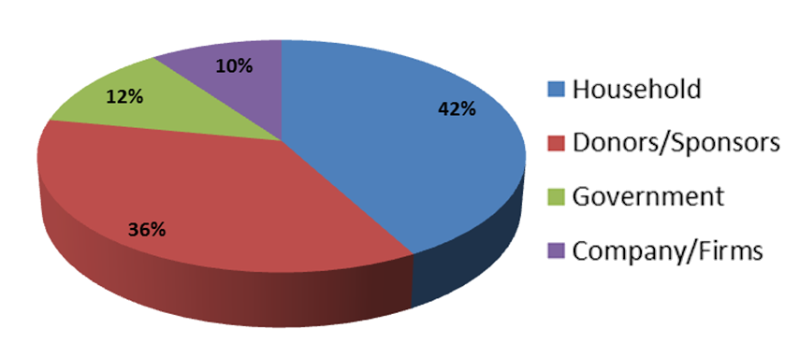
National Accounts Survey for Health (2008 & 2009) found that the burden of health expenses is mostly under the community (42%)

Slide 29
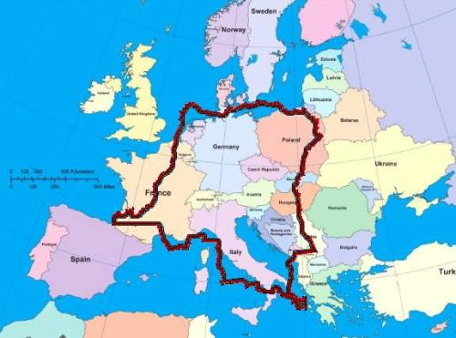
DR Congo Context
70 millions inhabitants
Only 2% of paved road.
Nat. Budget < 10 billion USD
High mortality rates
  infact (58 per 1,000)
  Child (104/1,000)
  Maternal (846/100,000)
Malaria (1/3 of consultations /Health Center)
Malnutrition: 43% among children ˂5 yrs
HIV: 1.8 % among pregnant women
Human Development Index: 187e (2011)
Last position in Global Hunger Index ( 2011)
“Post-Conflict” since the Independence in 1960: ˃ 20 wars)

Slide 30
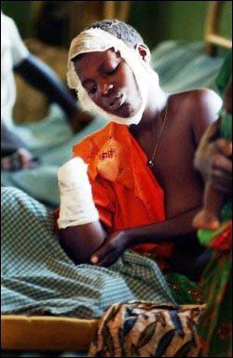
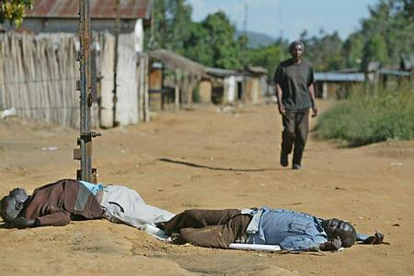
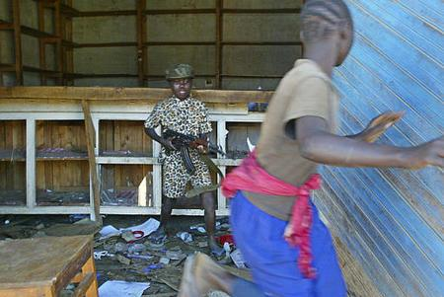
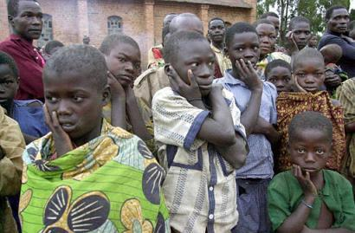
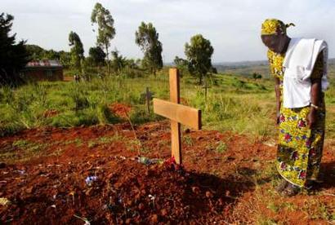

Slide 31
The Need of Resources is obvious!
MONEY +++ to help strengthing :
Human resources capacity
Equipment of Health Infrastructures
Drug availability
Affordable access to Quality care
Monitoring & Evaluation

Slide 32
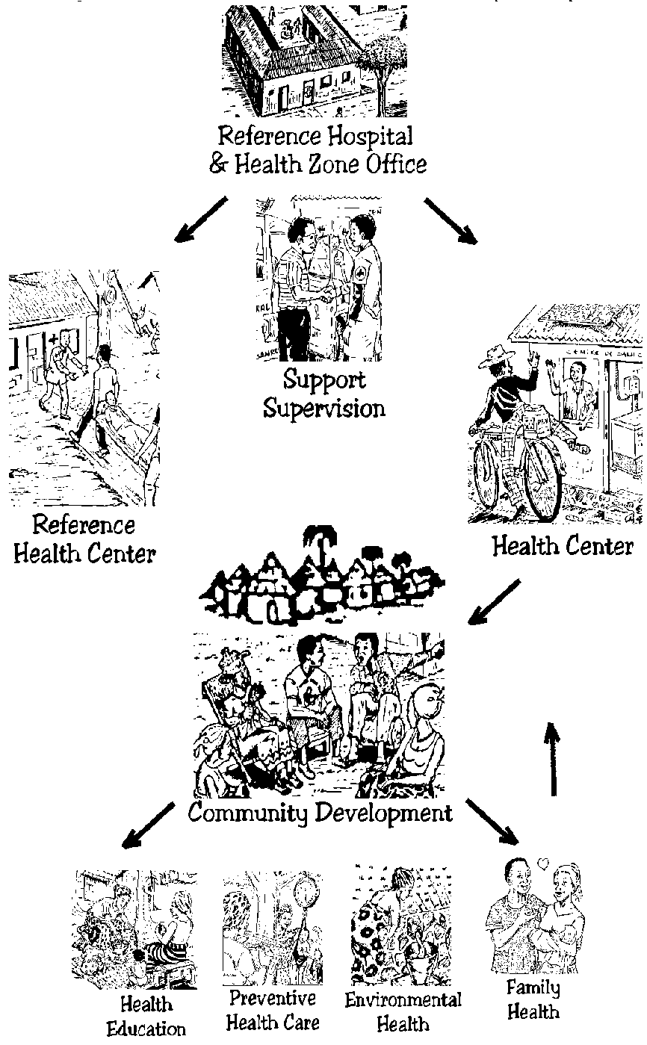
DR Congo Health System
516 Health Zones (HZ)
The Health Zone is composed of :
1 Reference Hospital
+-20 Health Centers
Catchment area of ~150 000 people
Managed from a Central office (BCZS)
Led by a HZ Medical Officer

Slide 33
VARIABLE LEVELS OF EFFORT
From 1981 to 1991:
Most HZ received support based on a comprehensive package ( appui global) for Health Center from USAID, European Union, World Bank …
Since 2000:
Most donors shifted to vertical support dealing with limited number of diseases:
  Global Fund Malaria-HIV-TB)
  PEPFAR (HIV)
  PMI (Malaria)
  GAVI (Vaccinations)

Slide 34
Leveraging Resources at the National Level
The International Group of Donor for Health (IGDH or GIBS) advocates to improve coverage and avoid duplication. Issue: Need for consensus and transparency
The GOC has (on paper) a National Plan for «Universal health care coverage». Pilot projects for Health Insurance exist for limited groups, e.g., teachers, state workers… Issue: Need for good management
The Gvt started (in 2014) an ambitious program of building and equipping 1000 HC and 66 Hospitals Issue: New political actors on scene by end of 2016

Slide 35
SANRU Strategies for Leveraging Resources
Strive to maximize resources to alleviate poverty
Seek convergence of health interventions at the HZ level even with vertical projects
Assist Provincial Health Administration (DPS) to supervise and coordinate assistance to HZ
Coordinate multiple projects from one regional office
Provide tools for M&E and Training for local partners
Empower all levels in better governance skills

Slide 36
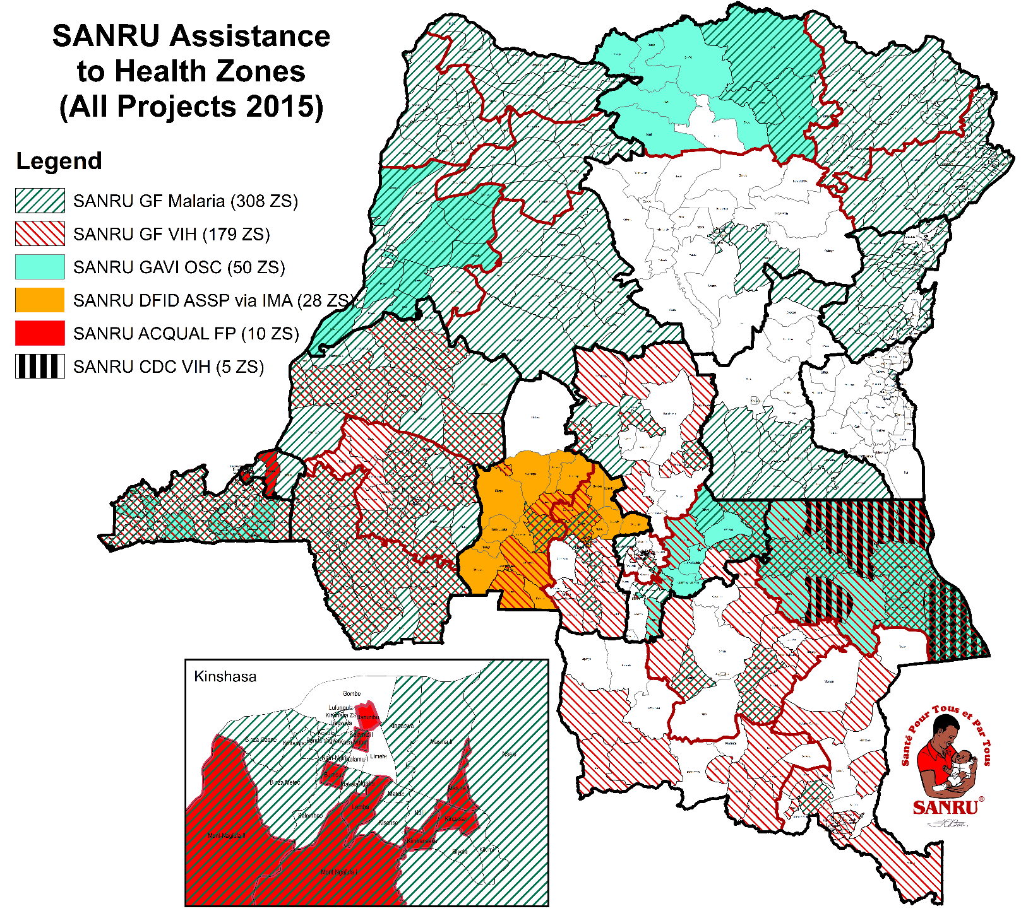
418 HZ Assisted via SANRU
(out of 516 HZs)

Slide 37
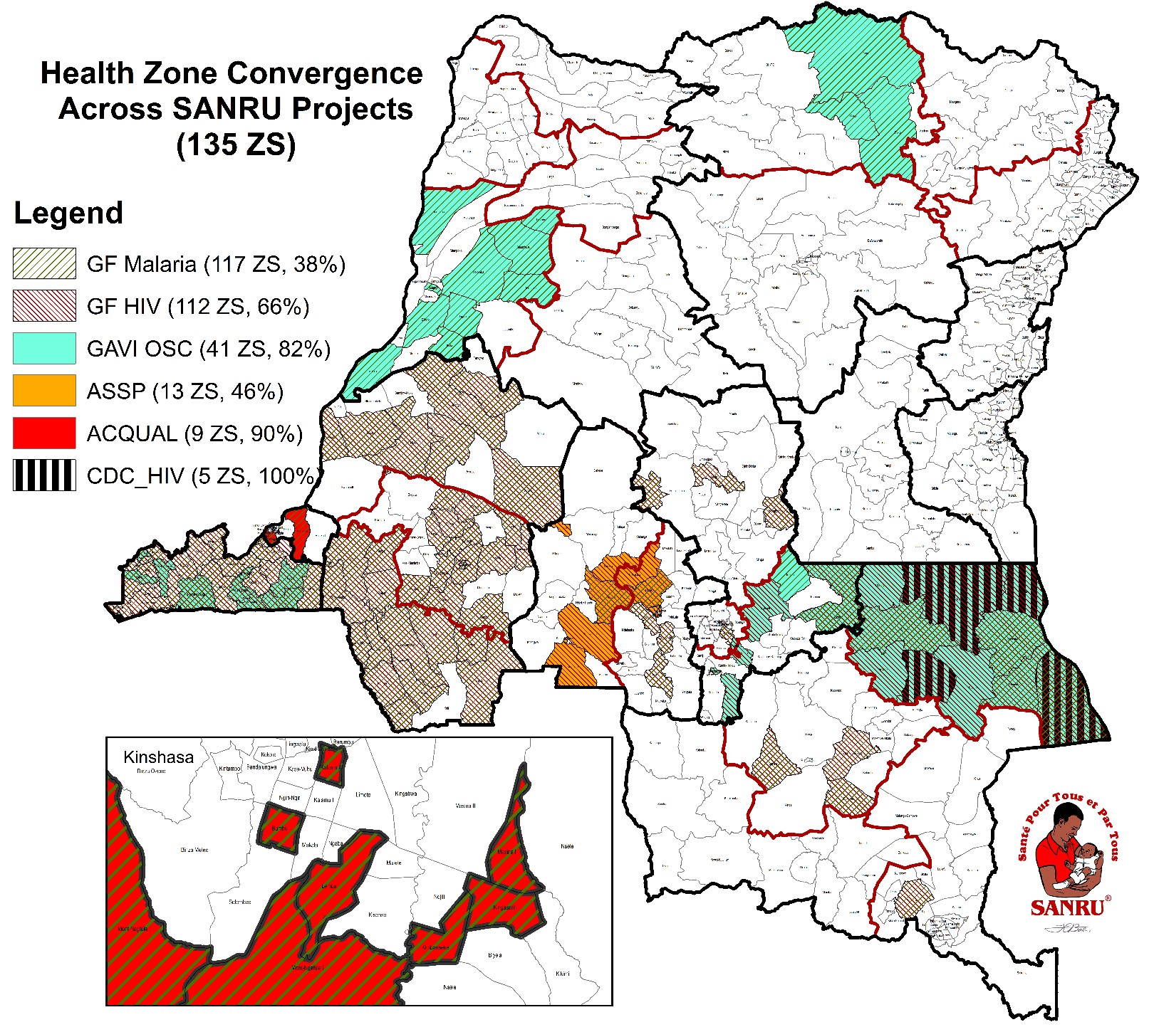
135 HZ with
“Converged”
Assisted via SANRU

Slide 38
More Comprehensive Development Assistance
A new generation of projects in DRC is embracing to more integrated/comprehensive health development that includes gardening, water/sanitation:
  DFID: Current project assisting 54 health zones via IMA (and SANRU)
  World Bank: 140 health zones with performance-based contracting for integrated services to being late 2015
  USAID: Integrated Health Projects proposed for an estimated 100 health zones proposed to begin late 2015

Slide 39
Encouraging Results from DFID-ASSP

Slide 40
In Conclusion
Leveraging and Converging HZ assistance (especially for vertical programs) can help make healthcare more accessible and affordable to needed populations
Health System strengthening depends on equity and good management beginning at the national level
Grants management organizations (like SANRU) can provide a platform for integrated/converged funding
Strengthening Health System needs the participation of all stakeholders.

Slide 41
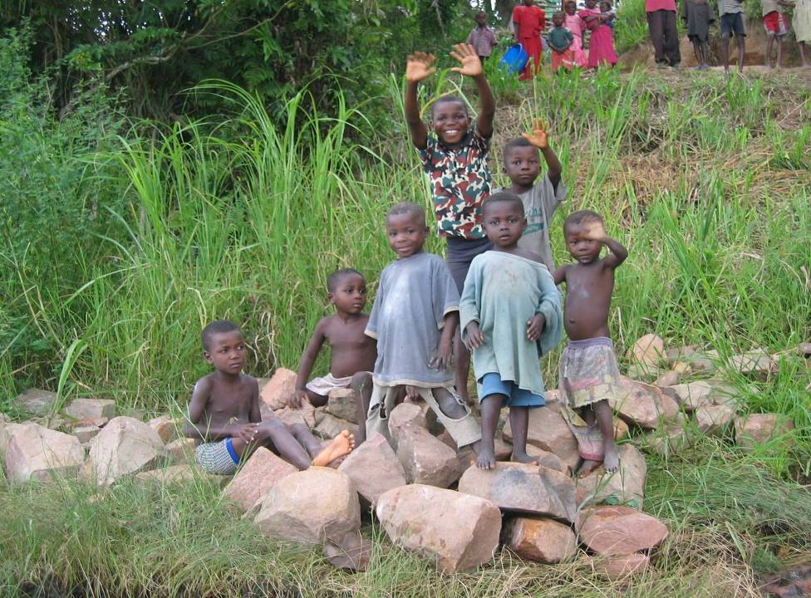
THANK YOU!

Slide 42

Combating Poverty through struggle against Malaria in DR CONGO
Dr. Albert KALONJI
Director technique, SANRU

Slide 43
Malaria: Some statistics
198 million people become infected each year.
18 countries account for 90% of infections in sub-Saharan Africa.
Nigeria (37 million infections) + DR Congo (14 million infections) = 40% of the estimated sub-Saharan African total.

Slide 44
Economical impacts of Malaria
$2 price of first-line treatment for malaria ( > 60% people in DRC live with less 1.5$/day)
Decreases productivity and increases the risk of poverty for the communities and countries affected (ex. Raining season)
Increases family health spending ( as the patient of pocket is the main source of financing the health services)

Slide 45
Economical impacts of Malaria
40% of public health spending (in highly affected country)
Slow businesses and may slow economic growth by up to 1.3% per year.
In total, malaria costs sub-Saharan Africa an estimated $12 billion in economic productivity,

Slide 46
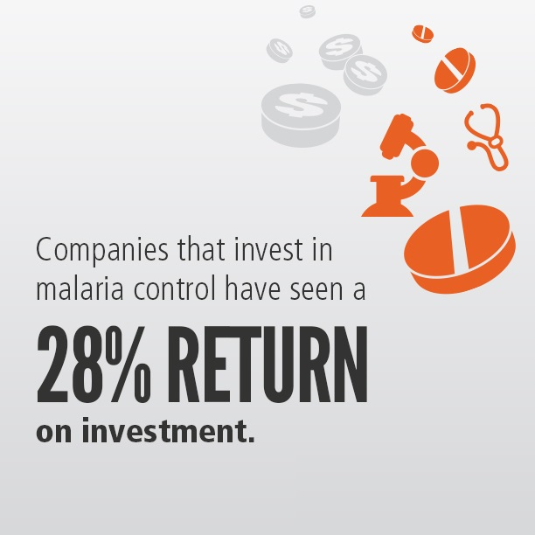
Investing in Malaria struggle has a return
The messages in Cost of Inaction: A report on how inadequate investment in the Global Fund to Fight AIDS, Tuberculosis and Malaria will affect millions of lives :
    $1 investment in malaria prevention and treatment delivers a return of $20 http://ow.ly/zvNWU#AfricaSummit
    The world could gain an estimated $208 billion by 2035 through progress against #malaria. http://ow.ly/zvNWU#AfricaSummit

Slide 47
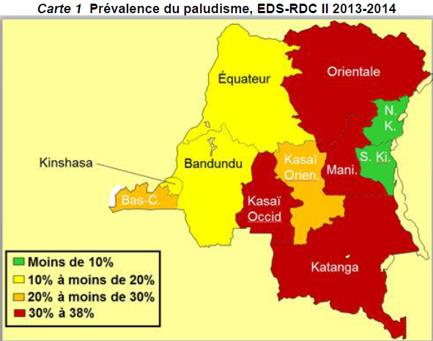
MALARIA PREVALENCE IN DRC
Moyennes nationales:
GE: 23%
RDT: 31%
PCR: 34%

Slide 48
Statistics
The country ranks second to last on the Human Development Index (186 out of 187 countries), and its per capita income, which stood at $220 in 2012, is among the lowest in the world
In 2013 a total of 11 363 817 cases of malaria were regeisterd (38 % external consultations) et 955 311 case of severe were hospitalized
30 918 deaths among the hospitalized (39 % hospitalized)
National Program Report 2013

Slide 49
Contribution of SANRU in malaria struggle
As Gloval Principal Recipient in DRC :
SANRU supports 5,669 Health Centers in 308 Health Zones out of a total of 516 HZs
SANRU covers 44,000,000 inhabitants sites
SANRU set up 2,422 Community-based care sites
13 of 19 sub-recipients are FBOs.
SANRU Supply Chain Management Support
Planned Results | 2012-14 | 2015-17
ACT Treatments | 19,942,091 | 31,293,387
LLINs (bednets) | 5,970,257 | 8,695,772
RDT (rapid tests) | 45,089,525 | 49,165,708

Slide 50





Teaming up against Malaria
5 ZS
56 ZS
181 ZS
Dont 27 MSH/SPP/UNICEF
308 ZS
/UNICEF

Slide 51

I. Case management Results trends to 2014 (2)

Slide 52
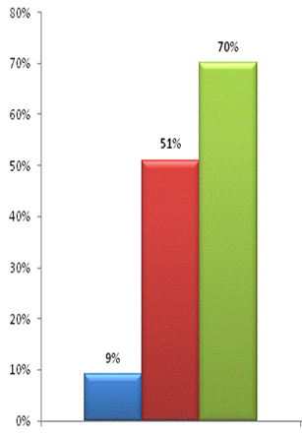
Usage of Long-Lasting Insecticide-treated Nets (LLINs)
Percentage
of Households
with a LLIN
Utilization rates by children < 5 yrs and pregnant women are equally impressive
2013-
2014
2010
2007

Slide 53
Most children still die from malaria at home!
DRC
HC
At home
80%
20%
GRH

Slide 54
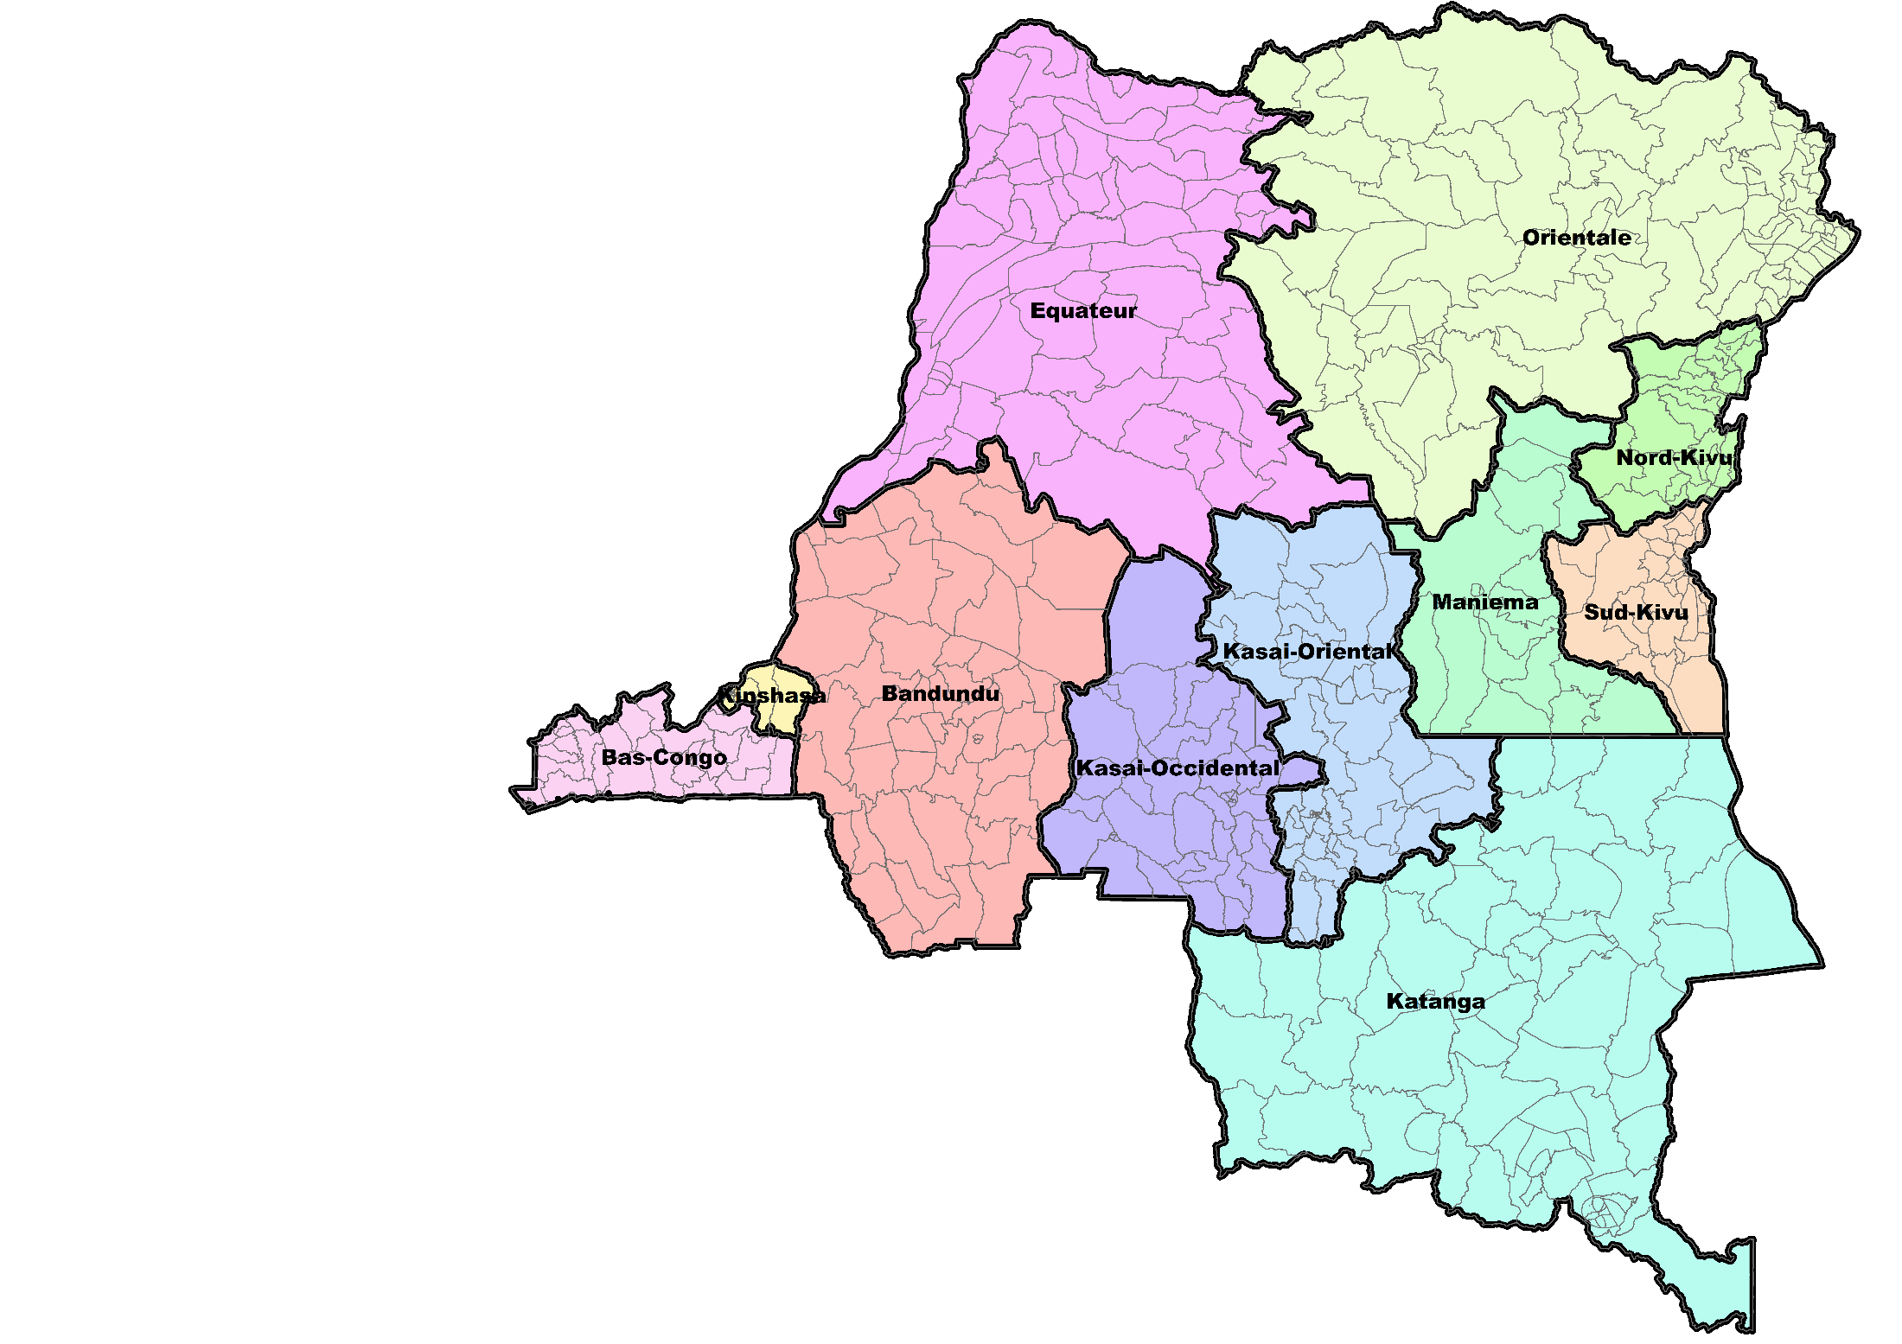
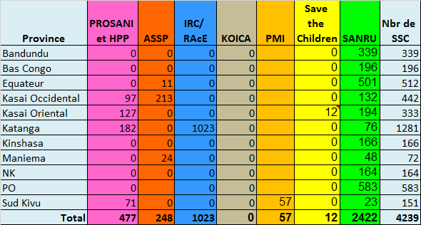
Community-Based Care Sites (SSC)
Sites/partner:
501
Prosani et HPP
ASSP
IRC/RAcE
KOICA
PMI
Save the Children
SANRU
11
583
164
24
57
127
166
132
71
23
196
194
48
339
97
213
12
76
1023
182

Slide 55
The Way to Forward
Building a partnership between the public sector, the private sector and civil society in order to effectively tackle malaria and then reach goals.
Increasing investments in health system and to incorporate malaria control into all relevant multi-sectorial activities.

Slide 56
SO, LET’S ACT NOW !

