Slide 1

COMBATTING POVERTY THROUGH STONG HEALTH SYSTEMS
BY
DR. NGOMA MIEZI KINTAUDI
MPH, Ph.D
EXECUTIVE DIRECTOR
SANRU

Slide 2

DR Congo
Notes:
What do you think of when you hear the word Congo?

Slide 3
General Information
More than 70 million people
Multisectorial crisis over two decades
Over 16 major wars since 1960
  (4 million deaths in the last one)
More than 400 tribes
Average number of children per women : 7
Analphabetization rate amount women: 44.1%

Slide 4
Some Health Key Indicators
Neonatal deaths : 28 ‰
Infant deaths (0-11 months) : 58 ‰
Child deaths (0-59 months) : 104 ‰
Maternal mortality: 846 per 100,000 live birth
Anemia prevalence among pregnant women: 43%
Average annual household health expenditures: $206

Slide 5
What is poverty?
State or condition of having little or no money, goods, or means of support, conditions of being poor
  Absolute poverty: is synomous with destitution and occurs when people can not obtain adequate resources (measured in trem of calories or nutrition) to support a minimum level of physical health
  Relative poverty: occurs when people do not enjoy a certain minimum level of living standard as determined by a government.

Slide 6
What is a health system?
A health system consists of all organizations, people and actions whose primary intent is to promote, restore or maintain health (WHO)
A health system, also sometimes referred to as health care system or healthcare system, is the organization of people, institutions, and resources that deliver health care services to meet the health needs of target population (Wikipedia)

Slide 7
What should be considered when developing a health system?
Take into account: the needs of its people and resources available
Consider all who can implement: government, religious organizations, trade unions, charities or other coordinated bodies to deliver planned health.
A health system must be a pyramid of publicly owned facilities that deliver personal health services (e.g., mother caring for a sick child, vector-control campaigns, safety legislation, etc…)

Slide 8
Certain Health Issues to Consider for
Poverty Reduction in D.R. Congo

Slide 9
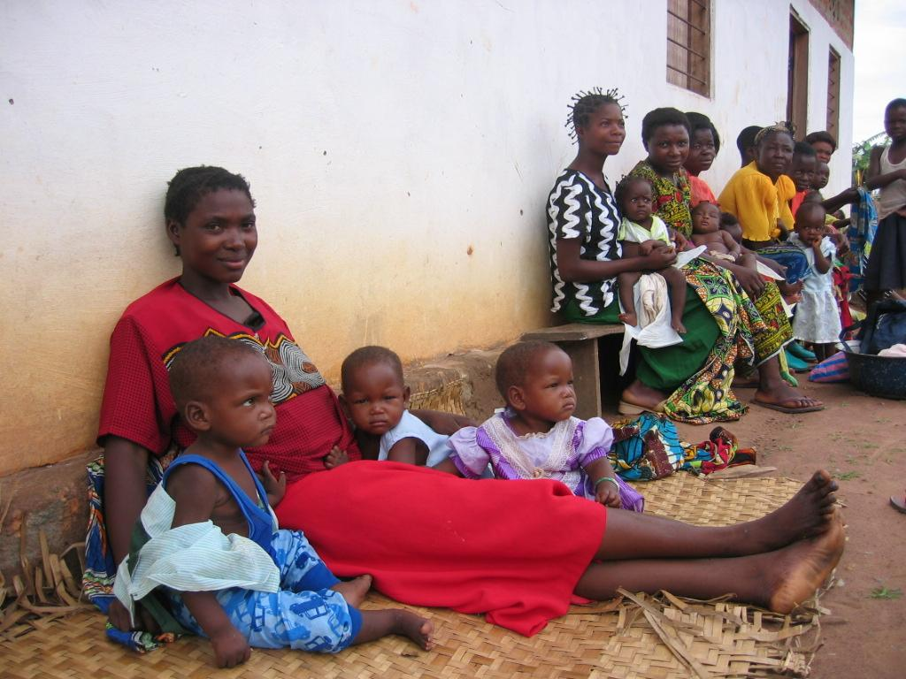
1. Number of children per household
Mother of many children (average 7)

Slide 10
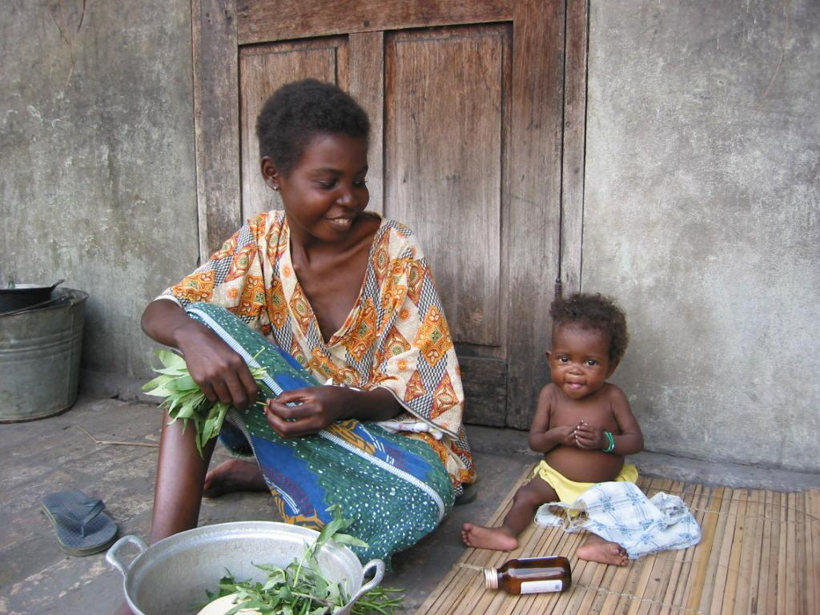
2. Poor Health conditions
Housewife and also key provider

Slide 11
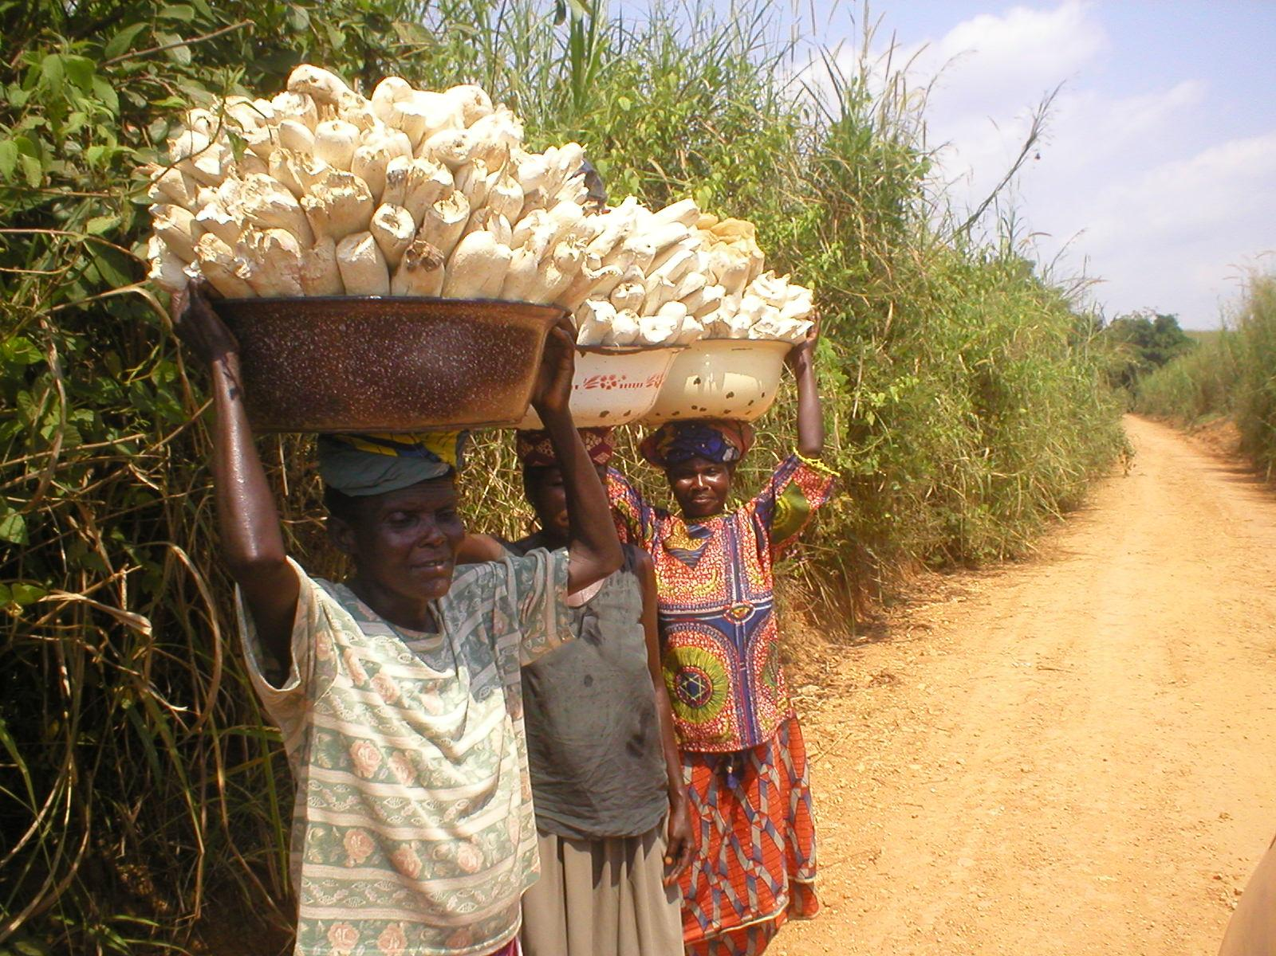
3. Main provider in house
Worker, producer, financial person …

Slide 12
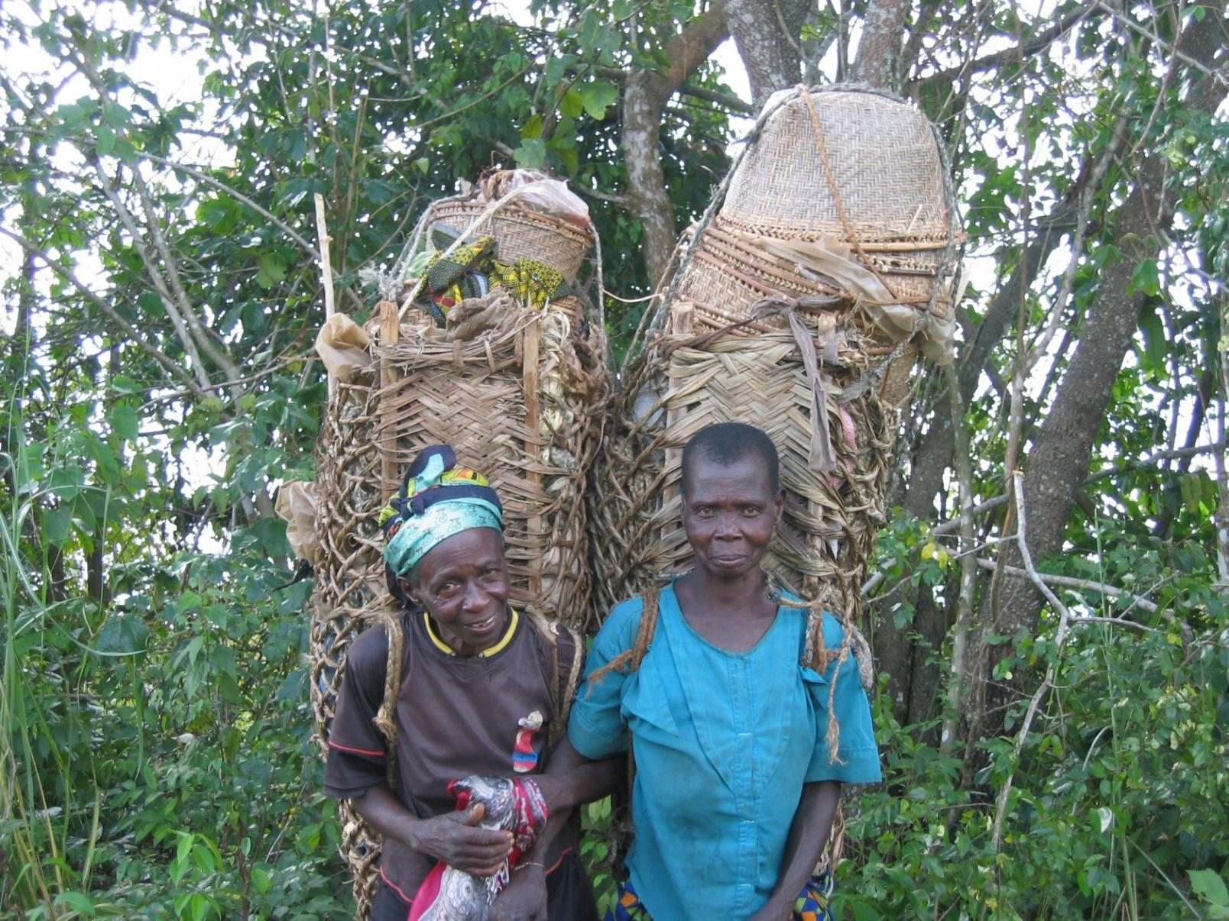
4. Social status
Second rank citizens

Slide 13
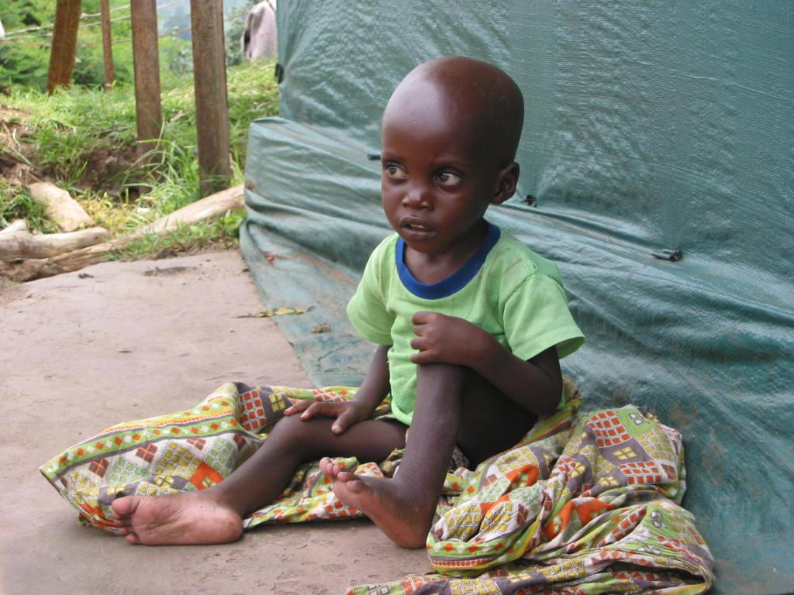
5. Chronic illnesses
Underweight, malnourished, vulnerable to illness

Slide 14
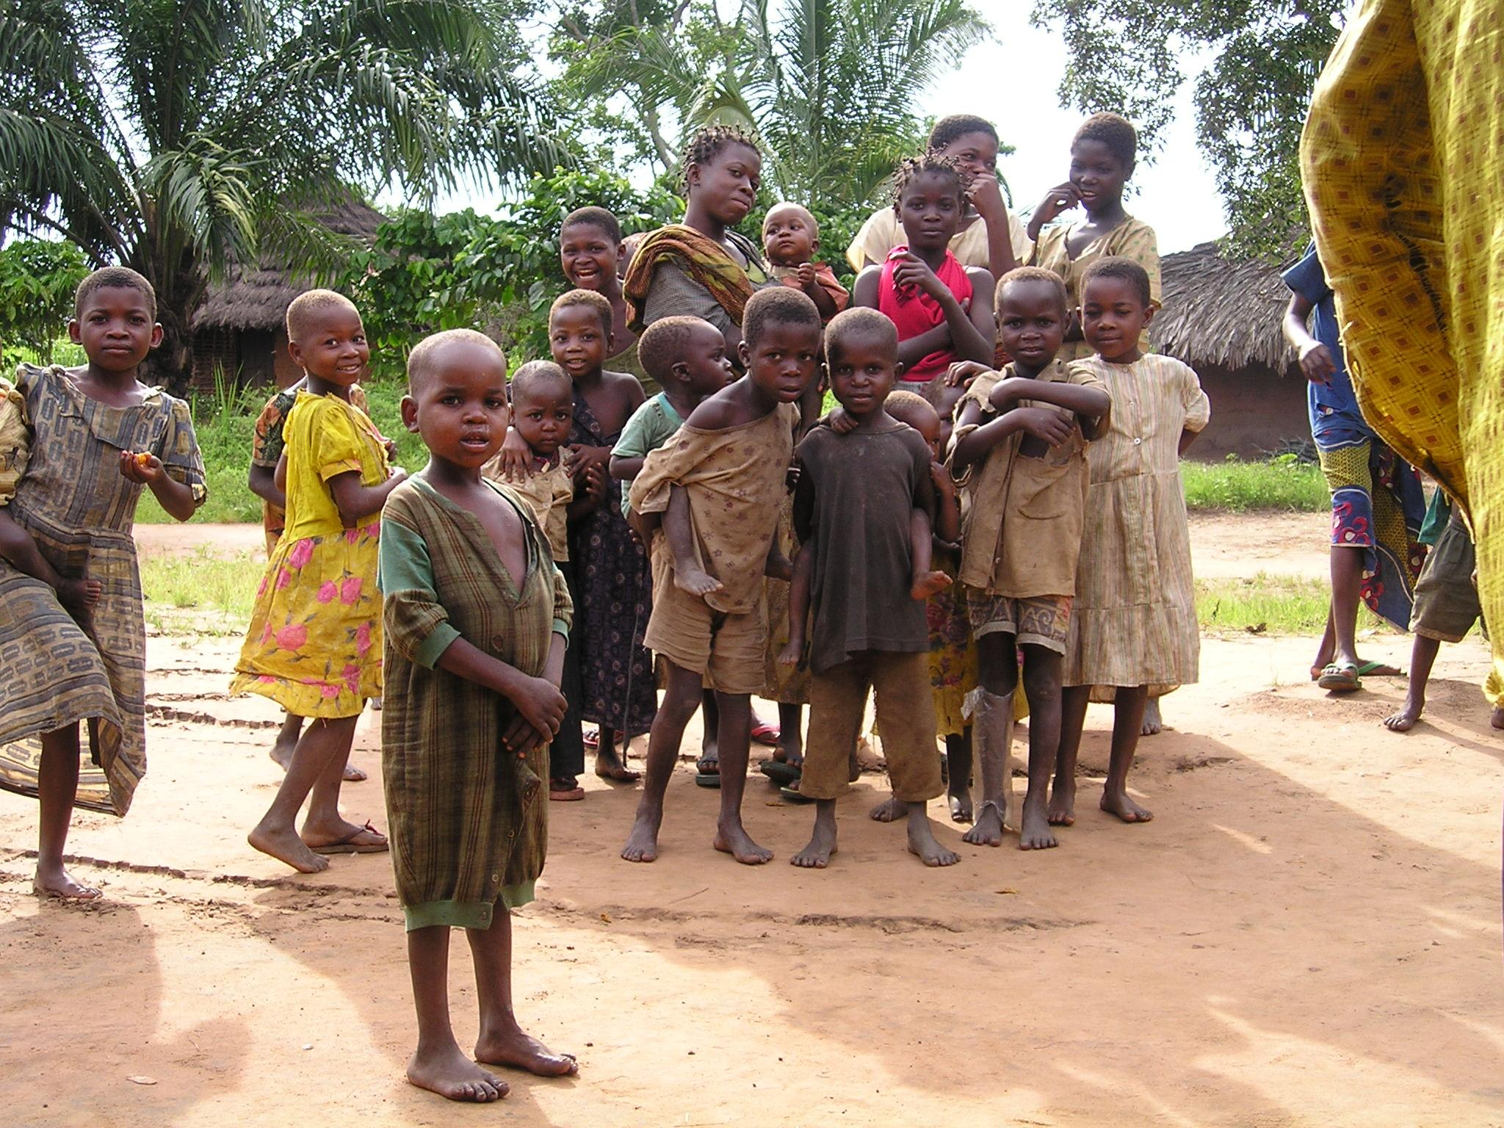
6. Lack of schools

Slide 15
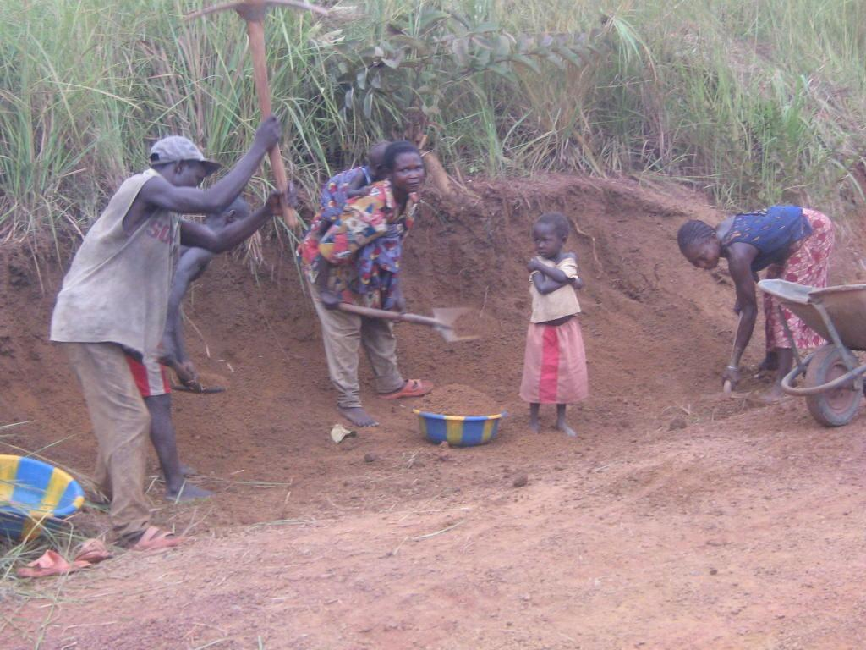
7. Lack of employment

Slide 16
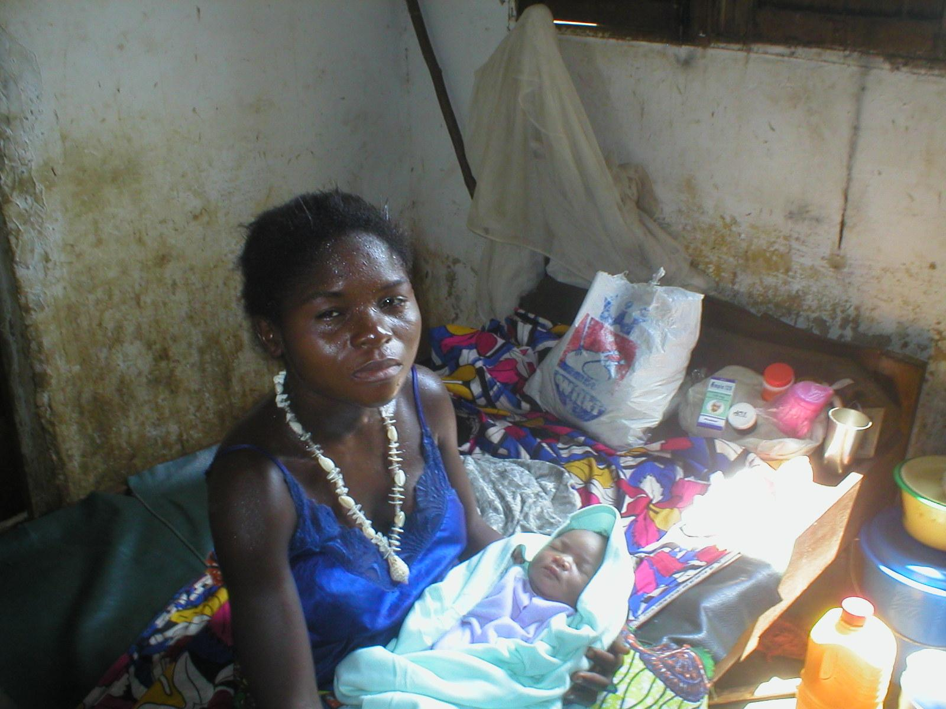
10. Premature motherhood

Slide 17
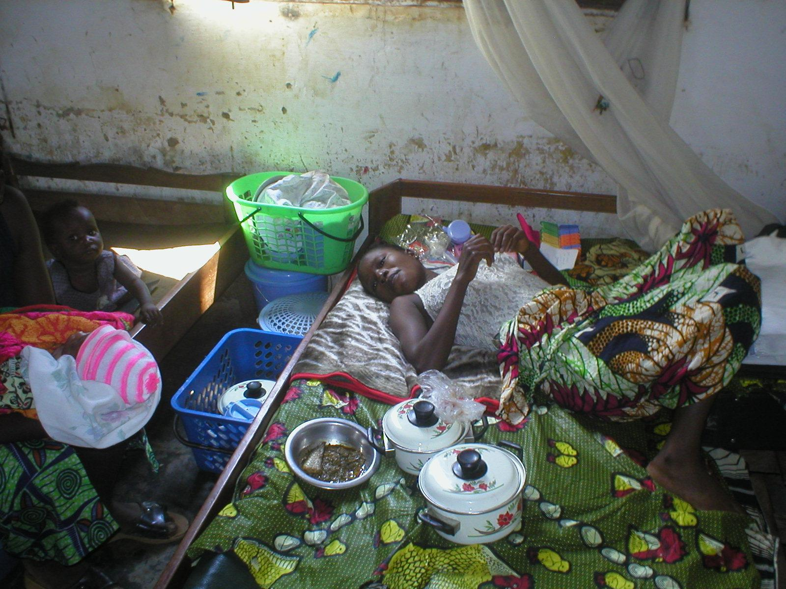
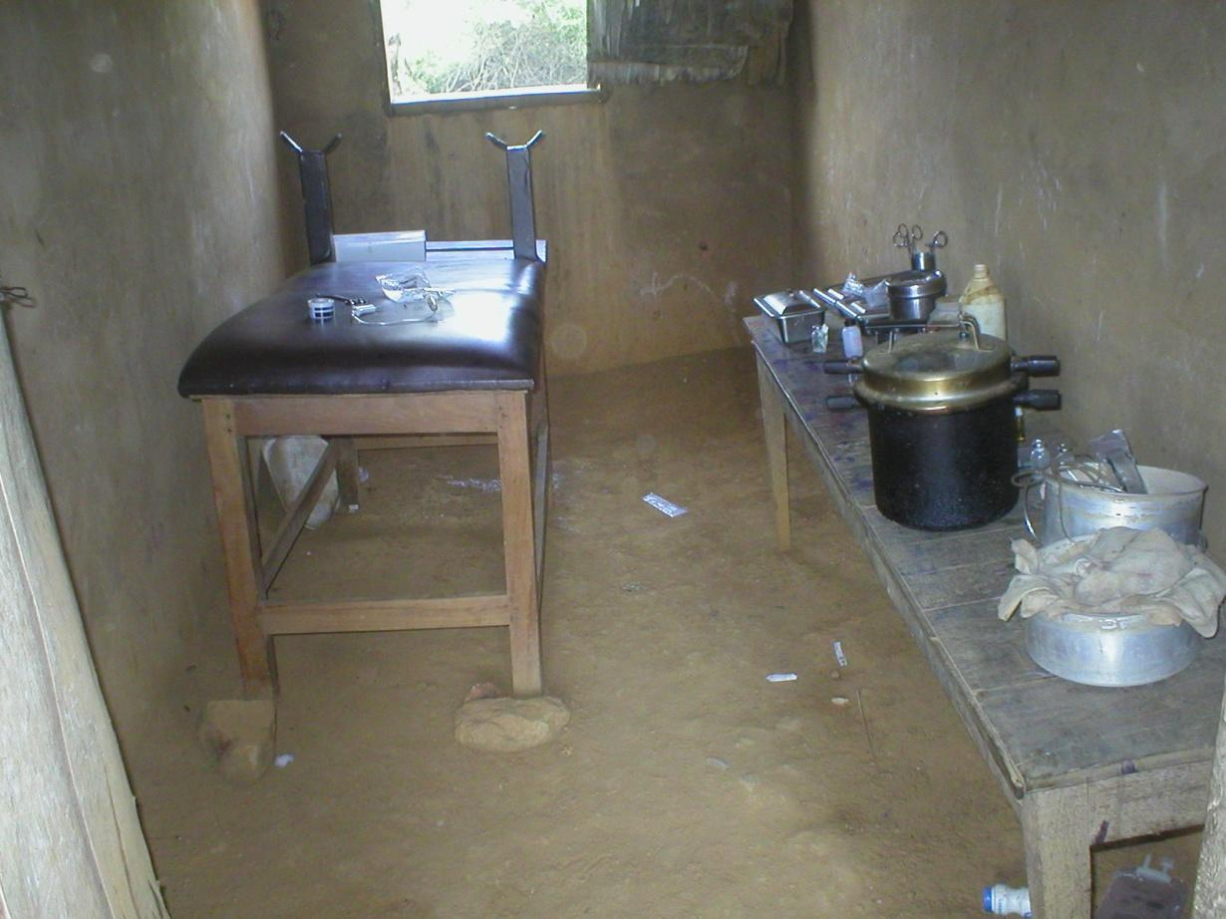
9. Poor health facility conditions

Slide 18
National Level Actions by SANRU
Grants Management of large projects:
  Global Fund: 20+ contracts to SRs totaling $100M/yr
  GAVI: Contracts with key Civil Society Organizations
Convergence of Assistance from multiple projects to improve funding per HZ (and reduce overhead)
Mapping donor assistance to reduce duplication of efforts and improve equity of resources.
Advocacy with MOH and donors for projects that really get of resources to communities in need.

Slide 19
More Actions Undertaken by SANRU
Strengthening PHC activities (ante-natal & well-child clinics, family planning, post-natal care, vaccination, etc…)
Health education and behavior change
Water and sanitation
Malaria & HIV prevention /treatment
Training of health teams
Essential drugs supply
Health Zone development assistance

Slide 20
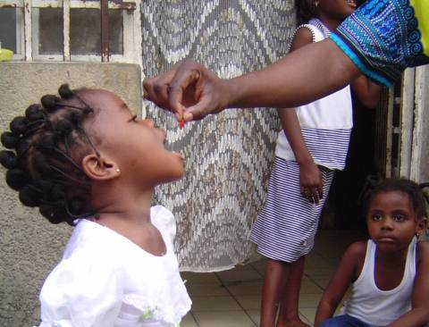
Vaccinations

Slide 21
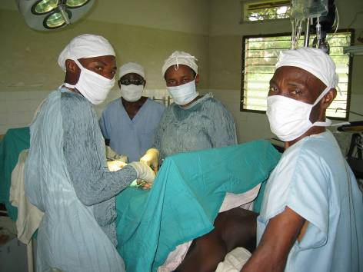
Curative care

Slide 22
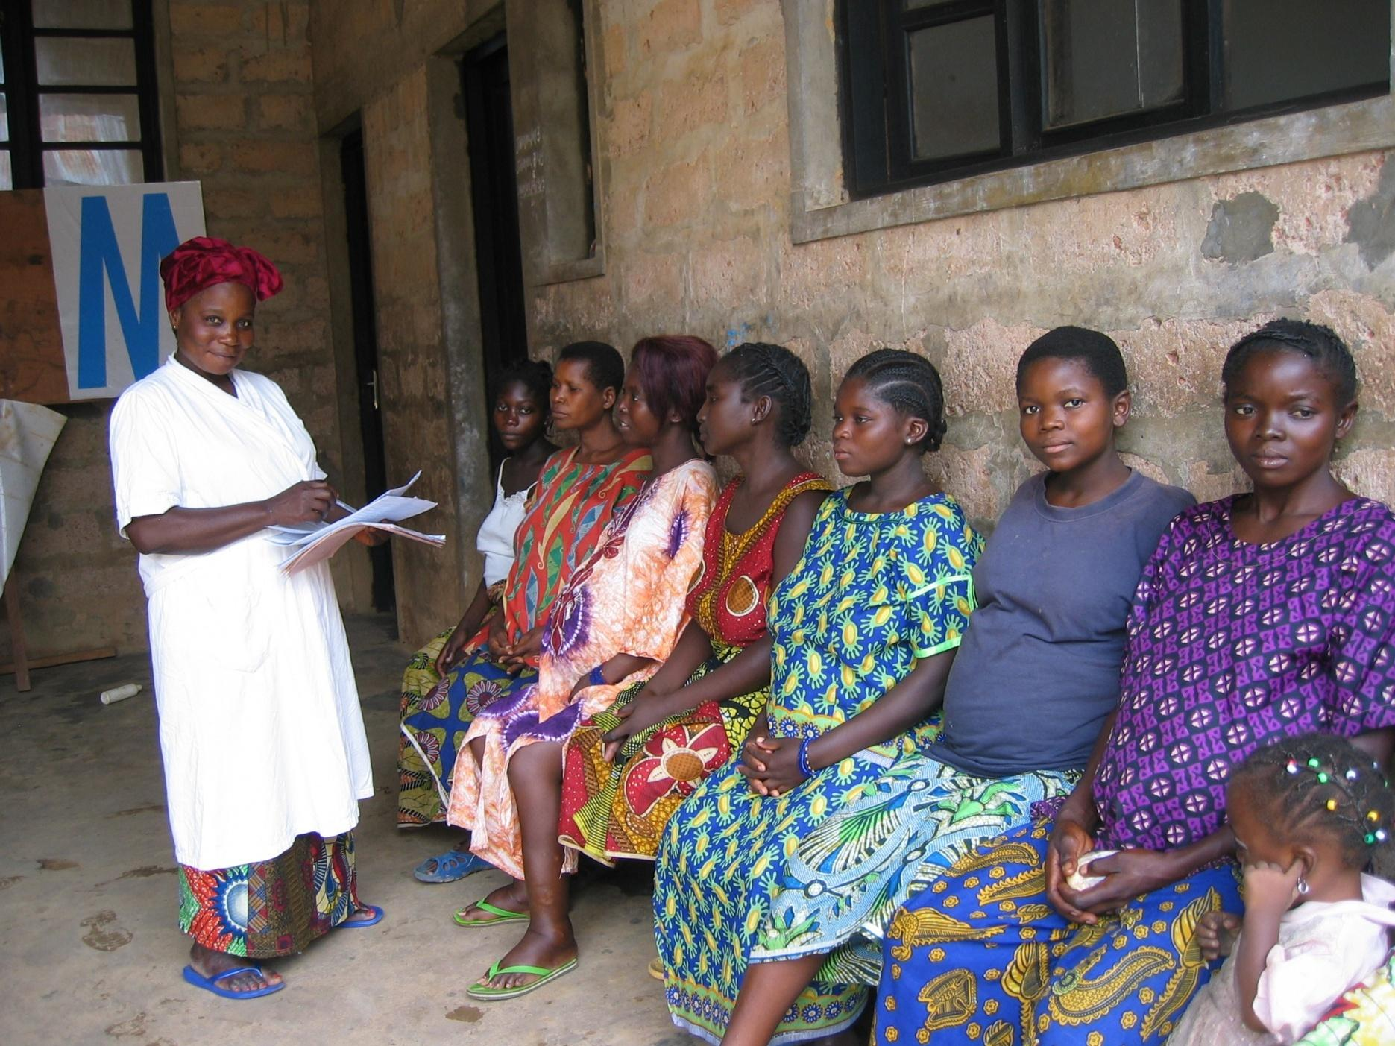
Prenatal care

Slide 23
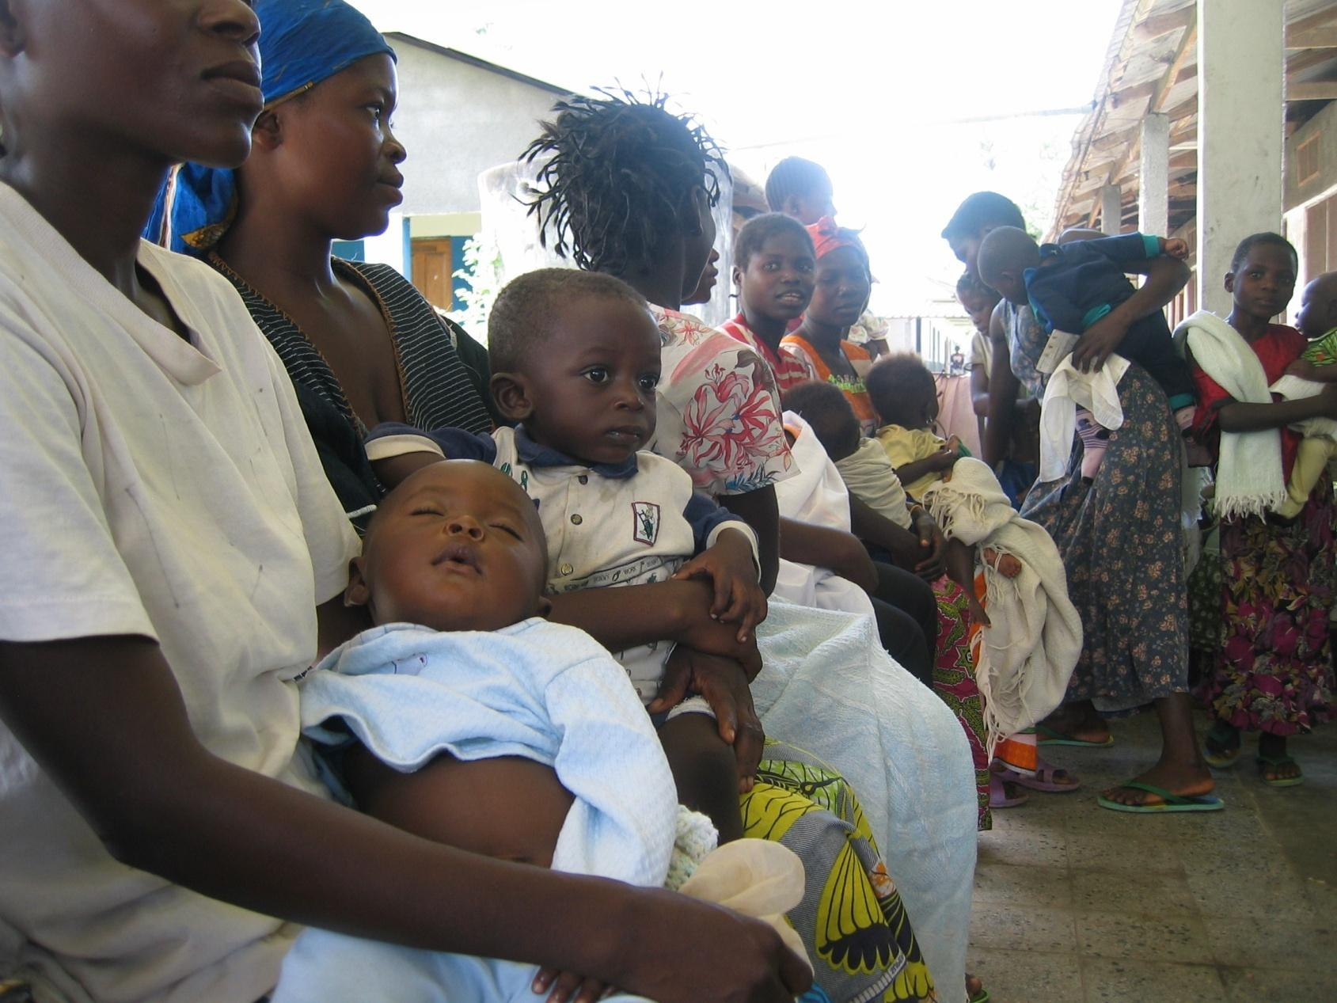
Well child care

Slide 24
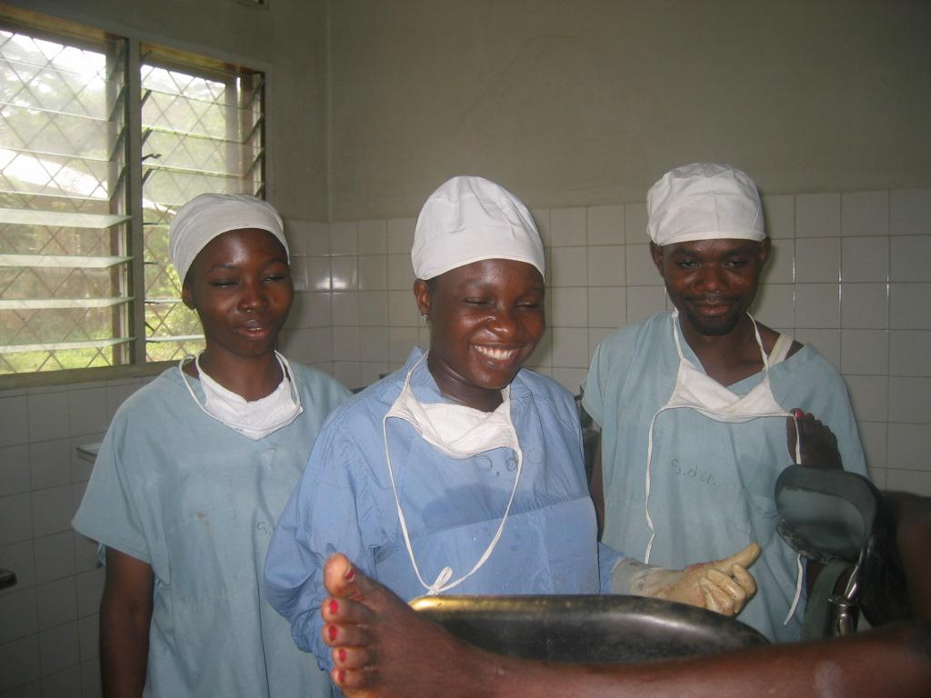
Quality of care (nurses and doctors)

Slide 25
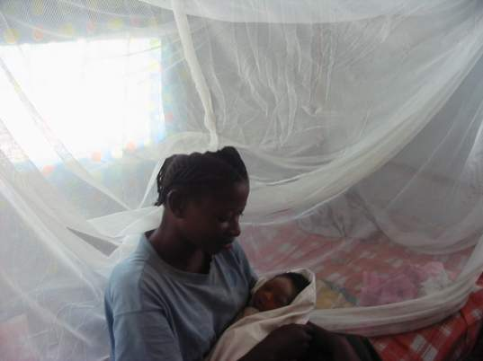
Preventive care (use of LLINs)

Slide 26
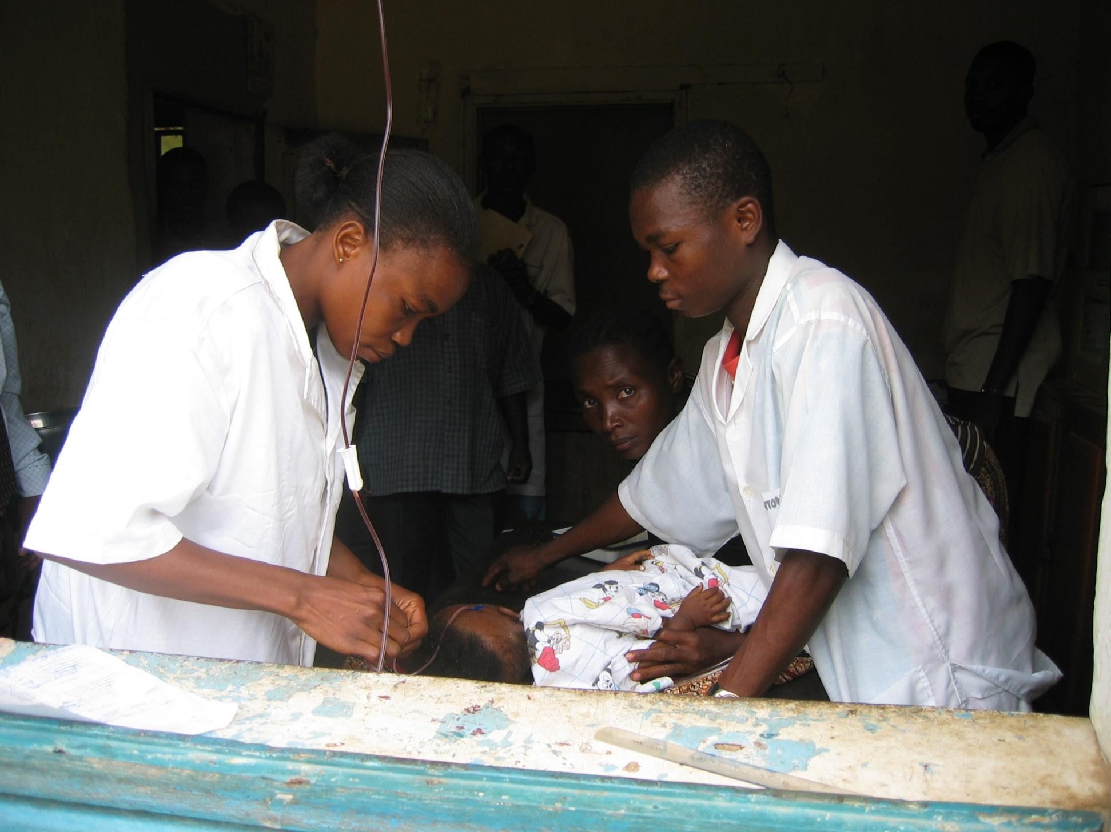
Blood safety

Slide 27
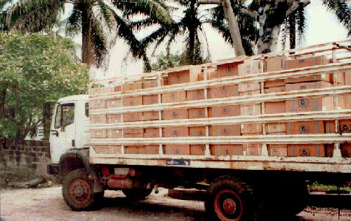
Essential drugs supply

Slide 28
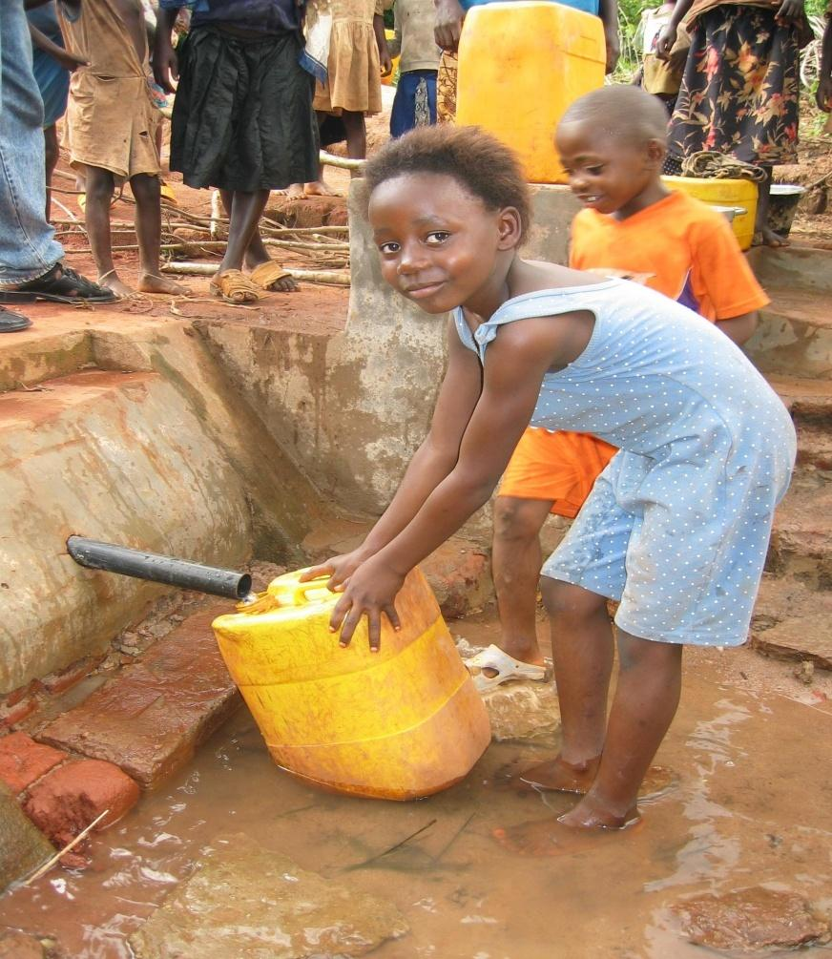
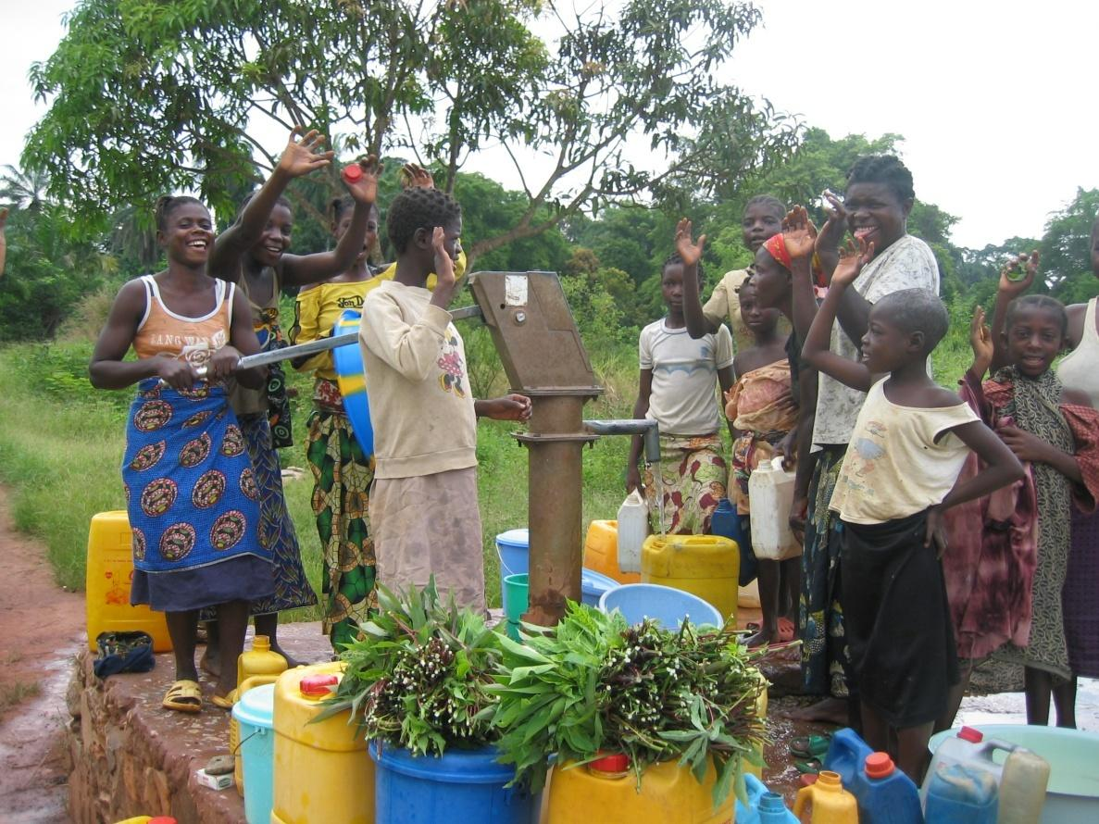
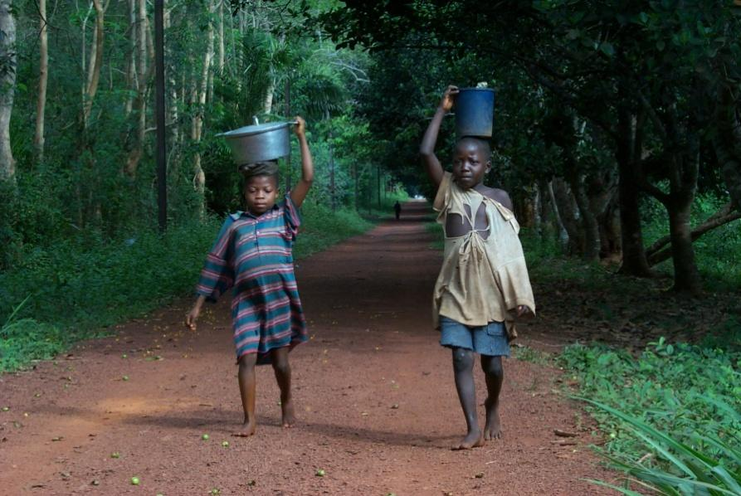
Water and sanitation

Slide 29
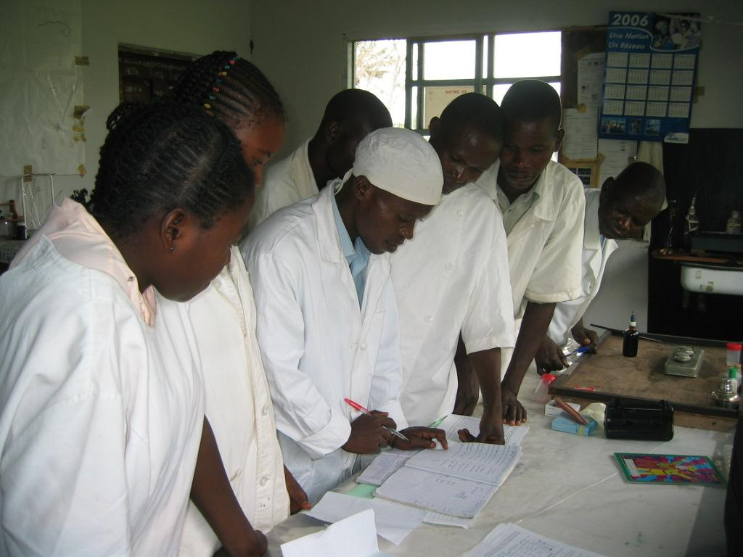
Training of health teams

Slide 30
Our Vision
Poverty cannot be reduced unless we have a healthy community, therefore:
  Service delivery has to improve
  Communities must be aware of what needs to be done, better facilities, and congregational-based care;
  Assist and strengthen health system management
  Existence of national support, advocacy, improve grants management

Slide 31
THANK YOU

