Slide 1

SANRU’s Experiences with Malaria program in DR CONGO
Dr. Albert KALONJI
Director technique, SANRU

Slide 2
SANRU’S MISSION
SANRU strives to actively promote and improve the health of Congolese particularly the most vulnerable.
Our Slogan : “HEALTH FOR ALL AND BY ALL”

Slide 3






SANRU: A Success story of partnership between USG, GOC and Faith-based partners
+
=
+
SANRU I (1981-86) 50 Health Zones
SANRU II (1986-91) 100 Health Zones
SANRU III (2001-06) 60 Health Zones
AXxes Project (2006-2010): 57 Health Zones

Slide 4
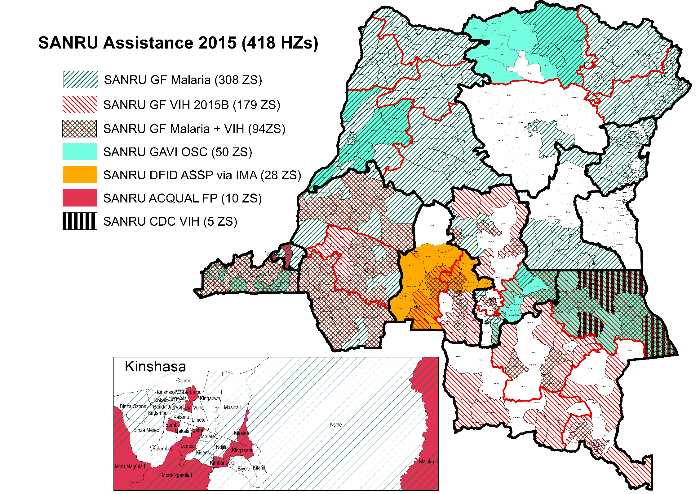
Today, SANRU projects assists 418/516 HZs

Slide 5
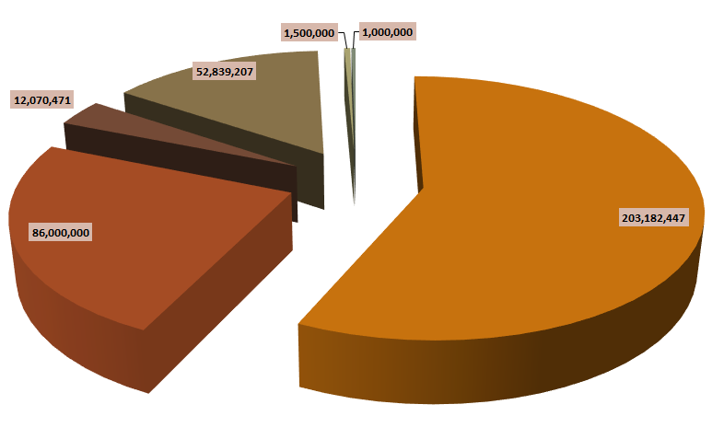
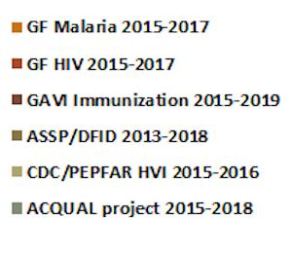
SANRU FUNDING FOR 2015-2018
1.5M USD
PEPAR
1M USD
52M USD
12M USD
86 Million USD
203 Million USD

Slide 6
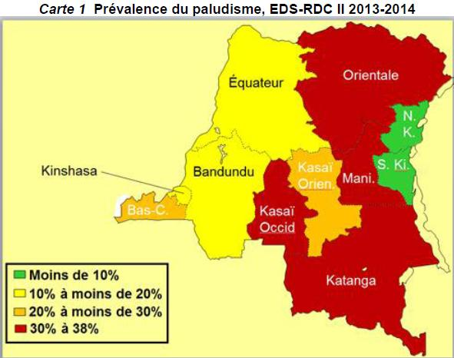
MALARIA PREVALENCE IN DRC
DR Congo has 11% of malaria cases in Sub-Saharan Africa

Slide 7





Teaming up against Malaria
5 ZS
Many donors are teaming up to combat malaria in the 516 health zones of DR Congo.
56 ZS
181 ZS
308 ZS

Slide 8
As Global Fund PR for Malaria SANRU Supports
308 Health Zones
5,669 Health Centers
2,422 Community Care Sites
44 Million people
68% (13/19) of GF SANRU funding is managed through FBO Implementing partners

Slide 9
Impressive Results
70% of households own at least one LLIN (9% in 2007)
56% of children under five slept under LLIN (6% in 2007)
60% of pregnant women slept under LLIN (7% in 2007
96% of cases reported were treated (61% in 2012)
(Sources: DHS 2007, DHS 2013-2014), PNLP National Report 2014

Slide 10
Much Remains to be Done
Only 14% of pregnant women received IPT (5% in 2007 )
29% of children < 5 with fever were treated by health centers
  but only 6% received ACT (the recommended treatment)
  and 71% never came to the health center

Slide 11
The Way Forward
Build and reinforce a partnership between the public sector, the private sector and civil society in order to effectively combat malaria.
Increase and sustain investments in the health system to incorporate malaria control into all relevant multi-sectorial activities.

Slide 12
SO, LET’S ACT NOW !

