Slide 1
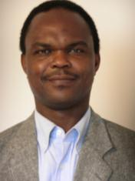
Pictures Contributed by Dr. Sambe Duale
Note: Dr. Sambe Duale was a Medical Director of Karawa Health Zone at the beginning of the SANRU I project. At that time M. Nlaba Nsona was the SANRU Project Director, Dr. Miatudila Malonga was the MOH representative, and Dr. Franklin Baer was the Project Manager. Dr. Duale moved from Karawa to Kinshasa to become the Technical Director of the Supervision Division of the SANRU I project. Upon the retirement of M. Nlba Nsona in 1985, Dr. Duale became the Director of the SANRU II Project with Dr. Kalambay Kalula as the MOH representative and Dr. Franklin Baer continuing as Project Manager.

Slide 2
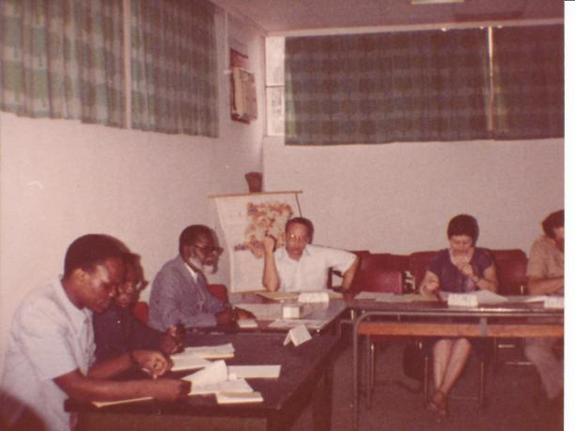
A SANRU I Review Meeting in 1982
L to R : Dr. Duale (MCZ, Karawa), Dr. Luvivila (SG, MOH), Papa Nlaba (Dir, SANRU), Mr. R. Thornton (HPn Lead, USAID), ..

Slide 3
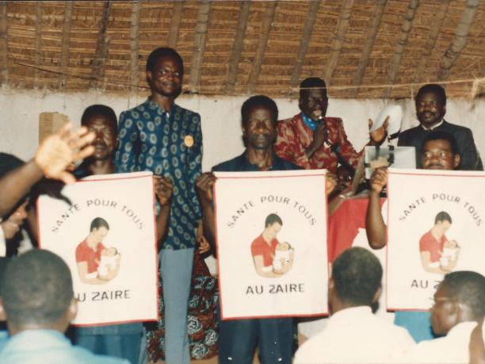
Village Sanitation Program
SANRU Flag awarded to villages with good sanitation and water program in the Karawa Rural Health Zone . (1983)

Slide 4
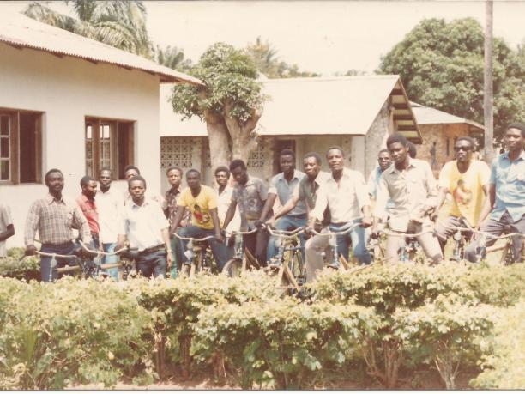
SANRU II Bicycles (1986)
Health Center Chief Nurses of the KARAWA Health Zone posing with their new bicycles

Slide 5
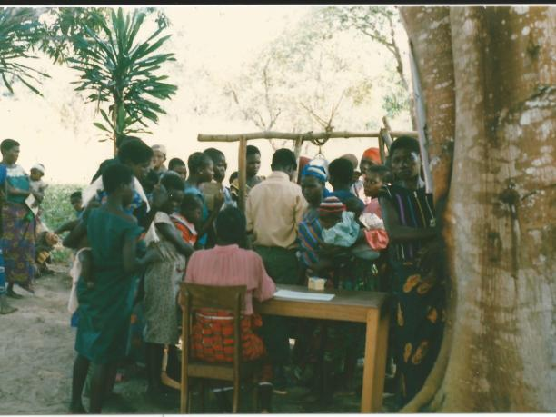
Child Growth Monitoring Session
A child growth monitoring and immunization session in a remote village in one of the Rural Health Zones in Zaire.

Slide 6
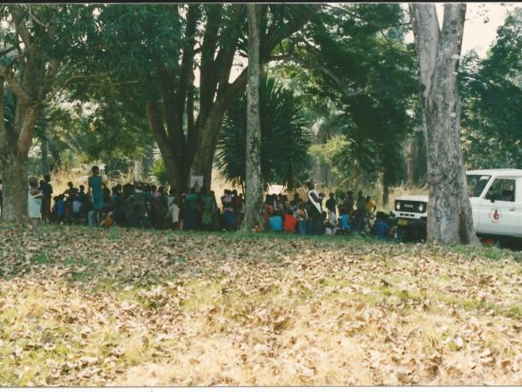
SANRU II Vehicle
A SANRU II vehicle is being used by a Health Zone Team to deliver child health services in remote areas

Slide 7
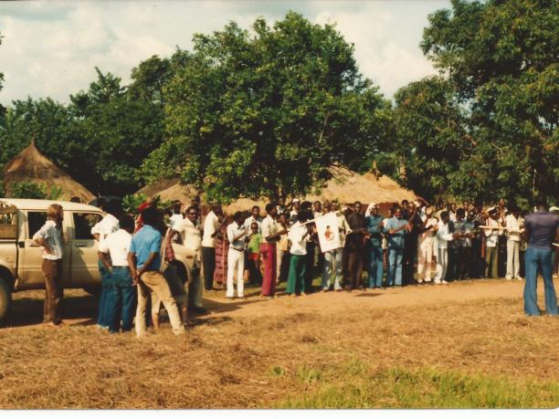
Field Visit by USAID Evaluation Team
A Community mobilization in the Karawa Health Zone to showcase community-based health activities to a USAID Evaluation Team of the SANRU Project. (1986)

Slide 8
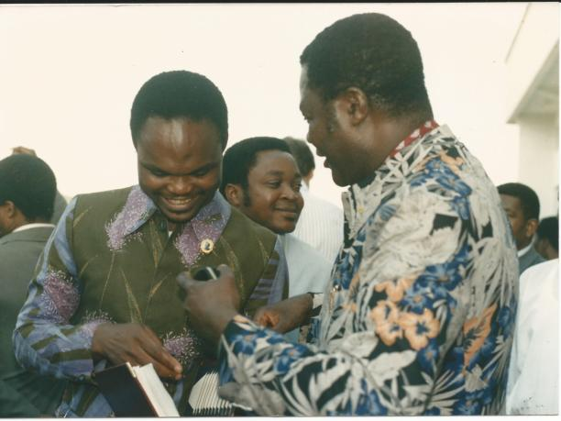
Public Health Leadership Development
Dr. Duale, SANRU Project Director and Prof. Kashala, Director of the Kinshasa School of Public Health having a chat after the official opening of the 1988-1989 Academic Year

Slide 9
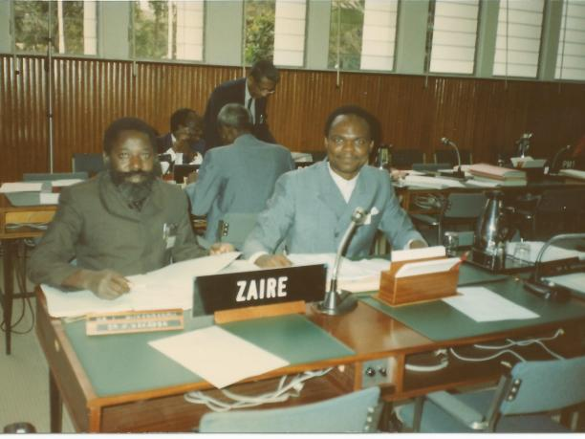
Primary Health Care in Zaire
Dr Makamba, Director of Sante pour Tous Project (Urban) and Dr. Duale, Director of SANRU Project (Rural) represented Zaire at a WHO-convened meeting to review progress in the implementation of primary health care in Africa. (1989?)

Slide 10
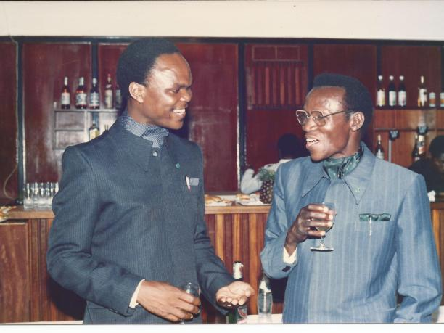
Taking Stocks of PHC Implementation
Dr. Duale, SANRU Project Director having a chat with Dr. Luvivila, Secretary General, Ministry of Health, Kinshasa, Zaire.

Slide 11
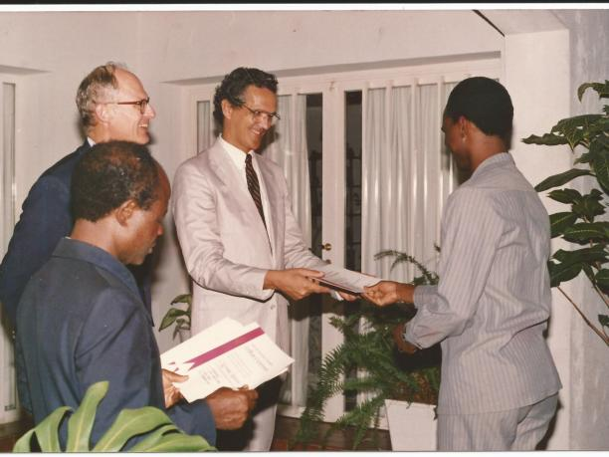
Post-Graduate Public Health Training
Dr Duale of SANRU receiving a certificate from Dennis Chandler, USAID Mission Director , in the presence of US Ambassador William Harrop during an award ceremony to recognize Zairian participants of the USAID-funded Post-graduate Training Program.

Slide 12
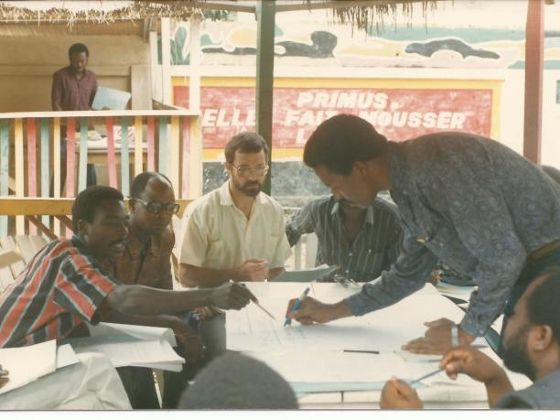
Public Health Planning and Management
Participants in a working group session during one of the SANRU-sponsored workshops on the implementation of primary health care

Slide 13
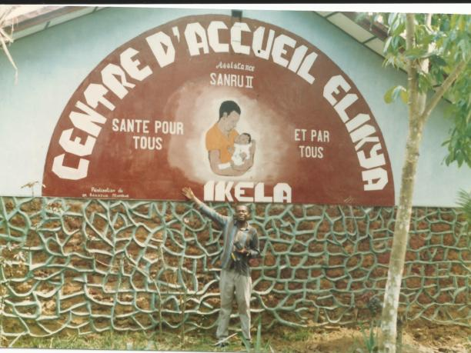
Infrastructure Rehabilitation
Dr. Bakaswa, MCZ of Ikela, proudly presents a building that was rehabilitated with funding from SANRU II Project.

Slide 14
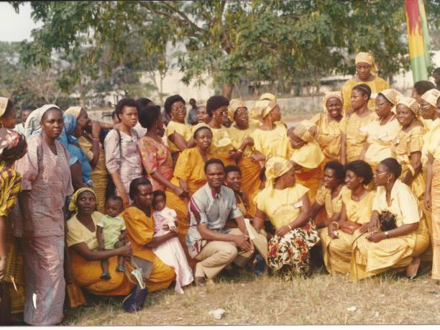
Mobilizing Women for Safe Motherhood
Dr. Duale of SANRU poses with Protestant women leaders after giving a seminar on family planning and safe motherhood during the ECZ Annual Meeting in 1989.

Slide 15
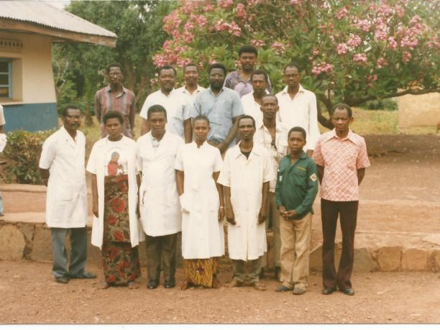
Supervision
The Medical Inspector of the North Ubangi District poses with staff of the Central Office of the Bosobolo Health Zone. The supersion was made possible with funding from SANRU (1987)

Slide 16
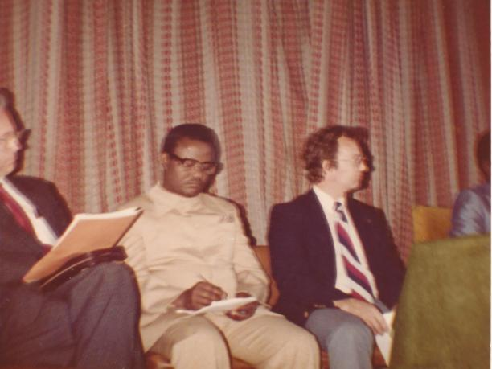
MOH and USAID Partnership
Prof. Kaba Sengele, Minister of Health, and Richard Thornton, Chief USAID Health Office, attend an Annual SANRU Conference (1982?)

Slide 17
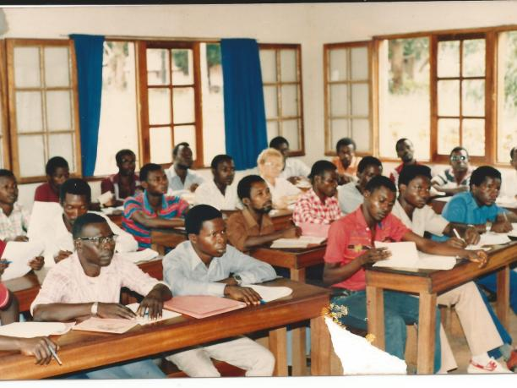
PHC Continuing Education
Karawa Health Zone Health Center Head Nurses attending a continuing education workshop. (1987)

Slide 18
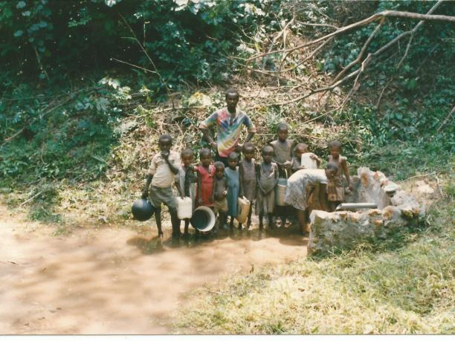
Safe Drinking Water
A protected water source made possible with funding from SANRU in Karawa Health Zone

Slide 19
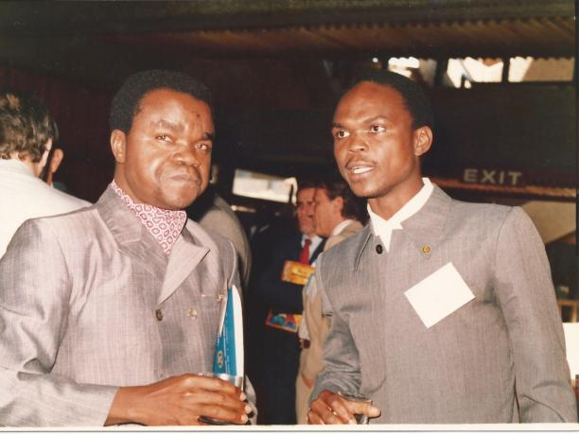
1st International Safe Motherhood Conference
Dr. Miatudila and Dr. Duale of Zaire at the 1987 1st International Conference on Safe Motherhood, Nairobi, Kenya.

