Slide 1
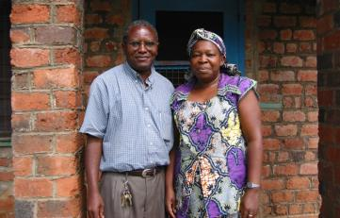
Pictures contributed by
Kambale Sadraka Soheranda
Dr. Kambale, shown below with his wife, served as the Health Zone Medical Director (MCZS) of Oicha health zone since its creation in 1982. He is generally recognized as having been the longest serving MCZS.

Slide 2
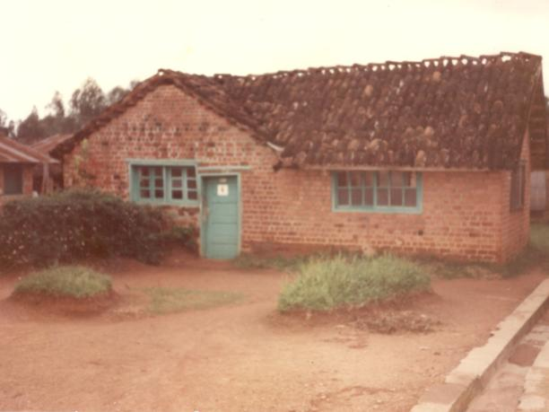
The Central Health Zone Office of Oicha HZ, 1982

Slide 3
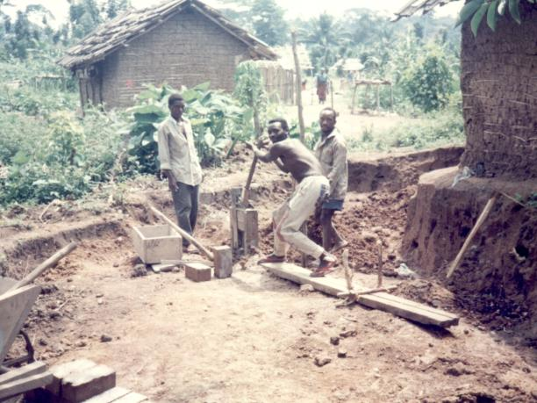
Community Participation, Oicha HZ, circa 1982

Slide 4
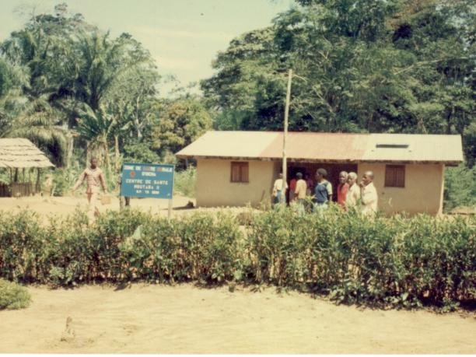
Mbutata Health Center, Oicha, HZ, 1988

Slide 5
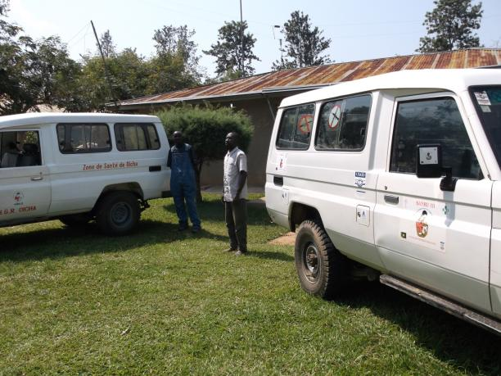
Oicha Health Zone Vehicles (SANRU I, II, III)

Slide 6
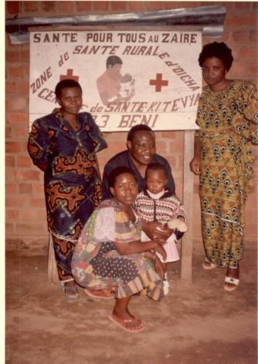
Supervision visit to Kitevya health center, Oicha HZ

Slide 7
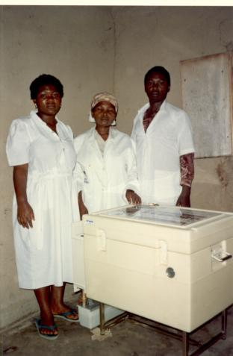
Oicha nurses with Vaccination Refrigeration

Slide 8
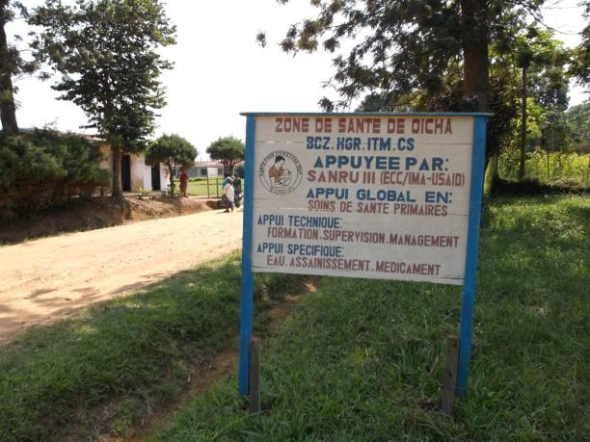
Sign for Oicha Health Zone and SANRU III Project

