Slide 1
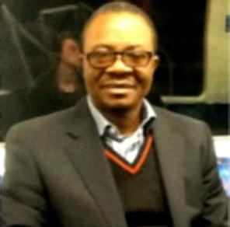
Pictures Contributed by Eng. Antoine Kasongo
Note: Engineer Antoine Kasongo was the head of the Infrastructure Division for the SANRU I and II projects. That division included 1) Rehabilitation & Construction of health facilities and offices; 2) Water and Sanitation installations, especially spring capping, and 3) Solar Energy (refrigeration and lighting).

Slide 2
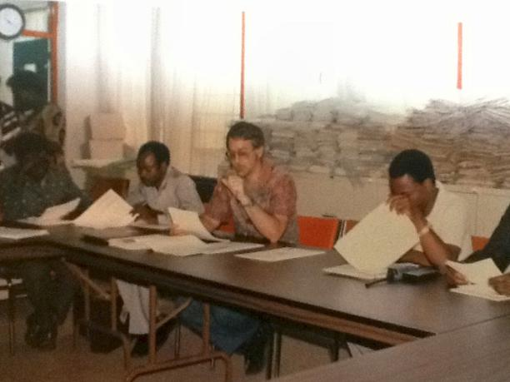
A SANRU Planning meeting (circa 1984)
Dr. Franklin Baer, SANRU I/II Project Manager is pictured above (center) facilitating a planning meeting in the SANRU “Documentation Center for Primary Health Care”.

Slide 3
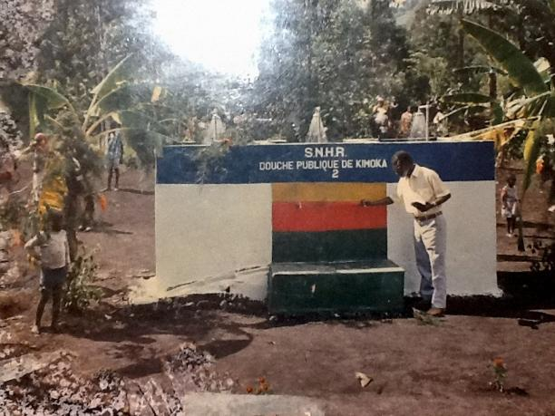
Nlaba Nsona during a field inspection
SANRU Director Nllaba Nsona is pictured inspecting a public shower constructed by SANRU in collaboration with SNHR (National Service for Rural Hydraulics)

Slide 4
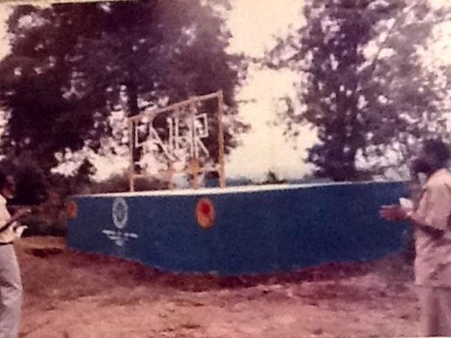
Water Reservoir funded by SANRU I
SANRU I Director Nlaba Nsona inspecting a water reservoir in Rwanguba HZ

Slide 5
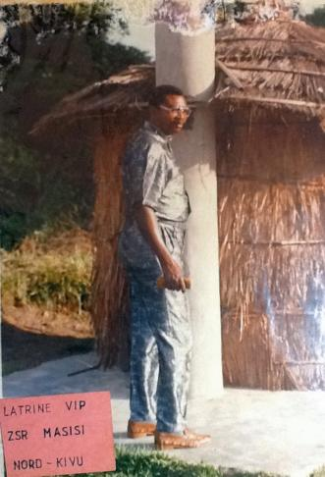
VIP Latrines
ITOKO Y’OLUKI, SANRU’s water and sanitation expert, is pictured inspection a model VIP latrine which SANRU helped to introduce to health zones in DRC

Slide 6
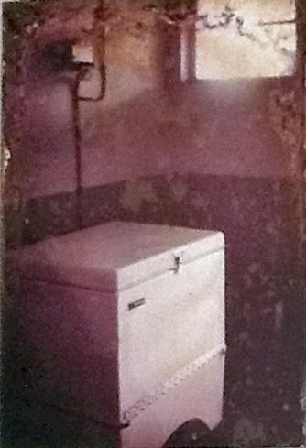
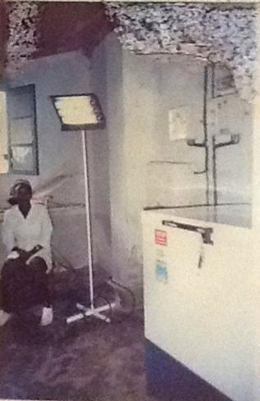
Pioneering Solar Refrigeration
SANRU helped to pioneer the introduction of solar refrigeration for protecting the vaccination cold chain. At left is a “Marvel” fridge that was imported from the U.S. At right is a DRC FNMA-made solar fridge.

Slide 7
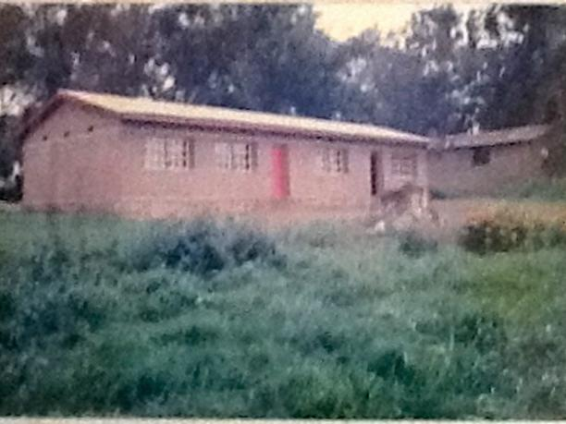
Maternity Construction, Luputa Health Zone

Slide 8
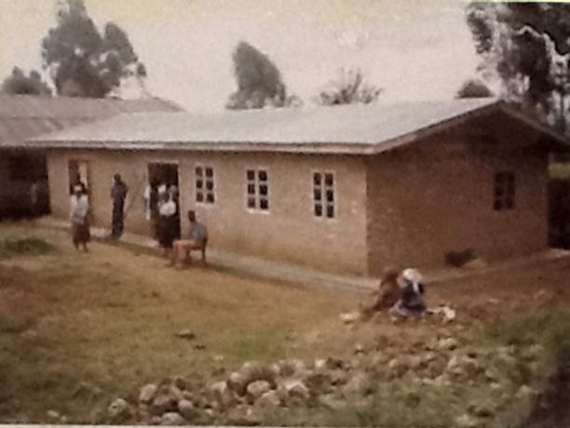
Nursing School Construction, Rethy Health Zone

Slide 9
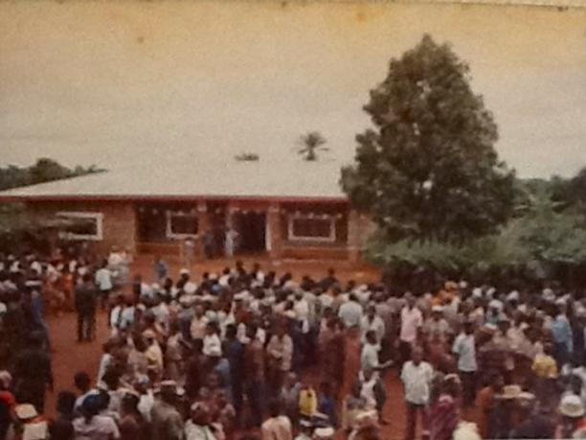
Inauguration of the Pawa Health Zone Central Office
SANRU I & II helped developed 100 of Congo’s 306 Health Zones. This included the construction of a number of Health Zones Offices, like the one above, for the coordination of health activities. In many cases the “construction would involve the rehabilitation of several rooms within the hospital complex rather than the construction of a new building.

Slide 10
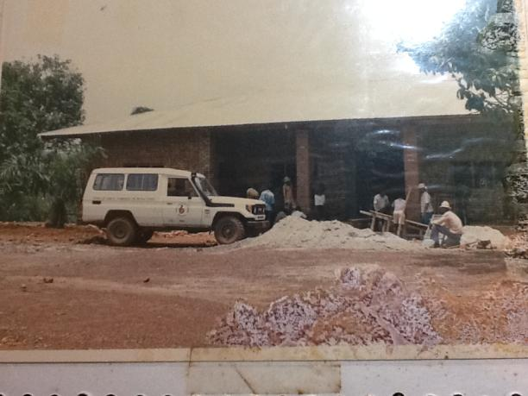
Health Zone Supervision Vehicle (SANRU II)

